Slide 1
Virtual Witness Testing
By: Amruta Potdar

Slide 2
Introduction:
Schneider Electric
Switchgear / Switchboard plant
8821 Garners Ferry Rd,
Hopkins, SC 29061

Slide 3
In Person Witness Testing:
Importance of Witness Testing in the Industry
Design expectation and performance
Feel gear
Avoid rework after shipping
Set up day
Safety process
Review documents
Actual testing and documentation

Slide 4
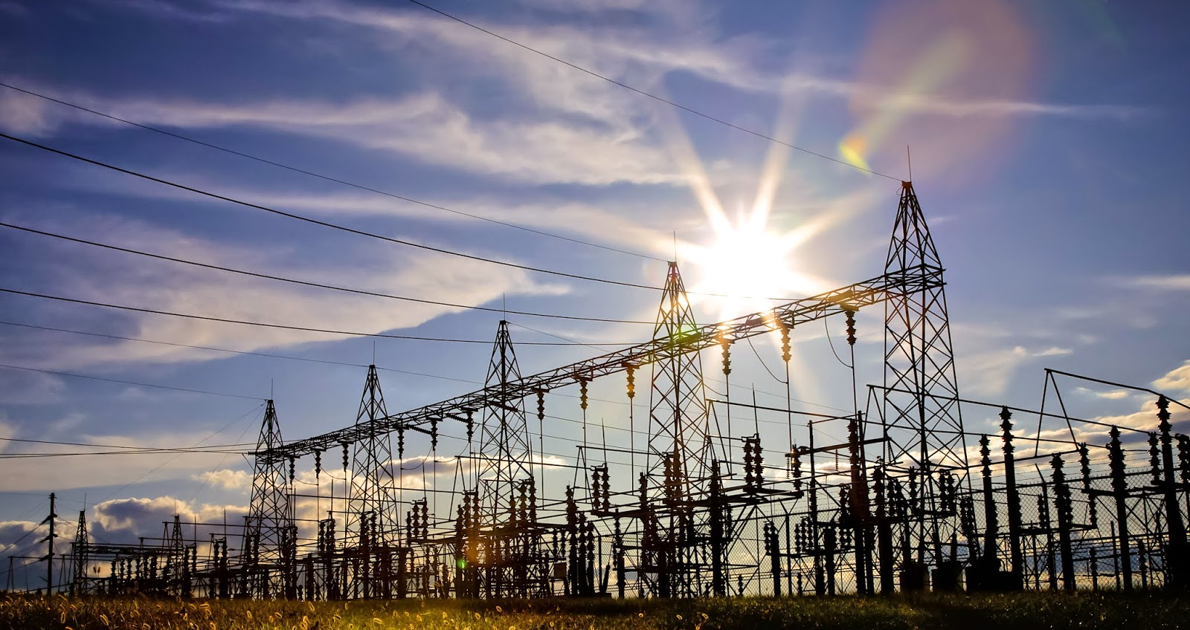
Virtual Witness Testing:
COVID-19 affects us all
Important to keep the industry alive

Slide 5
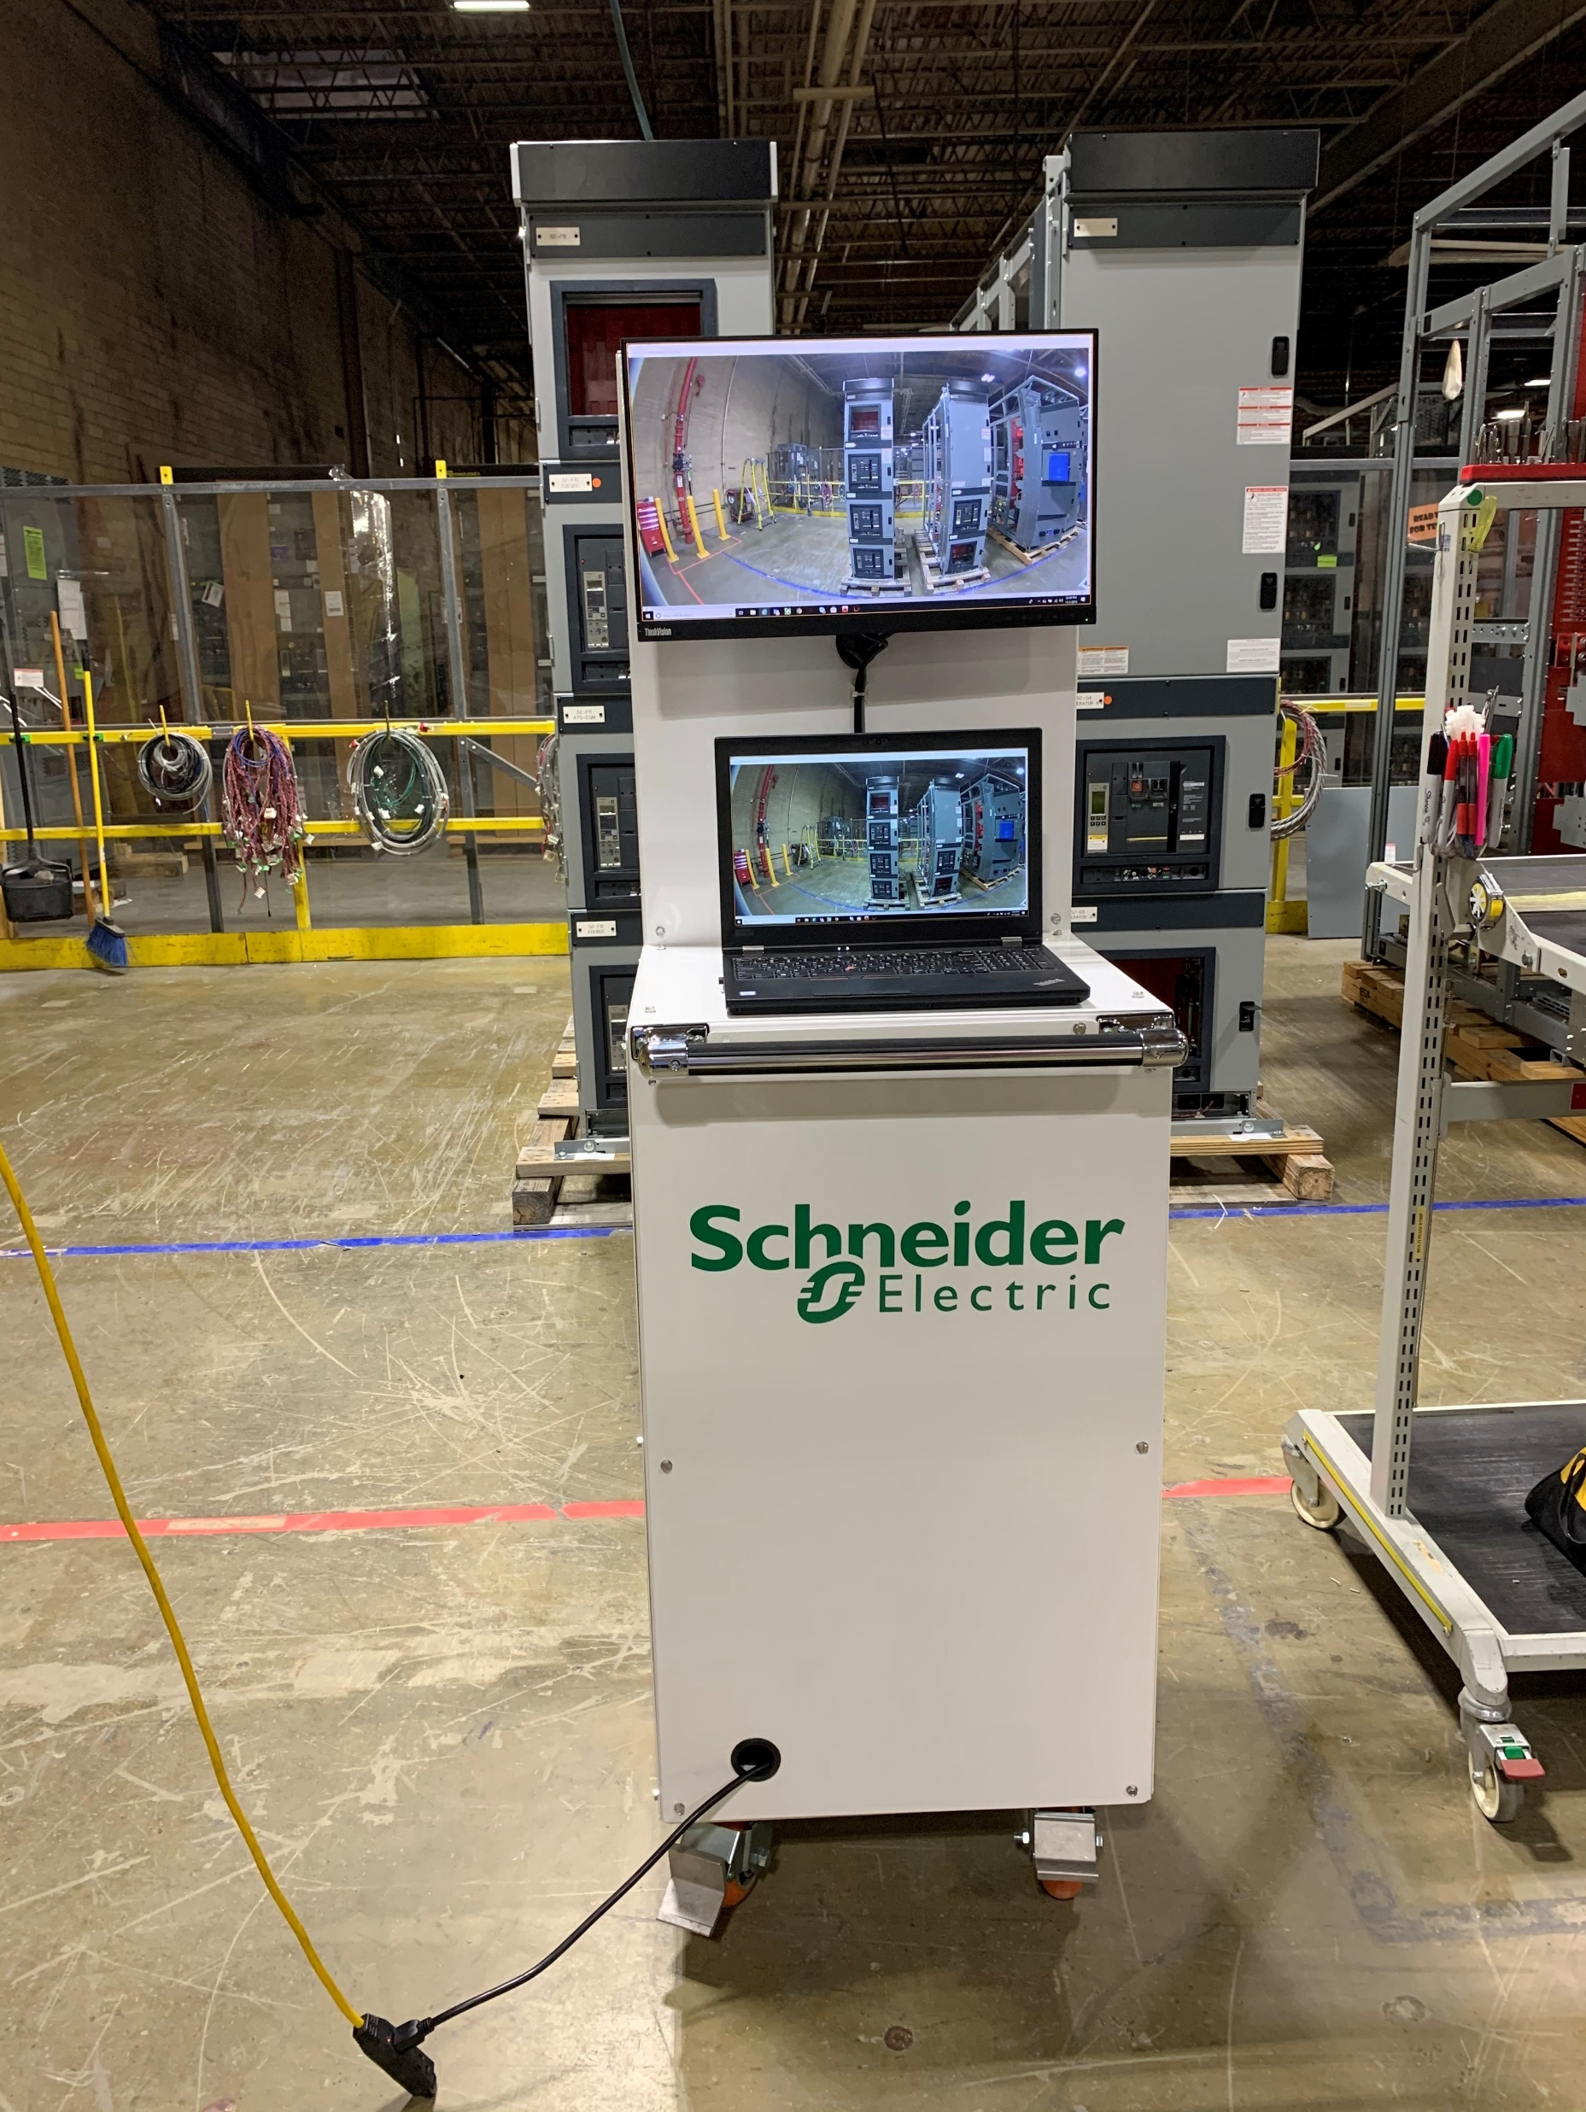
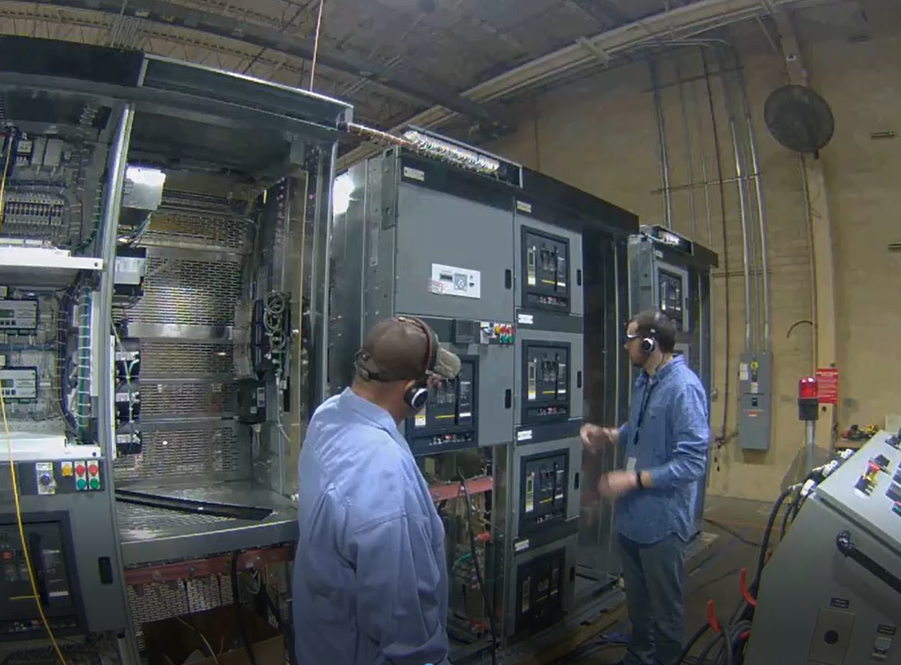
Virtual Witness Testing Specifics:
Set up skype meeting
Review documents
Actual testing and test documentation

Slide 6
Challenges/Looking Ahead:
Challenges
- Network limitation
- Setup limitation
Will this become a regular option?

Slide 7
Summary:
Witness test importance
Need of witness test
Challenges

Slide 8
Q&A:

