Slide 1
The Legal Implications of SB327
For Electrical & Lighting Design Projects
Copyright 2020 – AlphaGuardian Networks LLC. All rights reserved

Slide 2
What Things Brought About SB327?
We live in an increasingly connected world.
The virtual distance between any two points on earth is now 0.
Anyone, in any location, can attempt to connect to your devices.

Slide 3
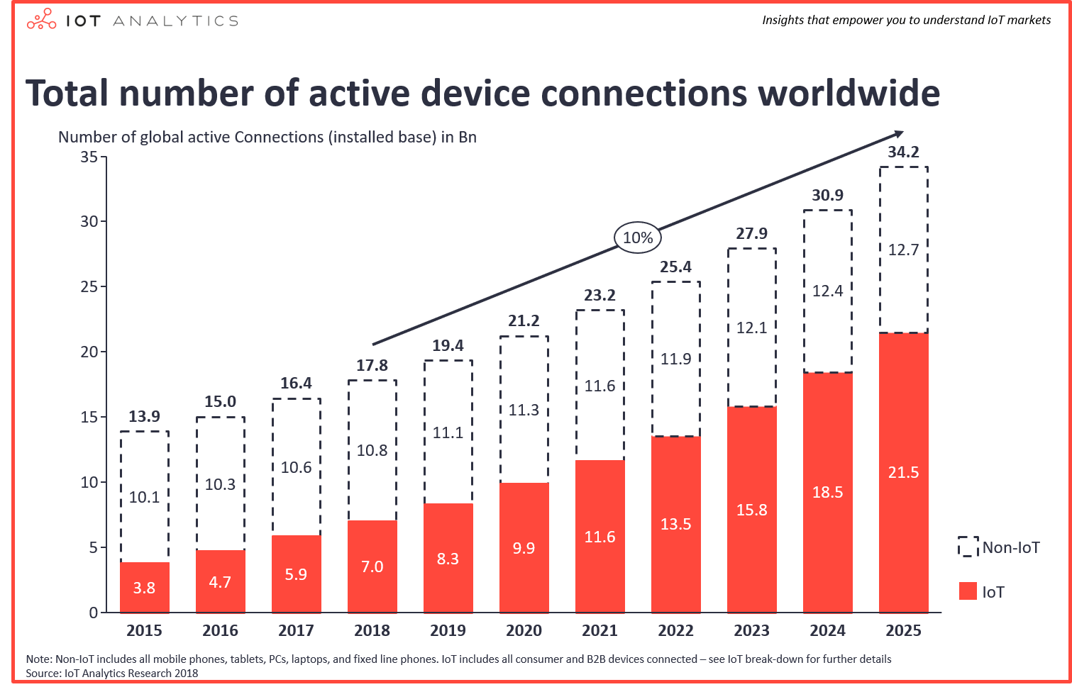
IoT is the Fastest Growing Connection Group

Slide 4
Connected Devices Can Be Compromised
The attacks on IoT devices surged 300% in 2019 – Forbes Magazine
Attackers are increasingly able to shut down or corrupt the actions of IoT devices that control equipment – Symantec

Slide 5
Serious Attacks Are Occurring on IoT Units
Major cyberattacks are targeting critical IIoT and endangering mission critical operations
UPS ICS-CERT issued an Alert stating that a Pipeline Company was hit with Ransomware causing the loss of polling to IIoT devices.
- ICS-CERT, Feb 18, 2020
Nortek Security and Controls, a major access controls vendor, has unpatched vulnerabilities in their access systems that allow hackers easy access to any room without detection.
- ZDNet, Feb 2, 2020
A new Industrial Control System malware, EKANS, is causing major ICS problems. The code kills software processes and hides key information from view. - Wired, Feb 3, 2020
UPS

Slide 6
Does This Sound Familiar?
Known malware and viruses are targeting IoT devices
Most IoT devices are not secured from attacks
”You can affect the course of this disease but, it takes a very aggressive program.” – World Health Organization
The Corona Virus

Slide 7
SB327 Was Created to Stop the Spread of Infections
California’s Senate Bill 327 is Titled: Security of Connected Devices.
Beginning on January 1, 2020, a manufacturer of a connected device must:
Subdivision(a); Equip the device with a reasonable security feature or features that are:
Appropriate to the nature and function of the device,
Appropriate to the information it may collect, contain, or transmit, and
Designed to protect the device and any information contained therein from unauthorized access, destruction, use, modification, or disclosure, as specified.

Slide 8
So We Must Define Reasonable Security
Reasonable Security must be compliant to all requirements of Subdivision(a) that reasonable security is “appropriate to the nature and function of the device.”
For example, the nature and function of a building power system has a higher level of security threshold than an Internet-connected refrigerator.
But how do we quantify what security features are are appropriate for a product?
Fortunately, we are not in the dark at all. California has now codified the standards of reasonable security with the Controls established by the Center for Internet Security
UPS

Slide 9
Center for Internet Security Standards
The Center For Internet Security provides a well-defined set of standards that are based upon the size of the organization installing the device.
The size is defined by “Implementation Groups” or “IG"
IG1 - Family-owed business with < 10 employees
IG2 – Regional organization providing a service, generally <1000 employees
IG3 – Larger organization with more than 1000 employees
So, SB327 provides some leeway of implementation based upon the size of a business or organization
UPS

Slide 10
Large Organizations: The Focus of Our Discussion
Because most of your design projects are for larger organizations or, for medium sized organizations which have access to critical data, we will focus our discussion this morning on the features required for Implementation Group 3
This is prudent for all of us because:
Lawsuits will always attempt to push the boundaries of each organization’s Implementation Group classification.
Even if IG2 is a logical conclusion for an organization, lawsuits will also push the boundaries of the Sub-Controls to the maximum
IG2 implements 82% of the 171 Controls in 20 Categories required by the CIS
UPS

Slide 11
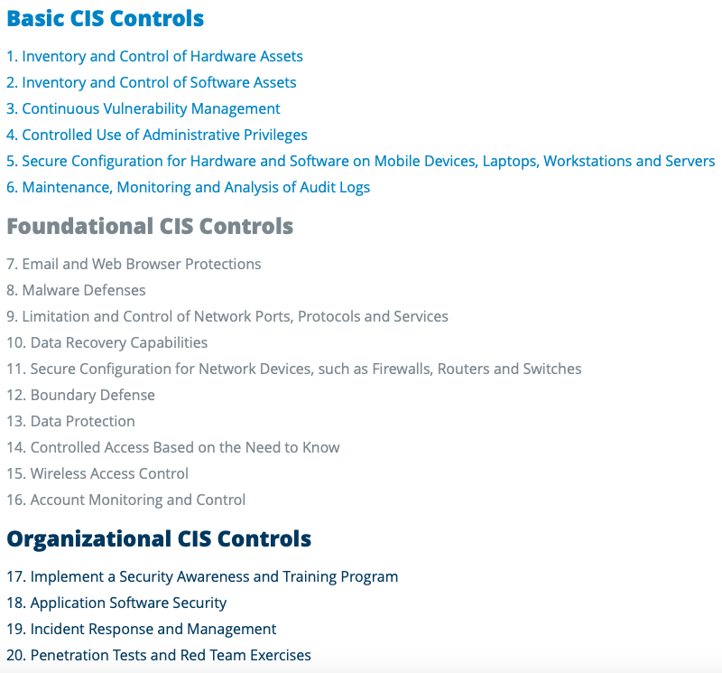
The 20 CIS Controls
UPS

Slide 12
Simplifying CES Standards
The fact that there are so many categories and so many individual requirements makes it difficult to get your mind around all the requirements.
But, fortunately, all of the standards implemented by the CIS are ultimately based on 3 security principals created by the National Institute for Standards and Technology (NIST).
NIST specifically states that ALL IT security and ALL Infrastructure security must include the ability to perform the following functions:
Confidentiality
Integrity
Availability
or simply: C I A
UPS

Slide 13
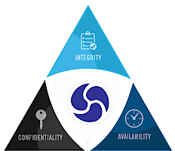
The NIST Standard for ICS Security
NIST’s Standard for Infrastructure security is abbreviated as: C I A
Confidentiality:
Authenticating users and Protecting Data Security
Integrity:
Ensuring that all Data is Correct and Current
Availability:
Protecting the Uptime for each Device
UPS

Slide 14
Confidentiality
NIST defines Confidentiality as follows:
“Preserving authorized restrictions on information access and disclosure, including means for protecting personal privacy and proprietary information.”
To keep data confidential, each device must offer the following:
Provide an encrypted authentication means to ensure that any connection is made by an authorized source
Provide encryption of all data to and from the device
UPS

Slide 15
Integrity
NIST defines Integrity as follows:
“Guarding against improper information modification or destruction, and includes ensuring information non-repudiation and authenticity.”
To ensure data integrity, each device must offer the following:
The ability to instantly identify a data value that may have been modified or altered for quick response to potential issues
The ability to determine the origin of each data packet and to reject any data packet of unknown origin.
UPS

Slide 16
Availability
NIST defines Availability as follows:
“Ensuring timely and reliable access to and use of information.”
To keep data available each device must offer the following:
The ability to instantly determine if the device is non-responsive
The ability to gather data as quickly and reliably as possible
UPS

Slide 17
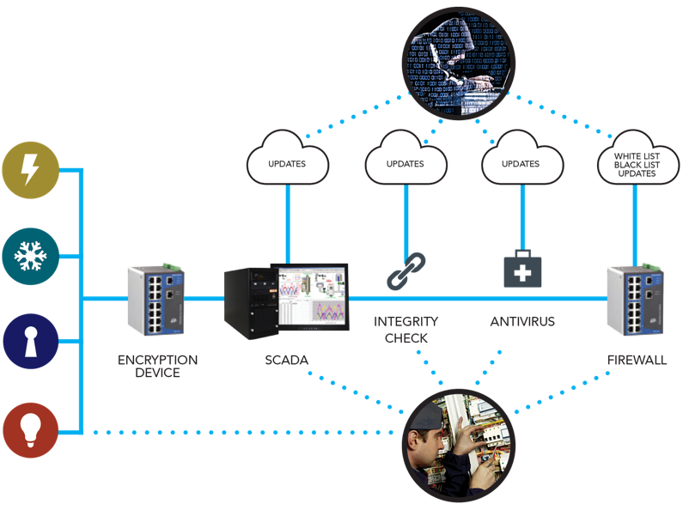
How Devices Are Compromised
Most devices do not have any protection against Communications hacking, Data Integrity Spoofing or Device Availability targeting, opening up multiple attack vectors.
Data can still be captured and altered without the knowledge of users due to the lack of authentication necessary for Confidentiality
Devices can be disconnected, altered and reconnected without being discovered
due to the slowness of device polling
causing a loss of data Integrity
Devices can be attacked locally or remotely from multiple locations due to multiple points of contact causing loss of Availability
UPS

Slide 18
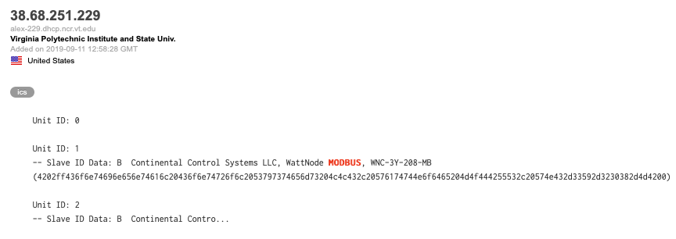
All Modbus Devices Fail CIS Standards
The Modbus protocol has become the de facto industrial communications standard…The Modbus protocol lacks the ability to authenticate a user and hence middle man attacks can easily take place in Modbus. California Energy Commission Cybersecurity White Paper
All Modbus devices sold in California must therefore include external security to provide required reasonable security
UPS

Slide 19
All Present BACnet Devices Fail CIS Standards
The present generation of the BACnet protocol also lacks the authentication security.
“Network security in BACnet is optional. The existing BACnet Network Security architecture defined in Clause 24 is based on the 56-bit DES cryptographic standard and needs to be updated to meet the needs of today’s security requirements.” – BACnet Secure Working Group Paper
The BACnet Secure Working Group is in the process of developing a standard that will include all 3 key security features that California has made their standard but may not be available for 2 years or more.
2 – BACnet secure working group document
UPS

Slide 20
Most SNMP Devices Fail CIS Standards
SNMPv1 and v2 lacks reasonable authentication security.
“Unauthorized users can read all SNMP information on SNMPv1 and SNMPv2 because the access password is not secure. SNMPv1 and SNMPv2 are now designated as obsolete.” Crestron filing in response SNMP security advisory
SNMPv3 does provide encrypted authentication but, it also has been shown to be easily fooled in the authentication process.
“SNMPv3 fails to provide its advertised security guarantees…These vulnerabilities are implementation agnostic and demonstrate a fundamental flaw in the current protocol” – Dr. Patrick Traynor, Georgia Institute of Technology
UPS

Slide 21
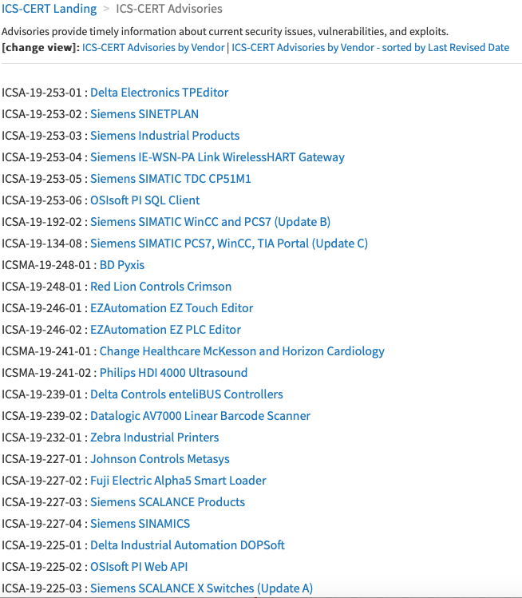
This is Not Just a State of California Concern
IIoT security problems are so pervasive that the Department of Homeland Security has set up a special division just to deal with cybersecurity problems for Industrial Systems: ICS-CERT
ICS-CERT has issued nearly one new alert per business day last year!

Slide 22
Let’s Summarize What We Know So Far
Cybersecurity is a major issue that is being addressed at both the State and National level.
SB327 requires secured authentication for devices all devices that connect to a network beginning January 1, 2020
Modbus, BACnet and SNMPv1 and v2 lack necessary security to be compliant with SB327.
The Center for Internet Security’s 20 Security Controls are the legal enforcement code for SB327
All 20 of the CIS Controls have as their basis just 3 principals created by NIST:
Confidentiality
Integrity
Availability
UPS

Slide 23
OK – We Know the Facts. What Can We Do?
For each device, you must specify an external security system that provides:
Confidentiality of communications by authenticating and encrypting all communications to and from a device
Integrity of communications by employing analytics to ensure that all data transmitted from a device is correct and accurate
Availability of the device by protecting each device with a firewall which prevents unauthenticated users from taking control of that device
Let’s have a look at the specifics of CIA for each device
UPS

Slide 24
Confidentiality for Each Device
We know that Modbus, BACnet and most SNMP and many other devices do not provide Confidentiality. They can easily be sniffed and taken-over
Must provide a system which can do the following:
Provide an encrypted authentication means to ensure that any connection is made by an authorized source
Provide encryption of all data to and from the device
A Firewall is a means to provide encrypted authentication
But most firewalls do not encrypt the authentication procedure. You must therefore specify a firewall that also provides encryption for all data going to and from each device with an IIoT network
UPS

Slide 25
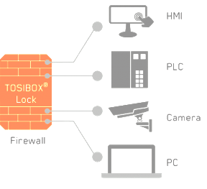
A Firewall and Encryption for each IIoT Device
IIoT Devices
UPS
Server

Slide 26
Integrity for Each Device
Must know that all data received from a device is reasonable and logical
Must provide a system which can do the following:
The ability to instantly identify a data value that may have been modified or altered for quick response to potential issues
The ability to determine the origin of each data packet and to reject any data packet of unknown origin.
You may use the alarm management within your BMS/EMS/SCADA system to ensure the integrity of the data. But must ensure that the polling rate is reasonable to catch any error.
You must have authentication keys between your server and IoT devicesfor packet authentication for each piece of data from an IoT device to the Server
UPS

Slide 27
A Firewall and Encryption for each IIoT Device
IIoT Devices
Encryption Key
UPS
Communications
Integrity
Server

Slide 28
Availability for Each Device
Must ensure that each Device remains available for all hours intended and, if interrupted for any reason, must have instant notification for the event.
Must provide a system which can do the following:
The ability to instantly determine if the device is non-responsive
The ability to gather data as quickly and reliably as possible
You may choose to use your BMS/EMS/SCADA to flag any downed device but, doing so in a long polling cycle brings the reasonableness argument into place. If a device is truly mission critical, can you wait to be notified for a minute…2 minutes…5 minutes?
You should consider a separate alarm management system to handle Availability for any mission critical device or task to ensure that you are making a reasonable effort to ensure Device availability
UPS

Slide 29
A Separate Alarm Management System
IIoT Devices
Encryption Key
Secured
Communications
UPS
Firewall
Server
Alarm Management

Slide 30
Contact: Bob Hunter
+1-925-421-0030
111 Deerwood Road, suite 200
San Ramon, CA. 94583
bhunter@alphaguardian.net
www.alphaguardian.net

