Slide 1
Grounding Recommendations for On Site Power Systems
Brian Pumphrey

Slide 2
Course Objectives
Grounding Recommendations for On Site Power Systems:
This course focuses on equipment and system grounding. Learners will understand the purpose of grounding and schemes to detect ground faults. This will lead to better understanding the selection of transfer switches (3-Pole vs 4-Pole), resistance grounding and grounding of paralleled generator sets.
Participants will be able to:
Understand the meaning of System grounding and Equipment grounding
Define the requirements for proper ground fault sensing to help design and install ground fault systems that work correctly
Define when a 3 pole verses 4 pole transfer switch should be used to reduce ground current loops, and assure ground fault detection systems work correctly
Identify key factors of Paralleled systems that need to be considered so that ground fault detection systems will work properly

Slide 3
Equipment Grounding vs System Grounding
Metal Enclosures
Equipment grounding
  Establishes a conductive path between normally non-current carrying metal parts of equipment and between these parts and the grounding electrode
  Earth connected to: non-current carrying parts
  Protect personnel
System grounding
  Deliberate connection between a circuit conductor of a power source and ground (earth)
  Earth connected to: current carrying parts
  Protect equipment
Both are paths for ground fault current
Neutral
Equipment Ground
System Ground
Grounding Electrode

Slide 4
Equipment Grounding vs System Grounding
Metal Enclosures
Equipment grounding
  Establishes a conductive path between normally non-current carrying metal parts of equipment and between these parts and the grounding electrode
  Earth connected to: non-current carrying parts
  Protect personnel
System grounding
  Deliberate connection between a circuit conductor of a power source and ground (earth)
  Earth connected to: current carrying parts
  Protect equipment
Both are paths for ground fault current
Neutral
Equipment Ground
System Ground
Grounding Electrode

Slide 5
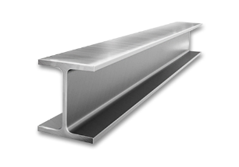
Equipment Grounding
  Earth connected to: non-current carrying parts
  Protect personnel
4 Pole ATS
Generator Set
Equipment Grounding Conductor (EGC)
Electrically connects the normally non–current-carrying metal parts of the equipment together to the:
  System grounded conductor (neutral)
  Grounding electrode conductor (GEC)
Grounding Electrode Conductor (GEC)
Provides the main low impedance path for ground fault current to trip the overcurrent device
Grounding Electrode:
A conducting object with a direct connection to earth, such as building steel or a ground rod
EGC
GEC
Grounding Electrode

Slide 6
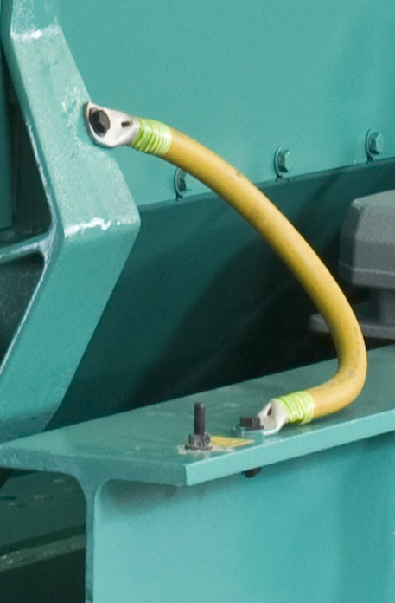
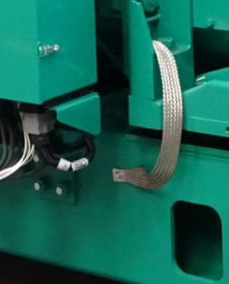
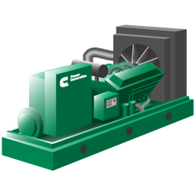
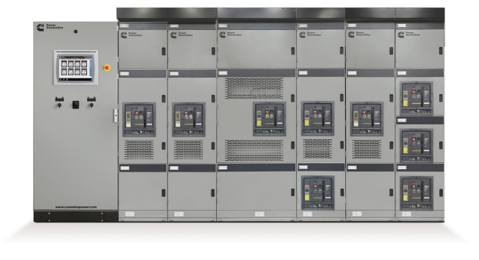
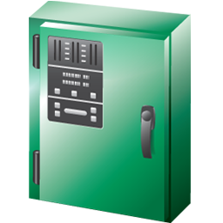
Why Ground Equipment?
Safety
Minimizes hazards of touching live equipment
Minimizes voltages on equipment during fault conditions
Provide a path for fault current to return to the source

Slide 7
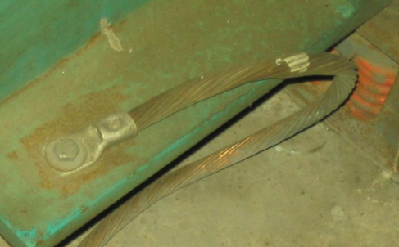
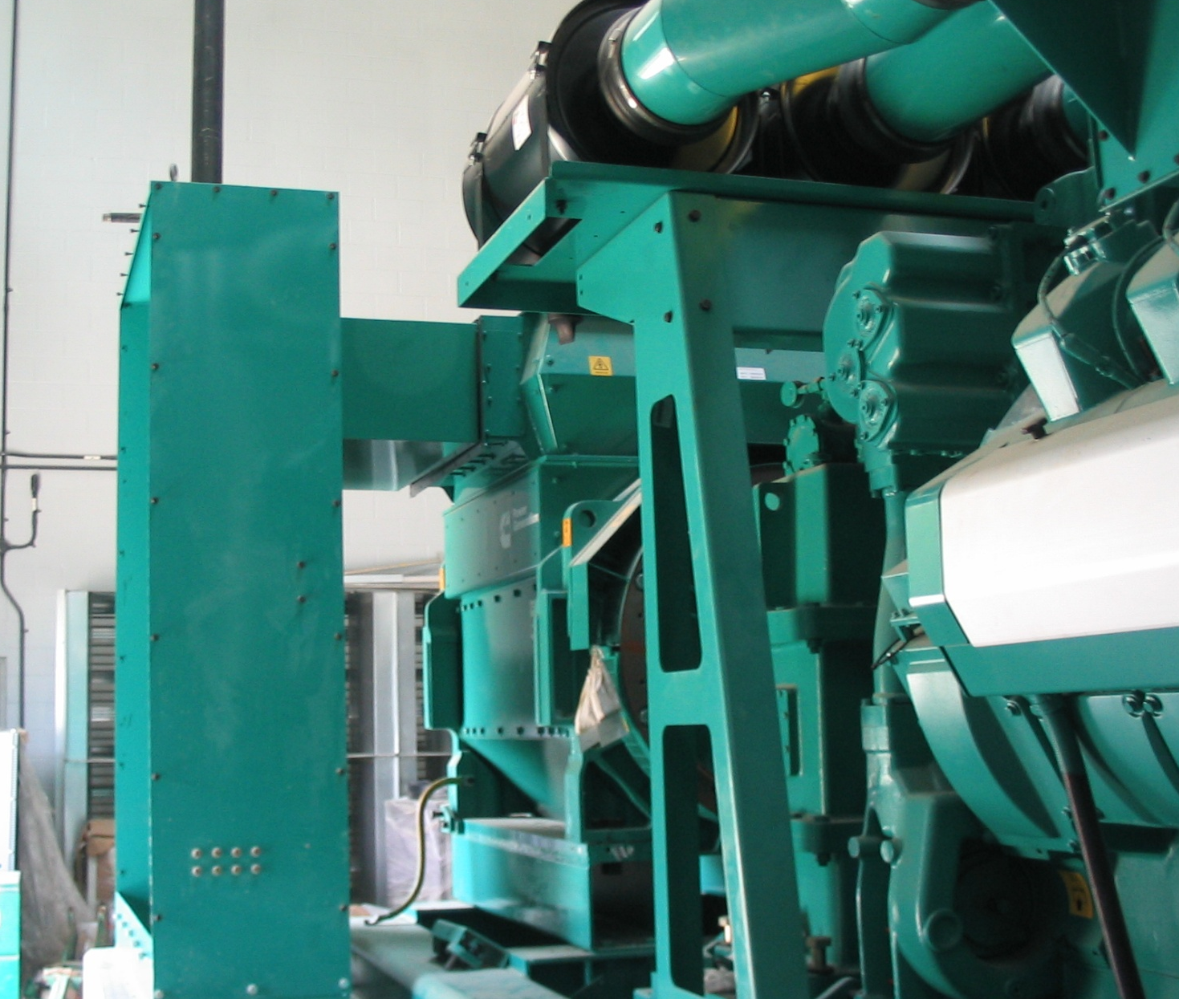
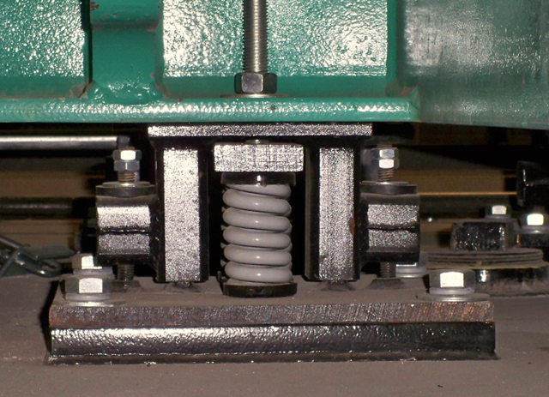
Impediments to Effective Equipment Grounding
Painted surfaces, use star washers to penetrate surface
Corroded or damaged connections, wires, or cables
Loose connections
Use flexible cable across anti-vibration mounts
Auxiliary enclosures require equipment ground
Corrosion
Auxiliary Enclosure
Anti-Vibration Mounts

Slide 8
System Grounding
  Earth connected to: current carrying parts
  Protect equipment
IEEE Std 142-2007 (Green Book)
Recommended Practice for Grounding of Industrial and Commercial Power Systems
System grounding is the intentional connection of a phase or neutral conductor to earth for the purpose of:
Controlling the voltage with respect to earth within predictable limits
Providing for a flow of current that will allow detection of an unwanted connection between system conductors and earth
Control of voltage to earth as to limit the voltage stress on the conductor insulation
Control of voltage for the reduction of shock hazards
C
A
V_{A-G} = 277 V
V_{C-G} = 277 V
V_{B-G} = 277 V
V_{N-G} = 0 V
N
V_{A-G} = 480 V
V_{C-G} = 480 V
V_{B-G} = 0 V
V_{N-G} = 277 V
G
C
A
G
N
B
B
Full Ground Fault on Phase B
IEEE: Institute of Electrical and Electronics Engineers

Slide 9
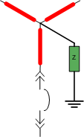
System Grounding Types
Solid Grounded
Impedance Grounded
Ungrounded
An intentional conductive path connected between a circuit conductor and ground
A resistance (or impedance) is deliberately connected between a circuit conductor and ground
No intentional connection between any circuit conductor and ground

Slide 10
System Grounding - Solidly Grounded
Direct electrical connection to ground, most common grounding method for low voltage generator sets as there is no impedance in the circuit
The most common configuration is the solidly-grounded wye as it supports single-phase (3 wire) to neutral loads
Enables ground fault detection and thus activation of ground fault protection equipment
Detection of a fault is easy and immediate, however a high level fault could potentially damage the equipment
L1
L2
L3
N
National Electrical Code (NEC) Article 250

Slide 11
System Grounding – Resistance (Impedance)
Grounded through resistance
Commonly used with medium voltage generator sets to limit the level of ground fault current -> GF detection needed
Low Resistance Grounding (LRG)
    Fault current usually limited to 200-800 amps
    Easily detectable with conventional CT’s
    Sufficient to trip circuit breakers
High Resistance Grounding (HRG)
    Fault current usually limited to 1-10 amps
    Intended to limit fault current to a level that is low enough to run safely but high enough so that ground fault relays can detect the fault
    Typically used in critical facilities
L1
L2
N
L3
National Electrical Code (NEC) Article 250
CT: Current Transformer

Slide 12
System Grounding - Ungrounded
Zigzag or wye-delta transformers may be used to obtain a neutral for ungrounded systems
Either solidly grounded or resistance grounded
High impedance to balanced normal phase currents
Low impedance to zero sequence (fault) currents
L1
L2
L3
National Electrical Code (NEC) Article 250

Slide 13
System Grounding (3 Wire System)
3-phase 3-wire System (Neutral Not Used)
4 wire systems pass the neutral through
Generator May Be Solidly-Grounded (Shown), Resistance Grounded, or Ungrounded.
3P ATS
GenSet
TO
UTILITY
EGC
GEC
GEC
SERVICE
ENTRANCE
To Loads
Grounding Electrode System
EGC (Equipment Grounding Conductor), ties enclosures together
GEC (Grounding Electrode Conductor)

Slide 14
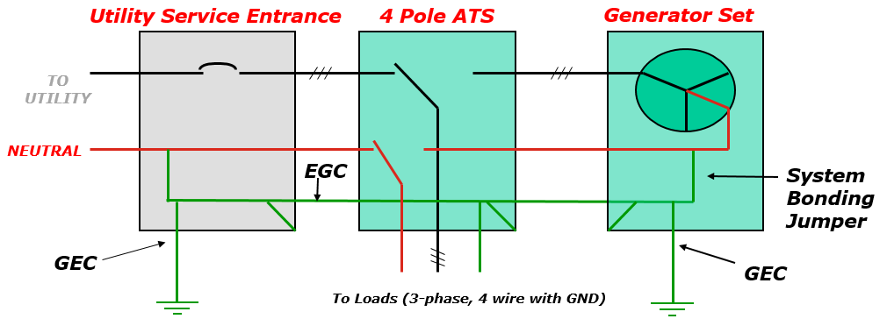
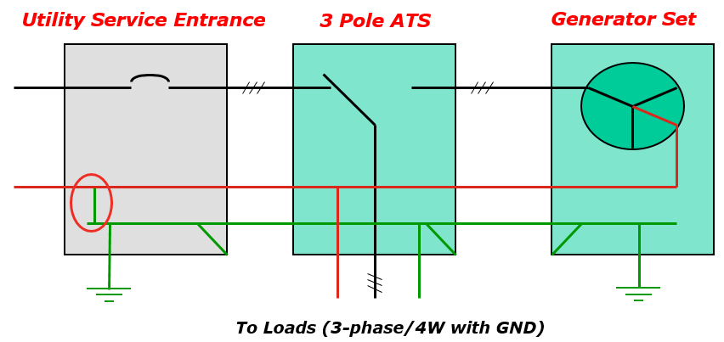
Separately / Non-Separately Derived System (4 Wire System)
Separately Derived System
Non-Separately Derived System
NEUTRAL
No direct electrical connection between sources (Neutrals are not connected)
Generator Neutral is solidly bonded to Ground - Jumper
Common Neutral for entire system
Neutral is connected to ground at the Service, Not at the generator set

Slide 15
Separately Derived System (4 Wire System)
No direct electrical connection between sources (Neutrals are not connected)
3 Phase, 4 Wire System
4 Pole Transfer Switch
Generator Neutral is solidly bonded to Ground - Jumper
Utility Service Entrance
4 Pole ATS
Generator Set
3 Phases
TO
UTILITY
NEUTRAL
EGC
System Bonding Jumper
GEC
GEC
To Loads (3-phase, 4 wire with GND)
EGC (Equipment Grounding Conductor)
GEC (Grounding Electrode Conductor)

Slide 16
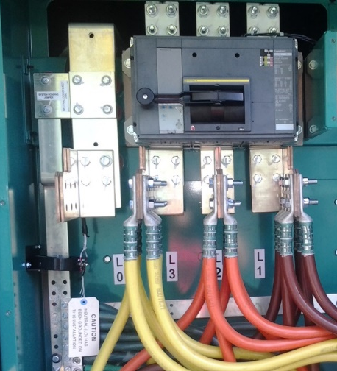
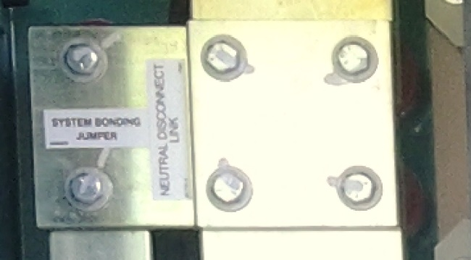
Separately Derived System (4 Wire System)
Neutral to Ground Bond on generator (Jumper)
NEC Definition
  “An electrical source, other than a service, having no direct connection(s) to circuit conductors of any other electrical source other than those established by grounding and bonding connections”
NEC Section 250.30(A)(1)
  Separately derived systems to have a system bonding jumper connected between the generator frame and the grounded circuit conductor (neutral)
Some manufacturers ship the generator with the neutral bonded, some don’t. Need to be specified by customer
Neutral
Bonding Jumper
Ground
National Electrical Code (NEC) Article 250

Slide 17
Non-Separately Derived System (4 Wire System)
Common Neutral for entire system
3-phase, 4 wire system
3 Pole Transfer Switch
Neutral is connected to ground at the Service, Not at the generator set
Utility Service Entrance
3 Pole ATS
Generator Set
3 Phases
TO
UTILITY
NEUTRAL
To Loads (3-phase/4W with GND)

Slide 18
Ground Fault Sensing, Protection and Indication
NEC 230.95
Ground Fault Protection (GFP) of equipment is required at the Service disconnect (utility breaker) for systems with:
  Solidly grounded wye electrical service
  More than 150 volts to ground (277/480 or 347/600VAC)
  Over current device rating of 1000A or more
NEC 700.6 (D)
Ground Fault Indication (GFI) is required at the Emergency source

Slide 19
How Do We Sense Ground Fault ?
Residual
  Most common method for circuit breakers
  CT on each phase and neutral
  Vector sum of current through all CT’s must be 0 (< threshold)
  Incoming and outgoing current must equal (Kirchoff’s Law)
Zero sequence
  Single CT around all three phases and neutral
  Same concept as residual method
Source ground return
  Single CT in the neutral to ground bond
  Method used by most genset controls
GFR: Ground Fault Relay
CT: Current Transformer

Slide 20
Ground Fault Sensing in LV Emergency Standby Systems
Most common method is to use GFP at the disconnect breaker
Two rules for proper GF sensing:
  Rule #1: There must be only one neutral to ground connection on any neutral bus at one time
  Rule #2: Bonding connection must be between the ground fault sensor and the source
These two rules drive the requirement that 4 pole transfer switches must be used when ground fault sensing is required or may be required in the future.
IEEE Std 446-1995 (Orange Book)
Recommended Practice for Emergency and Standby Power Systems for Industrial and Commercial Applications
7.9.1 “for most emergency and standby power systems with ground-fault systems, switching of the grounded circuit conductor by the transfer switch is the recommended practice.”
LV: Low Voltage
GFP: Ground Fault Protection
IEEE: Institute of Electrical and Electronics Engineers

Slide 21
Sensing a Ground Fault
3 Phase, 4 Wire System
3 Pole Transfer Switch
  Rule #1: There must be only one neutral to ground connection on any neutral bus at one time
  Rule #2: Bonding connection must be between the ground fault sensor and the source
Service Entrance
3 Pole ATS
Generator Set
CT
Ground Fault
To Loads (3-phase/4 wire with GND)
Ground fault will be sensed

Slide 22
Two Bonding Jumpers
3 Phase, 4 Wire System
3 Pole Transfer Switch
  Rule #1: There must be only one neutral to ground connection on any neutral bus at one time
  Rule #2: Bonding connection must be between the ground fault sensor and the source
Service Entrance
43Pole ATS
Generator Set
Ground Fault
To Loads (3-phase/4 wire with GND)
Parallel path for ground fault current on the neutral
GFP does not sense all fault current paths
Solution: remove the bond on the generator set
GFP: Ground Fault Protection

Slide 23
Single Bonding Jumper
3 Phase, 4 Wire System
3 Pole Transfer Switch
  Rule #1: There must be only one neutral to ground connection on any neutral bus at one time
  Rule #2: Bonding connection must be between the ground fault sensor and the source
ATS
Generator Set
Ground Fault
To Loads (3-phase/4W with GND)
Removing the generator set neutral bond solves the problem in the previous slide
There is only one path for earth fault current to return to the source

Slide 24
3-Pole ATS Connected to Emergency Side
  Rule #1: There must be only one neutral to ground connection on any neutral bus at one time
  Rule #2: Bonding connection must be between the ground fault sensor and the source
Service Entrance
3 Pole ATS
Generator Set
To Loads (3-phase/4 wire with GND)
This violates “Rule #2”
Ground fault returns on neutral
Possible nuisance trip during exercise
Solution: ground the neutral on the source side of sensor (use 4 Pole ATS)

Slide 25
Function of 4-Pole Transfer Switches
  Rule #1: There must be only one neutral to ground connection on any neutral bus at one time
  Rule #2: Bonding connection must be between the ground fault sensor and the source
Service Entrance
4 Pole ATS
Generator Set
To Loads (3-phase/4 wire with GND)
Fourth pole opens the path on neutral
Allows accurate GFP sensing on both sources
The neutral is grounded in only one place at a time
Ground fault sensor is downstream of the bonding connection
GFP: Ground Fault Protection

Slide 26
Multiple Automatic Transfer Switch Applications
Distribution Board
3P ATS
Service Entrance
Generator Set
Unbalanced
Load
3P ATS
2 levels of GFP and 2 or more 3-pole ATS
Neutral current may nuisance trip feeder GFP during normal conditions
GFP: Ground Fault Protection

Slide 27
Grounding of Paralleled Generator Sets
Generators in 3 wire systems are typically separately grounded
Medium or high voltage generators are often resistance grounded
4 wire systems typically have a single ground in the switchgear

Slide 28
Ground Fault Sensing with Paralleled Systems
Multiple sources and multiple grounds add complexity
Switching the neutral with 4 pole breakers or ATS is not always practical
Modified Differential Ground Fault Protection (MDGFP) is required in many complex systems
  Multiple grounds
  4 wire system with 3 pole breakers/ATS (not breaking the neutral)
  Utility paralleling
  Fault isolation is required in tie breaker applications
MDGFP Differentiates between circulating neutral current and fault current

Slide 29
Ground Fault Sensing with Paralleled Systems
4-Pole Breaker

Slide 30
Modified Differential Ground Fault Protection
Differentiates between circulating neutral current and fault current
Circulating neutral current does not result in current flowing through the trip units.
Fault current results in current flowing through the trip units.

Slide 31
Gensets Supplying Load, Normal Neutral Current Flow

Slide 32
Gensets Supplying Load, Fault Current Flow

Slide 33
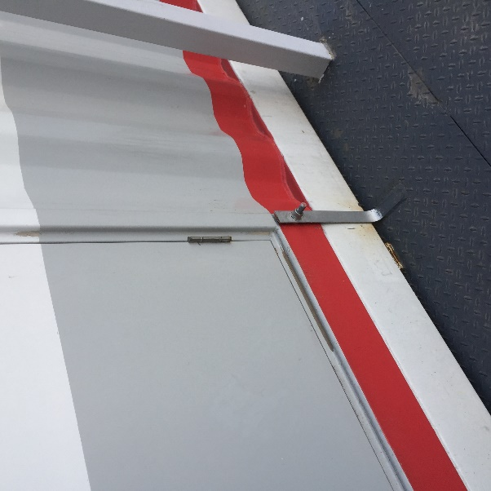
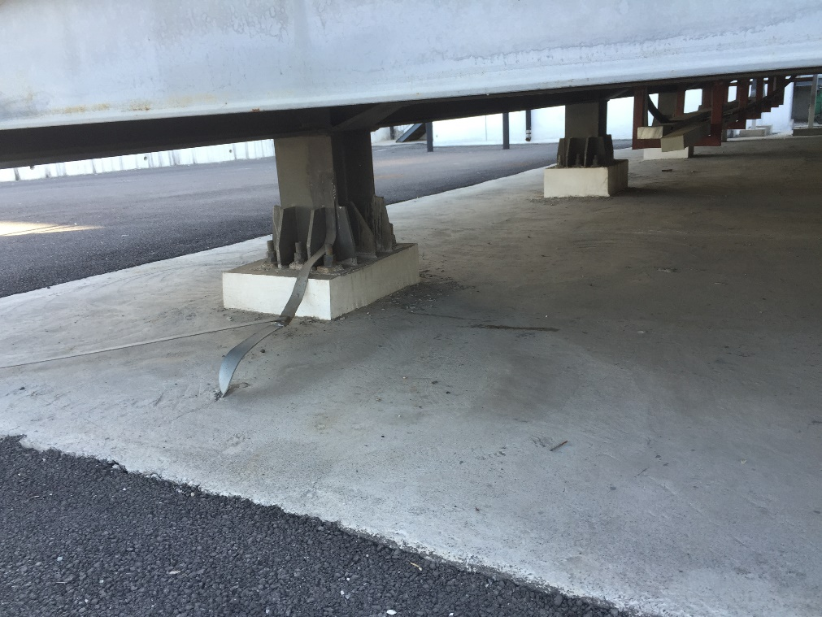
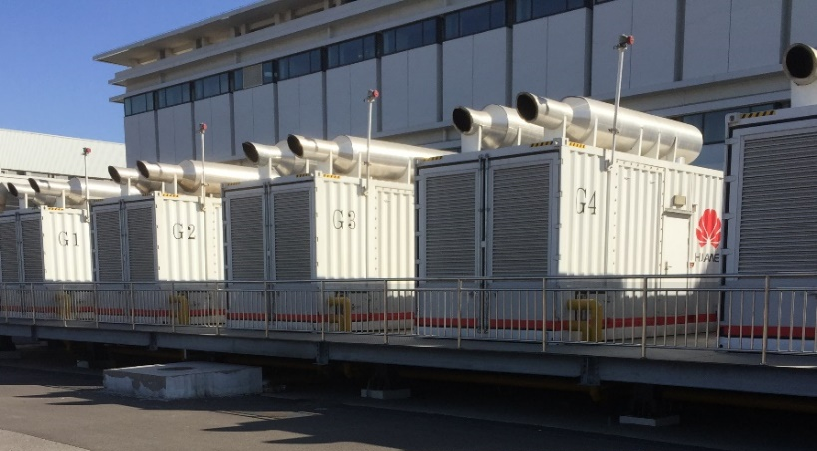
Grounding Case Study
Nine containerized generator sets on metal platform
Containers bonded to platform
Platform connected to underground ground ring
Each generator is grounded through an NGR located inside the container

Slide 34

Grounding Case Study
Platform is the fault current return path
Gen 1
Gen 9
… …
Load Bank
Metal Platform
Underground Ground Ring

Slide 35
Grounding Case Study
Gen 1
Gen 9
… …
Load Bank
Metal Platform
Underground Ground Ring
Ground ring is the fault current return path

Slide 36
Grounding Case Study
System ground consists of neutral conductors, NGRs, and ground ring
  System ground is intended to carry current – don’t rely on metal structures
Equipment ground consists of containers, platform, cabinets, etc., and ground ring
  Ground ring is common to both equipment and system ground
Establish a low impedance path for fault current to return to the source
  Path should be through ground ring, not across platform, cabinet, railings
Minimize step and touch potential hazard
NGR: Neutral Ground Resistor

Slide 37
Recommendations
All equipment that can be energized must be grounded
Ground fault current must have a defined low impedance path to return to the source
Remember the two big rules for ground fault sensing in emergency standby systems:
  There can be only one neutral-to-ground bond in the system
  Bonding connection must be between the ground fault sensor and the source
Paralleled sources may require complex ground fault schemes
  Modified Differential GFP can differentiate between fault current and normal neutral current in systems with multiple sources and grounds
  Multiple grounds, 4 wire solid neutral systems and utility paralleling applications may require MDGFP

Slide 38
Course Summary
Grounding Recommendations for On Site Power Systems:
Understand the meaning of System grounding and Equipment grounding
Define the requirements for proper ground fault sensing to help design and install ground fault systems that work correctly
Define when a 3 pole verses 4 pole transfer switch should be used to reduce ground current loops, and assure ground fault detection systems work correctly
Identify key factors of Paralleled systems that need to be considered so that ground fault detection systems will work properly
Specify
Specify 4 Pole ATS if:
  GF Protection on Normal Service / GF Indication on Emergency is required
  Any 3 phase 4-wire with line-to-ground voltage above 150V when future expansion to the facility is expected

Slide 39
Q+A

Slide 40



