Slide 1
Inference with OpenVX
Rajy Rawther
Kiriti Nagesh Gowda
3:00 – 5:30 PM

Slide 2
Introduction to MIVisionX Toolkit
MIVisionX toolkit is a comprehensive set of computer vision and machine intelligence libraries, utilities and applications bundled into a single toolkit.
AMD OpenVX is delivered as Open Source with MIVisionX.
Primarily targeted at applications requiring a combination of machine learning inference, computer vision, and image/video processing.
Includes a model compiler for converting and optimizing a pretrained model from existing formats such as Caffe, NNEF and ONNX to an OpenVX backend.
After compilation, MIVisionX generates an optimized library specific for a backend to run inferencing and vision pre- and post-processing modules.
It is beneficial to have lightweight and dedicated APIs optimized for AMD hardware for inference deployment as opposed to heavyweight frameworks.

Slide 3
Introduction to MIVisionX toolkit
All the software for MIVisionX is available under ROCm - AMD’s platform for GPU computing and machine learning.
In this tutorial we will show how to use MIVisionX toolkit to run some sample neural net applications doing image classification, object detection or segmentation.
The tutorial includes hands on training examples that allow participants to develop real world applications including computer vision, inferencing and visualization.
The tutorial demonstrates how the OpenVX framework with neural network extension is used to deploy some sample applications.

Slide 4
Inference with OpenVX
Convert Pre-trained models in Caffe/NNEF/ONNX to OpenVX graph
Optimize NN model in OpenVX
Layer Fusion
Memory Optimization
Quantization
Tensor Fusion
Dynamic batch size update
Add pre- & post-processing nodes
Run Optimized inference on target hardware

Slide 5
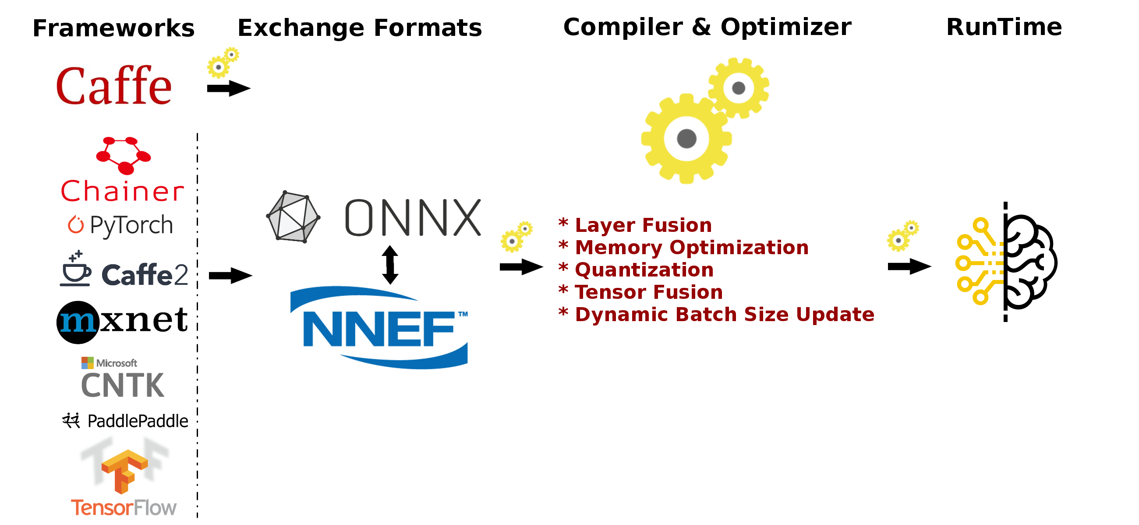
Inference with OpenVX

Slide 6
Inference with OpenVX

Slide 7
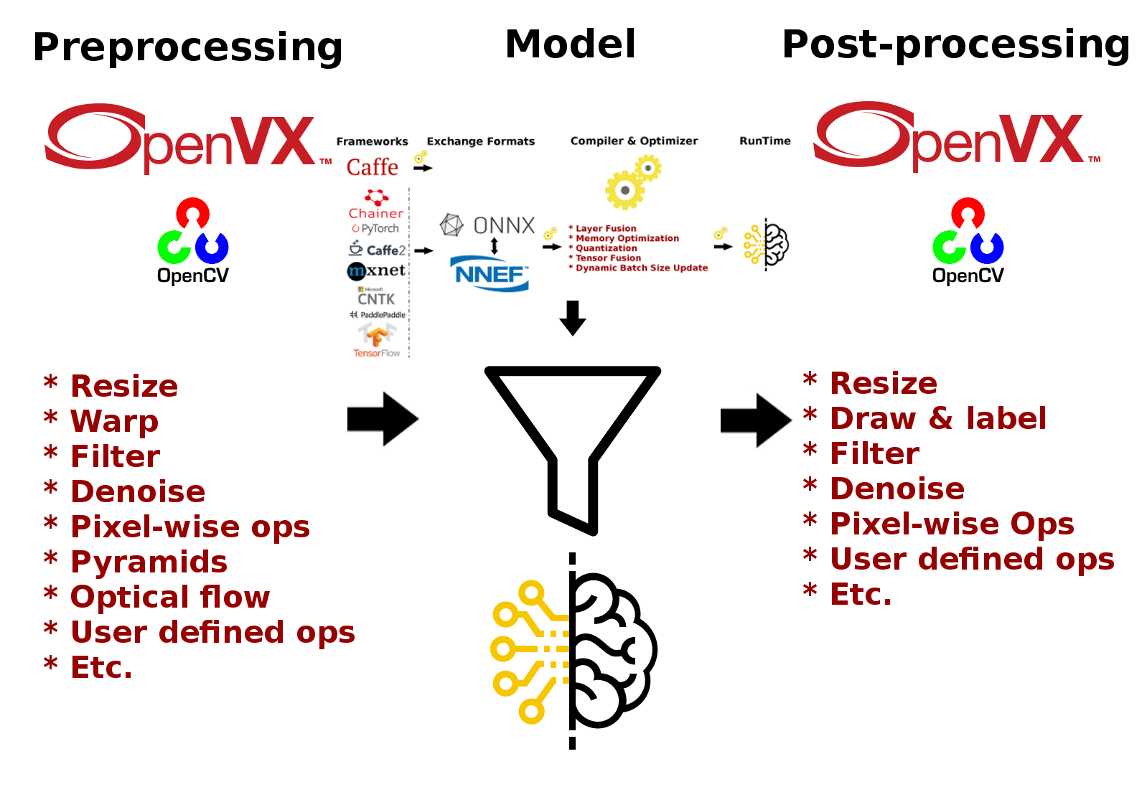
Inference with OpenVX

Slide 8
Inference with OpenVX
Prerequisites
Ubuntu 16.04/18.04 or CentOS 7.5/7.6
ROCm supported hardware
AMD Radeon GPU or APU required
ROCm 2.5 and above
Build & Install MIVisionX
MIVisionX installs model compiler at /opt/rocm/mivisionx
Tutorial : We will be using MIVisionX Dockers

Slide 9
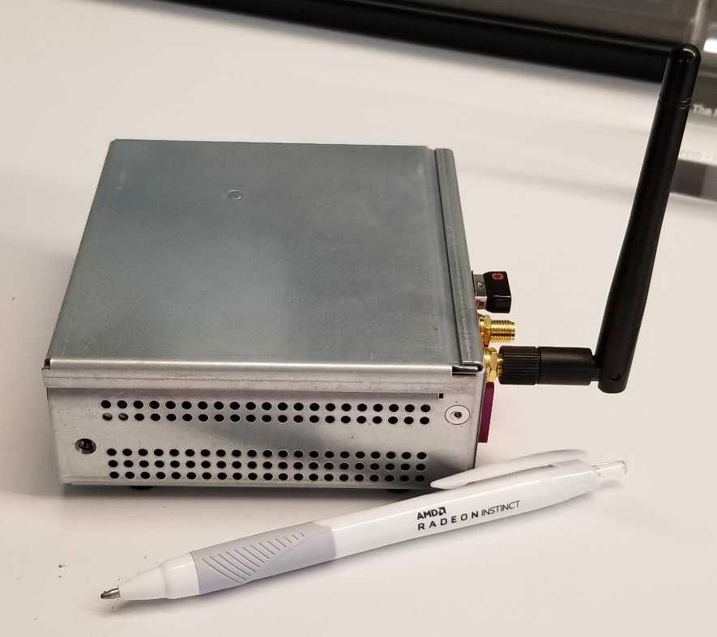
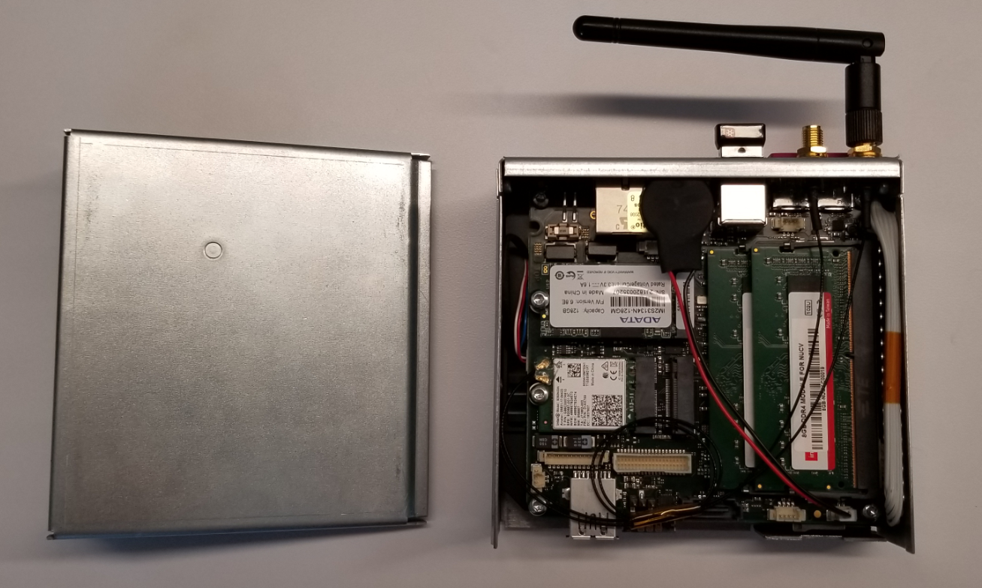
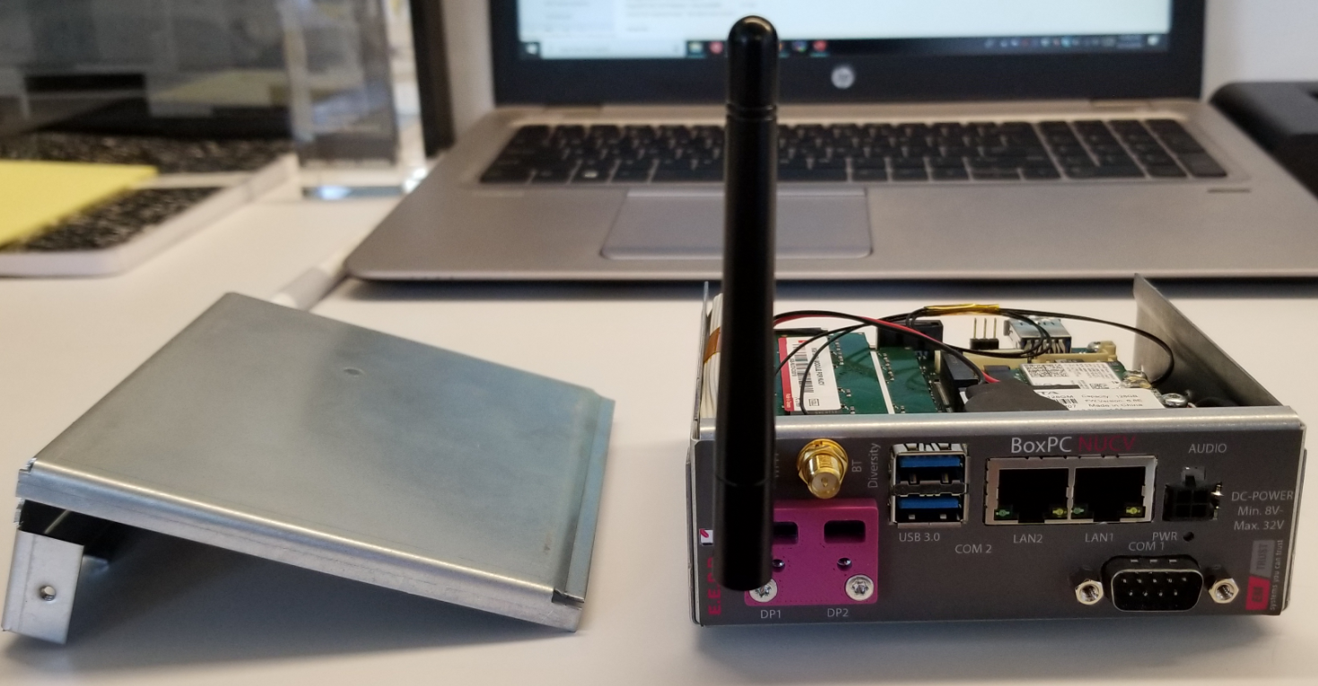
hardware
AMD Ryzen™ Embedded V1807B with Radeon™ RX Vega 11 Graphics
# of CPU Cores: 4
# of Threads: 8 CPU
Max Freq.: 3.8GHz
CPU Base Freq.: 3.35GHz
Integrated GPU: AMD Radeon™ Vega 3 (V1202B) Vega 8 (V1605B / V1756B) Vega 11 (V1807B) Graphics

Slide 10
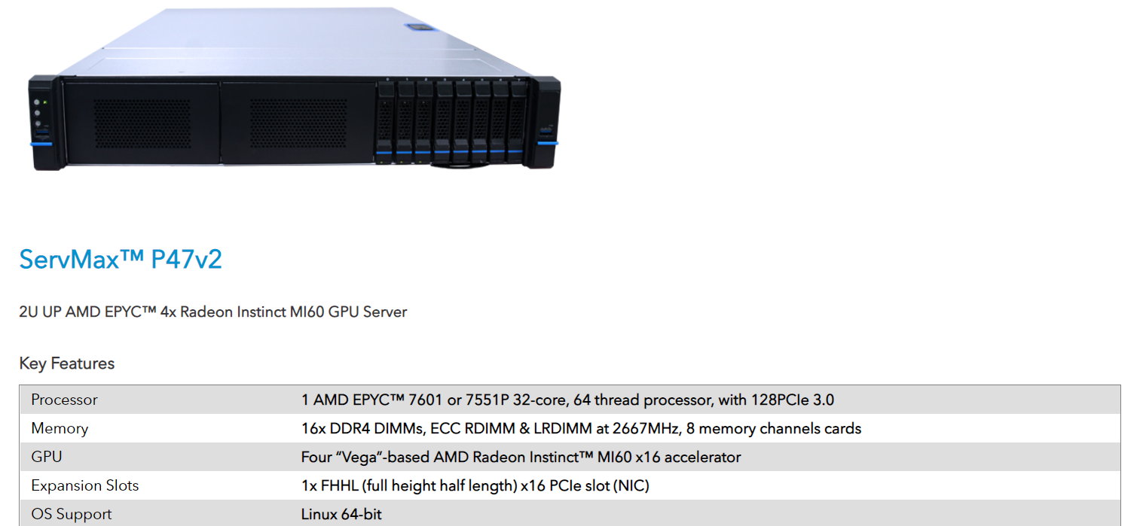
hardware

Slide 11
AMD ML SOFTWARE Stack with ROCm
Data Platform Tools
Machine Learning Apps
MIVisionX Apps
open source Foundation for Machine learning
Frameworks
Exchange formats
Latest Machine Learning Frameworks
MIVisionX
Middleware and Libraries
Optimized Math & Communication Libraries
MIOpen
BLAS, FFT, RNG
RCCL
Eigen
OpenMP
HIP
OpenCL™
Python
Docker and Kubernetes support
ROCm
Fully Open Source ROCm Platform
11
Up-Streamed for Linux Kernel Distributions
Devices
GPU
CPU
APU
Future Accelerators

Slide 12
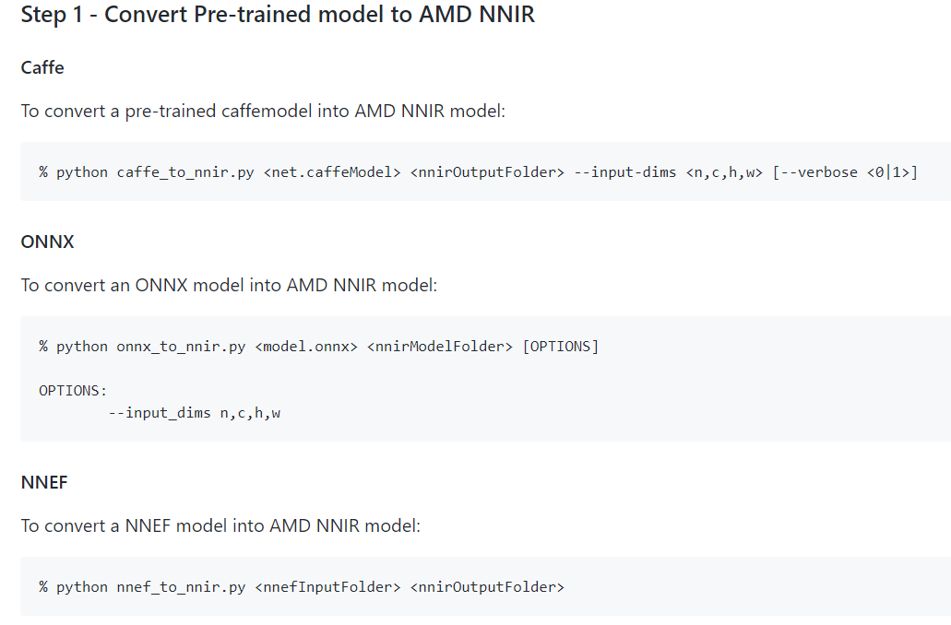
Tutorial Example 1: Image classification
Using a pretrained ONNX model
Step 1 : Convert Pre-trained models in Caffe/NNEF/ONNX to OpenVX graph
Convert Pre-Trained model to AMD NNIR

Slide 13
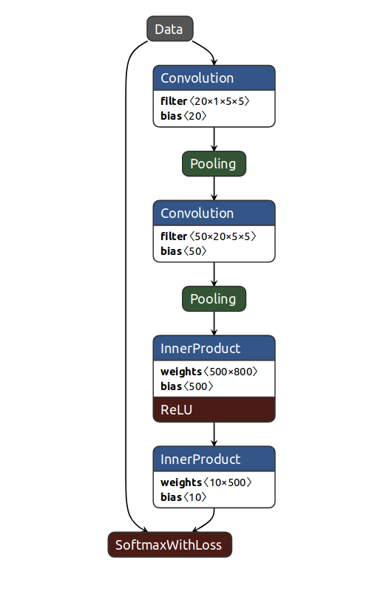
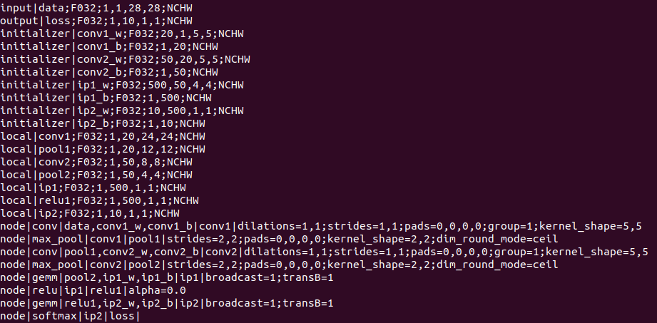
Tutorial Example 1: Image classification
Using a pretrained ONNX model
Step 1 : Convert Pre-trained models in Caffe/NNEF/ONNX to OpenVX graph
Convert Pre-Trained model to AMD NNIR

Slide 14
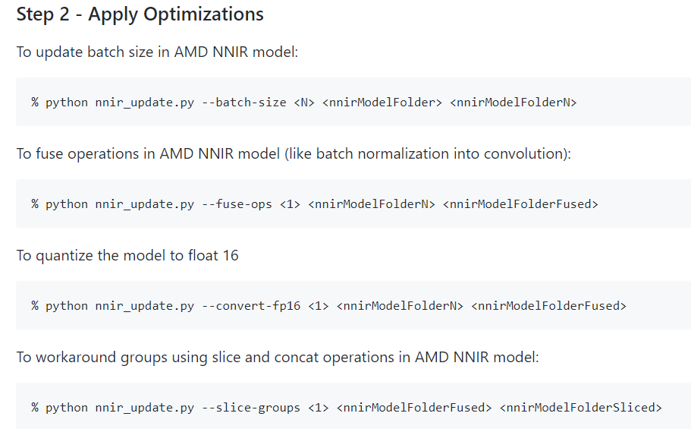
Tutorial Example 1: Image classification
Using a pretrained ONNX model
Step 1 : Convert Pre-trained models in Caffe/NNEF/ONNX to OpenVX graph
Apply Optimization

Slide 15
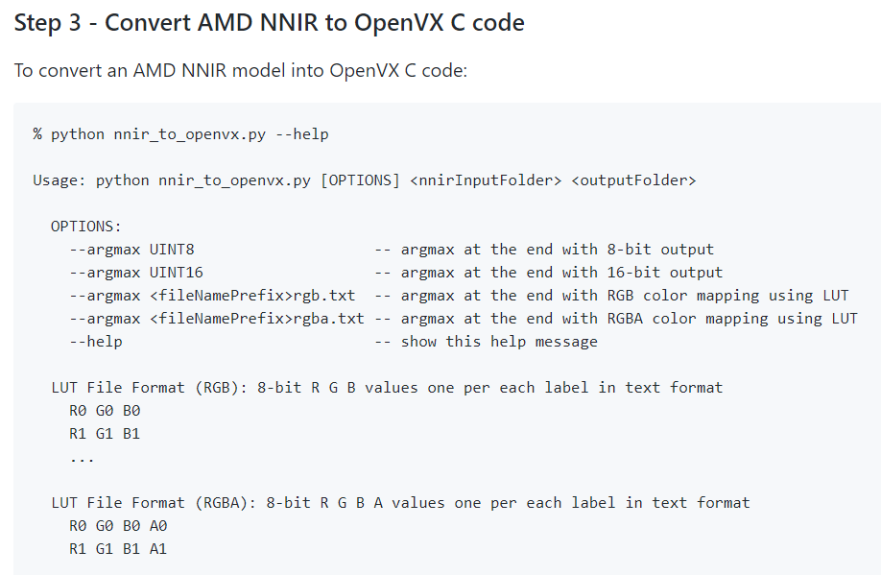
Tutorial Example 1: Image classification
Using a pretrained ONNX model
Step 1 : Convert Pre-trained models in Caffe/NNEF/ONNX to OpenVX graph
Convert AMD NNIR to OpenVX C Code

Slide 16
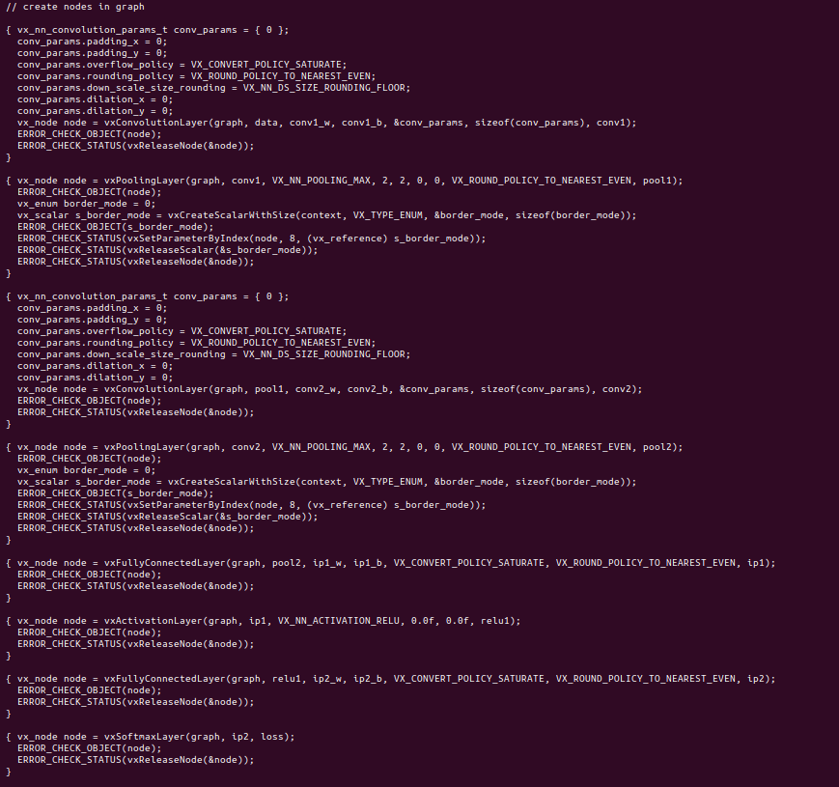
Tutorial Example 1: Image classification
Using a pretrained ONNX model
Step 1 : Convert Pre-trained models in Caffe/NNEF/ONNX to OpenVX graph
Convert AMD NNIR to OpenVX C Code

Slide 17
Tutorial Example 1: Image classification
Using a pretrained ONNX model
Step 2 : Add pre & post processing nodes

Slide 18
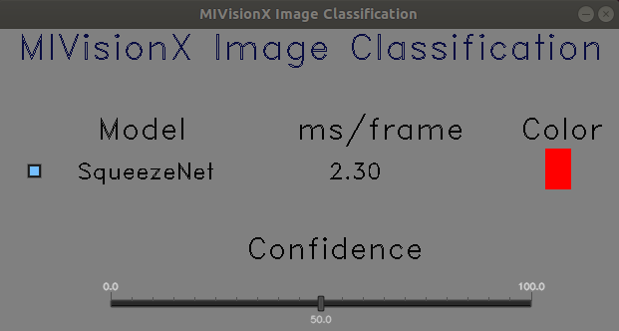
Tutorial Example 1: Image classification
Using pretrained ONNX model
Step 3 : Run Optimized inference on target hardware

Slide 19
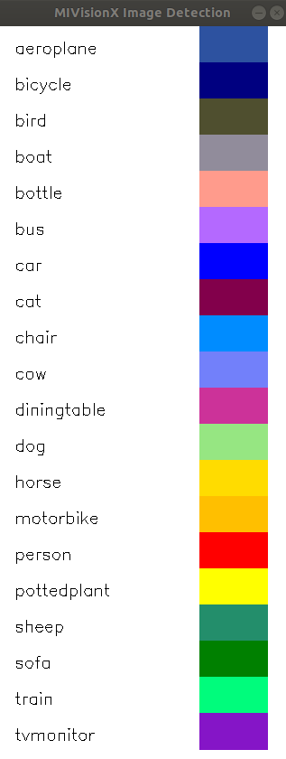
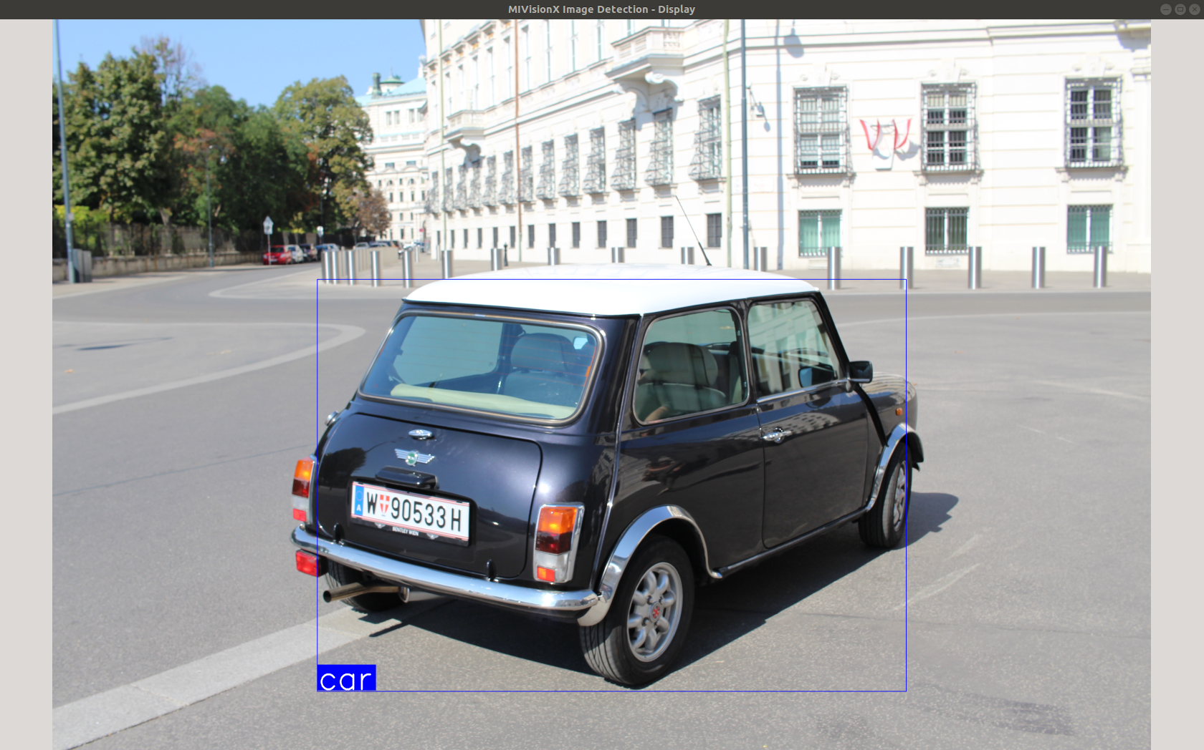
Tutorial Example 2: Object Detection
Using a Pre-Trained Caffe model

Slide 20
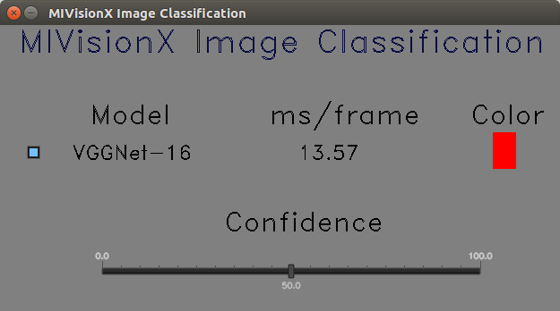
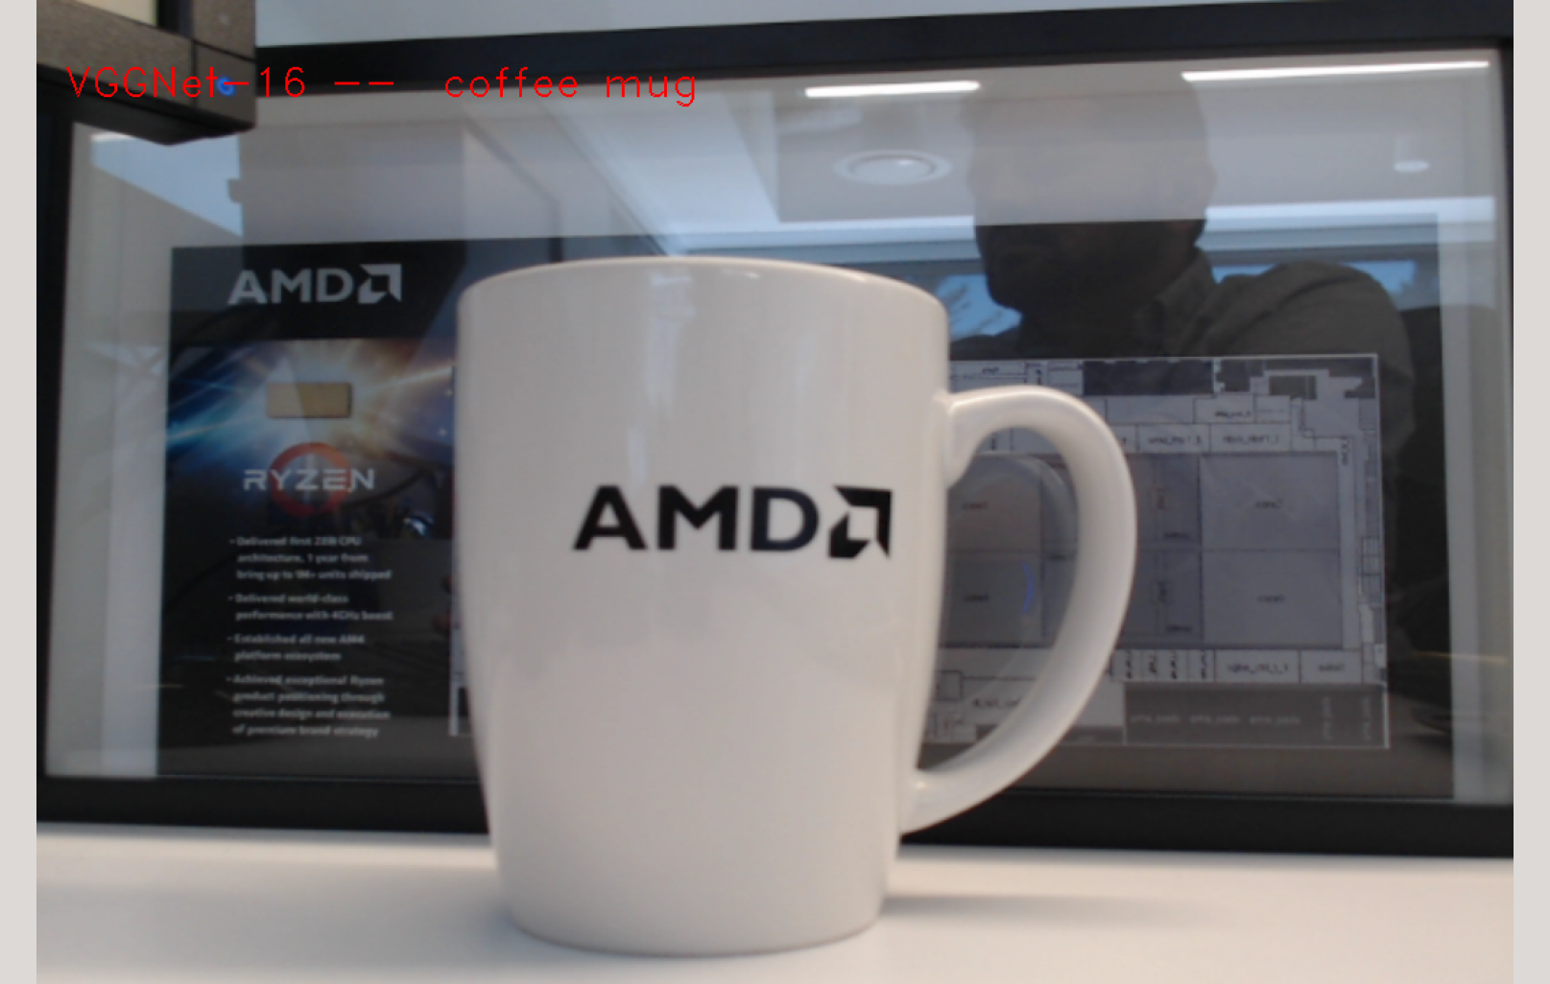
Tutorial Example 3: Image Classification
Using a Pre-Trained NNEF model

Slide 21
MIVisionX Inference Deployment API
Enables a pre-trained CNN model to be deployed on AMD’s ROCm stack with MIVisionX
Architected to support different backends including OpenCL-ROCm, OpenCL-HIP, WinML etc. All options use OpenVX for executing the inference engine.
Two stage process
mv_compile for compiling the model (Caffe, ONNX, NNEF) for the specific backends with the option to run Model Optimizer for fuse operations, quantization etc.
mv_compile generates deployment library (libmvdeploy.so), binary weights for the model, and some .cpp and .h files required to run inference engine.
Also it generates a post-processing module for running argmax or bounding box object detection.
Users can use the deployment package to develop real-world applications for both inference and vision.

Slide 22
MIVisionX Inference Deployment Block Diagram
Deployment package:
library, weights & sample
[Application] Use deployment package and add pre/post processing modules to build real-world application
mv_compile
Pre-trained and Optimized NN Model (Caffe, ONNX, NNEF)
Convert to NNIR
Optimize NNIR Model
NNIR2clib compiler
Fuse kernels, memory optimization, quantize etc.

Slide 23
MIVisionX Deployment Workflow
mv_compile --model <model_name: name of the trained model with path> [required] --install_folder <install_folder: the location for compiled model> [required] --input_dims <input_dims: n,c,h,w - batch size, channels, height, width> [required] --backend <backend: name of the backend for compilation> [optional - default:OpenVX_Rocm_OpenCL] --fuse_cba <fuse_cba: enable or disable Convolution_bias_activation fuse mode (0/1)> [optional - default: 0] --quant_mode <quant_mode: fp32/fp16 - quantization_mode for the model: if enabled the model and weights would be converted
Compile model for specific backend using mv_compile.
mv_compile options..
--model <model_name> : name of the trained model with full path [required]
--install_folder <install_folder> : the location for compiled model [required]
--input_dims <n,c,h,w>: dimension of input for the model given in format NCHW [required]
--backend <backend>: is the name of the backend for compilation [optional : default:OpenVX_Rocm_OpenCL]
--fuse_cba <0/1> :enable or disable Convolution_bias_activation fuse mode(0/1) [optional-default:0]
--quant_mode <fp32/fp16>: if enabled the model and weights would be converted [optional(default:fp32)]
Deploy the compiled model with optional pre and/or postprocessing functions. mvdeploy_api.h has all the API function definitions for deploying the model.

Slide 24
MIVisionX Deployment API
API Function | Description
mvInitializeDeployment (const char* install_folder) | Initializes the deployment engine with the URL of the install_folder
QueryInference (int *num_inputs, int *num_outputs,..) | Returns the model config such as input and output dimensions
SetPreProcessCallback (mv_add_preprocess_callback_f preproc_f, …) | Callback function to add preprocessing nodes to the same OpenVX graph as the inference
mvCreateInferenceSession(mivid_session *inf_session, const char *install_folder) | Creates an inference deployment session and returns a handle
mvSetInputDataFromMemory/File (mivid_session inf_session, int input_num, void *input_data, ..) | sets input for the inference or copies it to input tensor
mvRunInference (mivid_session inf_session, …) | Executes the inference for a single frame for #iterations
mvGetOutput (mivid_session inf_session, void *out_mem,..) | Copies the output to user specified memory
mvShutdown (mivid_session inf_session) | Releases inference session and free all resources

Slide 25
Tutorial Example 5: Object detection from video using OpenVX video decoder preprocessing node.
This example shows how to add pre-processing nodes, such as decoding with the amd_video_decoder node along with inferencing for a realistic object detection application.
Shows the use of MIVisionX utility mv_compile, which is used to compile an inference deployment package from a pre-trained model for a specific backend. The compiled package consists of a library, header files, application specific source files and the binary weights of the model.
Also it shows how to add a pre-processing node to the inference graph using the MIVisionX deployment API.
It demonstrates how to build an application which does objection detection using YoloV2 from one video stream or multiple video streams. This example shows the advantage of using OpenVX which avoids extra data copies thereby achieving a significance performance increase.

Slide 26
Tutorial Example 5: Flow chart
yolov2 pretrained model
Lib_mvdeploy.so, weights.bin, mv_deployapi.cpp, sample app
mv_compile
mv_compile utility
Initializes deployment from the library;
loads weights for the constant tensors
mvInitializeDeployment()
preprocess_addnodes_cb()
Adds vx_amdMediaDecoder node, vx_convertImageToTensor() node
mvCreateInference()
Creates vxGraph, vxContext and calls vxVerifyGraph()
mvobjdetect example
mvRunInference(),
called in a loop for all frames in the video
VxProcessGraph() with pre-processing nodes and CNN nodes
mvShutdown(),
Releases vxGraph, all vx memory resources

Slide 27
Tutorial Example 5: use of mv_compile.exe
Step 1: mv_compile.exe --model <model> --install_folder <install_folder> --input_dims n,c,h,w --fuse-cba <0/1>
Generates library libmv_deploy.so, mvdeploy.h, weights.bin, mvdeploy_api.cpp, mvtestdeploy.cpp in the install_folder
Generates mv_extras library for doing the most common postprocessing functions like argmax and bounding box detections
Step 2:. Compile and run mvobjdetect example using the precompiled deployment package
Copy additional source files and CMakeLists.txt from mvobjdetect folder to the install_folder
Build the mvobjdetect example
Run using mvobjdetect <input_file.mp4> --install_folder . --frames <num> --bb cls, th1, th2 --v
Shows the usage of OpenCV for visualizing the results

Slide 28
Mv_objdetect using 4 video streams
Example shows decoding 4 video streams simultaneously using amd_media_decoder OpenVX node and running the inference on 4 streams and visualizing the results using OpenCV.

Slide 29
Resources
Tutorial part 1: https://github.com/kiritigowda/MIVisionX-Inference-Tutorial
Tutorial part 2: https://github.com/rrawther/MIVisionX-OpenVX-Tutorial
MIVisionX: https://github.com/GPUOpen-ProfessionalCompute-Libraries/MIVisionX

Slide 30
Disclaimers and attributions
The information contained herein is for informational purposes only and is subject to change without notice. Timelines, roadmaps, and/or product release dates shown in these slides are plans only and subject to change. “Polaris”, “Vega”, “Radeon Vega”, “Navi”, “Zen” and “Naples” are codenames for AMD architectures, and are not product names.
While every precaution has been taken in the preparation of this document, it may contain technical inaccuracies, omissions and typographical errors, and AMD is under no obligation to update or otherwise correct this information. Advanced Micro Devices, Inc. makes no representations or warranties with respect to the accuracy or completeness of the contents of this document, and assumes no liability of any kind, including the implied warranties of noninfringement, merchantability or fitness for particular purposes, with respect to the operation or use of AMD hardware, software or other products described herein. No license, including implied or arising by estoppel, to any intellectual property rights is granted by this document. Terms and limitations applicable to the purchase or use of AMD’s products are as set forth in a signed agreement between the parties or in AMD's Standard Terms and Conditions of Sale.
The information contained herein is for informational purposes only and is subject to change without notice. While every precaution has been taken in the preparation of this document, it may contain technical inaccuracies, omissions and typographical errors, and AMD is under no obligation to update or otherwise correct this information. Advanced Micro Devices, Inc. makes no representations or warranties with respect to the accuracy or completeness of the contents of this document, and assumes no liability of any kind, including the implied warranties of noninfringement, merchantability or fitness for particular purposes, with respect to the operation or use of AMD hardware, software or other products described herein. No license, including implied or arising by estoppel, to any intellectual property rights is granted by this document. Terms and limitations applicable to the purchase or use of AMD’s products are as set forth in a signed agreement between the parties or in AMD's Standard Terms and Conditions of Sale. GD-18
©2019 Advanced Micro Devices, Inc. All rights reserved. AMD, the AMD Arrow logo, Ryzen, Threadripper, EPYC, and combinations thereof are trademarks of Advanced Micro Devices, Inc. Other product names used in this publication are for identification purposes only and may be trademarks of their respective companies.

