Slide 1




Machine Learning @ AMD
Ajit Mathews
Corp. VP Software Development
ML Software Engineering
3:00 PM

Slide 2

open source Foundation for Machine learning
Applications
Machine Learning Apps
Frameworks
Caffe 2
PyTorch
TensorFlow
ONNX
Latest Machine Learning Frameworks
Middleware and Libraries
MIOpen
MIVisionX
BLAS,FFT,RNG
RCCL
Eigen
Optimized Math Libraries
OpenMP
HIP
OpenCL™
Python
ROCm
Fully Open Source ROCm Platform
Dockers and Kubernetes Support
Devices
GPU
CPU
APU
DLA
Up-Streamed for Linux Kernel Distributions

Slide 3
open source Foundation for Machine learning
Applications
Machine Learning Apps
ML APPS use open source machine learning frameworks
Low level software components are abstracted - therefore CUDA is not a factor
Frameworks
Caffe 2
PyTorch
TensorFlow
ONNX
Middleware and Libraries
MIOpen
MIVisionX
BLAS,FFT,RNG
RCCL
Eigen
OpenMP
HIP
OpenCL™
Python
Publicly available for machine learning experts to try out on our hardware
ROCm
Fully Open Source ROCm Platform
Devices
GPU
CPU
APU
DLA

Slide 4


Machine Learning Frameworks
Applications
Machine Learning Apps
Caffe 2
MXnet
PyTorch
TensorFlow
Frameworks
Caffe 2
MXnet
PyTorch
TensorFlow
Frameworks
Middleware and Libraries
MIOpen
BLAS,FFT,RNG
RCCL
Eigen
ROCm
OpenMP
HIP
OpenCL™
Python
Fully Open Source ROCm Platform
Devices
GPU
CPU
APU
DLA
Supports:
  Vision (CNNs, GANs)
  Translate (RNNs, LSTMs, Transformer)
  Reinforcement Learning
High performance FP16/FP32 training with up to 8 GPUs/node
v1.13.1 and v2.0-alpha – Available today as a docker container:
https://hub.docker.com/r/rocm/tensorflow
or as Python PIP wheel:
https://pypi.org/project/tensorflow-rocm/
Matching AMD versions are available within days of official release
Notes:
TensorFlow – we have v1.13.1 released today. This the latest stable TensorFlow version.

Slide 5


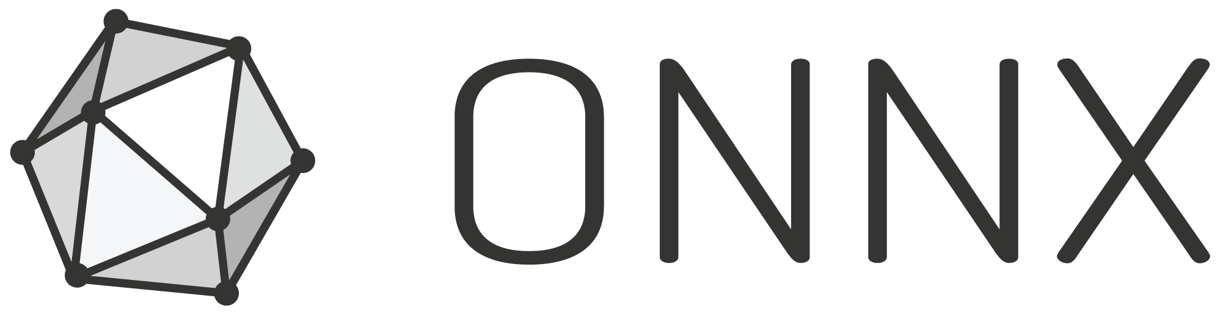
Machine Learning Frameworks
Applications
Machine Learning Apps
Caffe 2
MXnet
PyTorch
TensorFlow
Frameworks
Caffe 2
MXnet
PyTorch
TensorFlow
Frameworks
Middleware and Libraries
MIOpen
BLAS,FFT,RNG
RCCL
Eigen
ROCm
OpenMP
HIP
OpenCL™
Python
Fully Open Source ROCm Platform
Devices
GPU
CPU
APU
DLA
AMD related changes have been upstreamed
https://github.com/pytorch/pytorch
High performance FP16/FP32 training with up to 8 GPUs/node
Available today as a docker container (or build from source):
https://hub.docker.com/r/rocm/pytorch
ROCm is an official build target for PyTorch CI, ensures continuous testing and minimal regressions
Supports:
  All Torch-Vision models
  PyTorch Translate
  All PyTorch examples
Supports:
https://github.com/facebookincubator/gloo/tree/master/gloo
Supports

Slide 6
Inference with OpenVXTM
Mike Schmit
Director of Software Engineering ML Computer Vision
3:00 – 5:30 PM

Slide 7
MIVisionX = OpenVXTM with tools/libraries
MIVisionX
Conformant OpenVXTM 1.0.1, Open source (MIT license)
Neural net extensions w/ Optimized MIOpen libraries
Model compiler / model optimizer
OpenCVTM interop
Radeon Loom 360 stitching library
WinML for Windows
Utilities
  ADAT (AMD Dataset Analysis Tool)
  RunVX (command line OpenVX interpreter)
  GDF (OpenVX scripting language & debugger)
  LoomShell (360 image scripting language & debugger)
High-level summary

Slide 8
Introduction to MIVisionX Toolkit
MIVisionX toolkit is a comprehensive computer vision and machine intelligence libraries, utilities and applications bundled into a single toolkit.
AMD OpenVX is delivered as Open Source with MIVisionX
Primarily targeted at applications requiring a combination of machine learning inference and computer vision or image/video processing.
Includes a model compiler for converting and optimizing a pretrained model from existing formats such as Caffe, NNEF and ONNX to an OpenVX backend.
After compilation, MIVisionX generates an optimized library specific for a backend to run inferencing and vision pre- and post-processing modules.
It is beneficial to have lightweight and dedicated APIs optimized for AMD hardware for inference deployment as opposed to heavyweight frameworks.

Slide 9






Neural Network Deployment options
Frameworks
MIVisionX Model Compiler / optimizer
ONNX
network
…
training
Application
Application
Application
Application
OpenVX run-time
& libraries
OpenVX Binary run-time
& libraries
WinML
run-time
& libraries
Future target system(s)
Deployment Option #1
Deployment Option #2
Deployment Option #3
Deployment Option #4

Slide 10






AMD ML SOFTWARE Stack w/ ROCm
Data Platform Tools
Machine Learning Apps
MIVisionX Apps
open source Foundation for Machine learning
Frameworks
Exchange formats
Latest Machine Learning Frameworks
MIVisionX
Middleware and Libraries
Optimized Math & Communication Libraries
MIOpen
BLAS, FFT, RNG
RCCL
Eigen
OpenMP
HIP
OpenCL™
Python
Docker and Kubernetes support
ROCm
Fully Open Source ROCm Platform
10
Up-Streamed for Linux Kernel Distributions
Devices
GPU
CPU
APU
Future Accelerators
ROCm = Radeon Open Compute platform
HIP = Heterogeneous-compute Interface for Portability

Slide 11
Tutorial Examples
Tutorial #1: Image Classification with ONNX
Tutorial #2: Object Detection with Caffe
Tutorial #3: Image Classification with NNEF
Tutorial #4: Object Detection with multi-stream HW video decode
Not all Tutorials may be presented based on time available
Links:
https://github.com/kiritigowda/MIVisionX-Inference-Tutorial#mivisionx-inference-tutorial
https://github.com/rrawther/MIVisionX-OpenVX-Tutorial

Slide 12
Tutorial Systems and Room Setup
AMD Developer Cloud Server
AMD EpycTM + Radeon InstinctTM MI25
Laptop
Laptop
Laptop
AMD RyzenTM 7
+ RadeonTM Vega VII
WiFi router
Laptop
Laptop
AMD Ryzen ThreadripperTM
+ RadeonTM Vega 10
Laptop
See printed instructions to get connected now

Slide 13
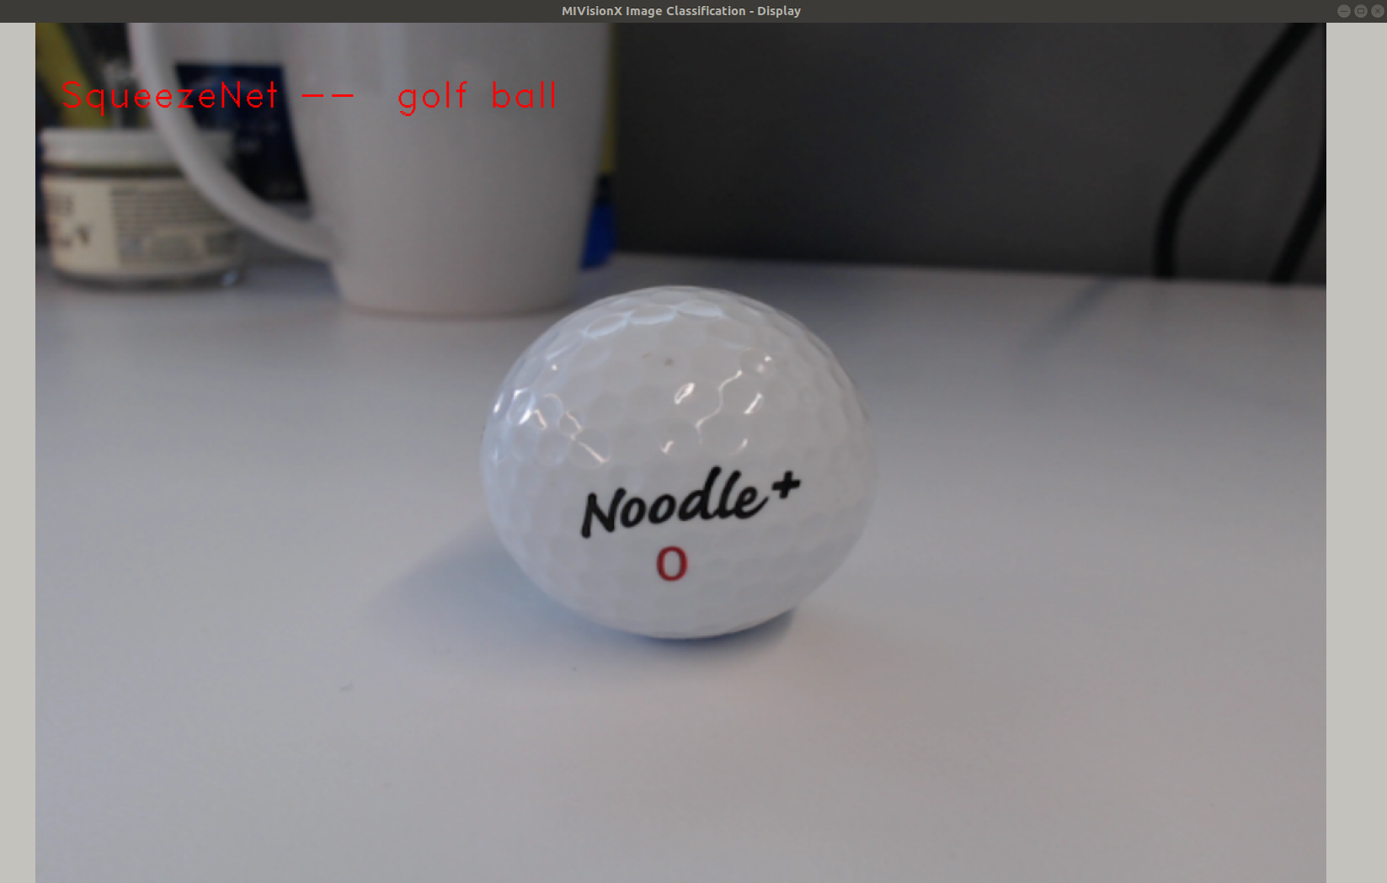
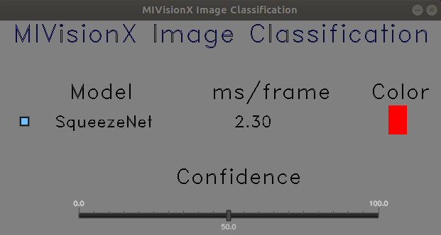
Tutorial Example 1: Image Classification
Using pretrained ONNX model

Slide 14
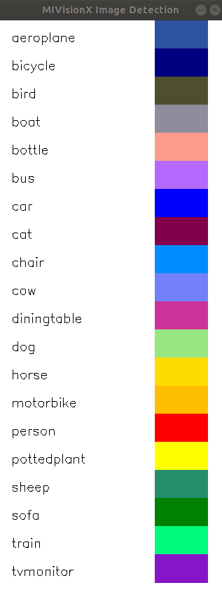
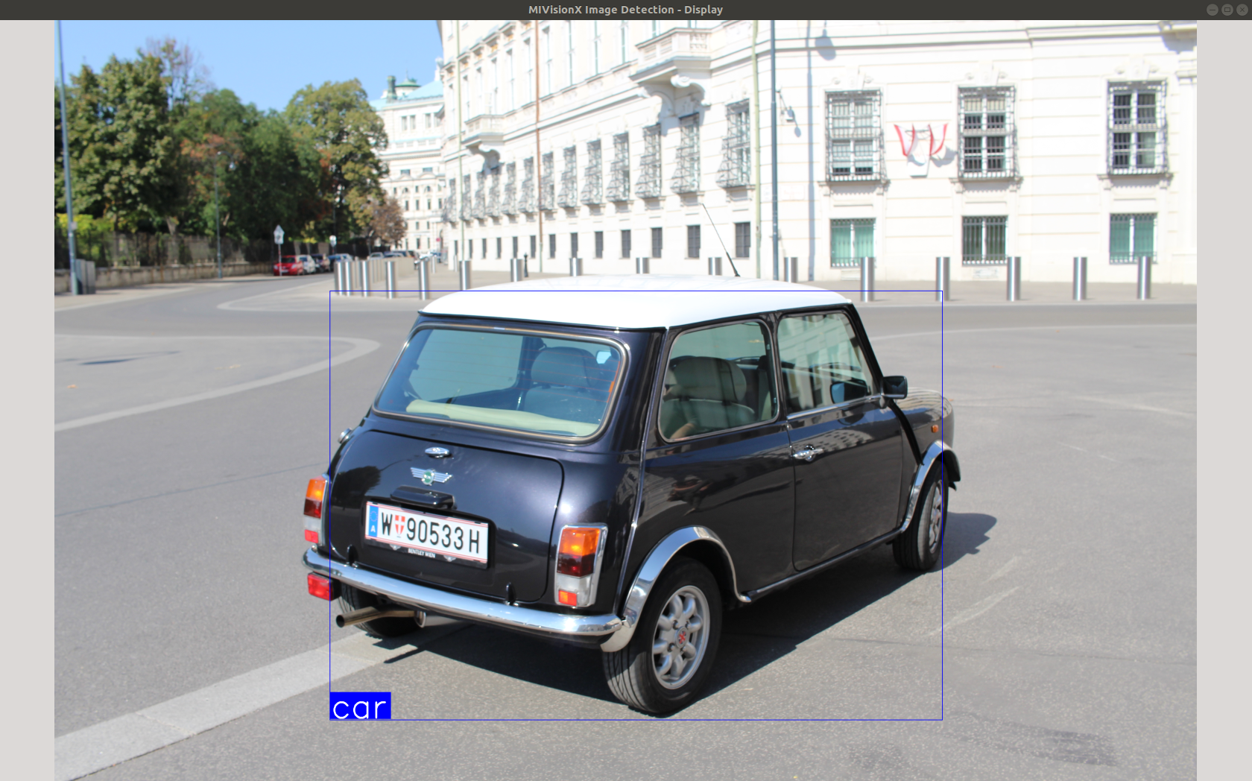
Tutorial Example 2: Object Detection
Using Pre-Trained Caffe model

Slide 15
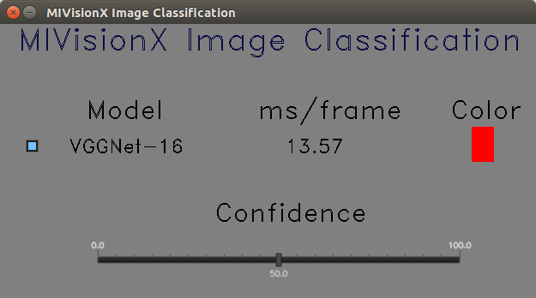
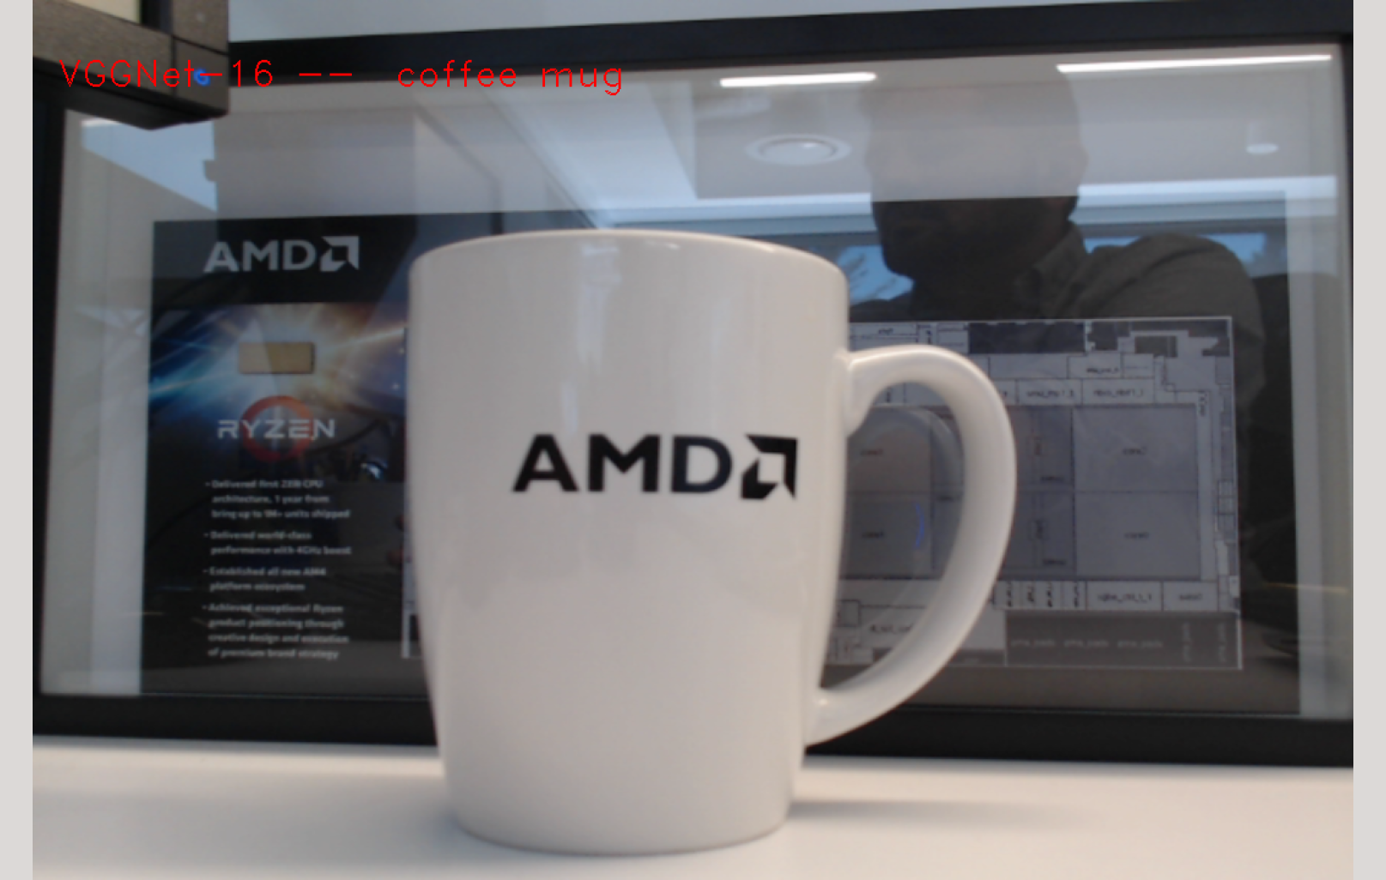
Tutorial Example 3: Image Classification
Using Pre-Trained NNEF model

Slide 16
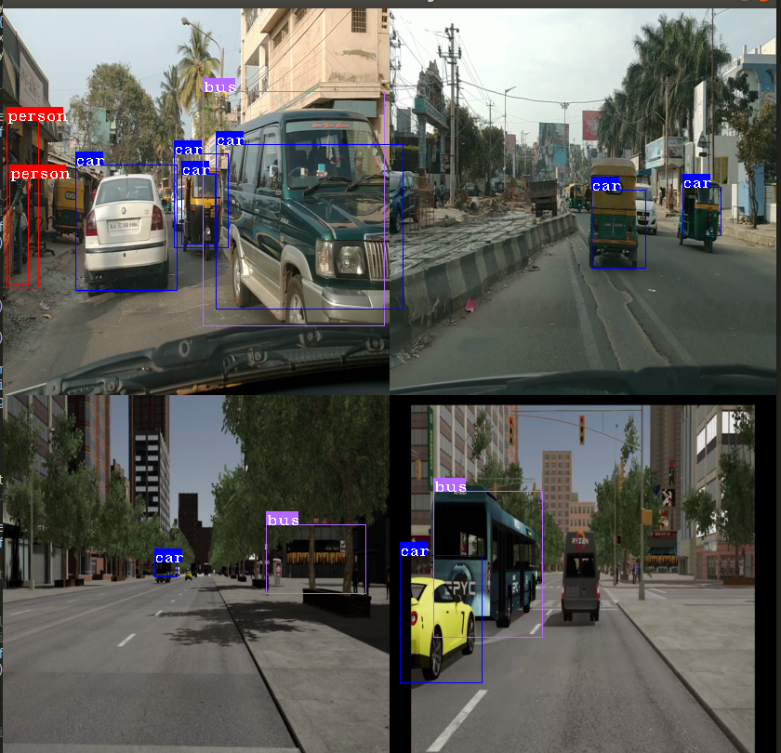
Mv_objdetect using 4 video streams
Example shows decoding 4 video streams simultaneously using amd_media_decoder OpenVX node and running the inference on 4 streams and visualizing the results using OpenCV.

Slide 17
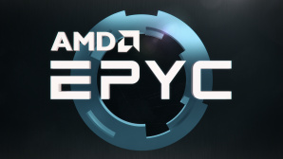
Inference server demo
Setup phase
Model
E
Parameters
1. Model compilation
GPU #0
1. Choose model & parameters
Status
Image database
C
D
GPU #1
A
2a. Image decode
2b. Multiple GPU execution
2. Choose dataset
GPU #2
B
Images
G
GPU #3
Results
3. View results
F
…
Results
Inference execution
up to 8 MI25 or MI60 GPUs
A-G
Critical path flow
Numbers show the complete setup and inference

Slide 18
Bytes processed (per 1000 images)
Client: Read HDD
Client: Xmit
Server: JPEG Decode
Copy: PCIe to GPU
GPU: inference
Server: send results
Client: Display results
A
B
C
D
E
F
G
15 MB/sec
(assume 10:1 compression)
15 MB/sec
150MB/sec &
600 MB/sec
(best case w/ no resize)
600 MB/sec
1000 images
1000 * 64
partial results shown;
Full results reported
Example Capacities:
Examples
HDD = 100-200 MB/sec
SATA III SSD = 550 MB/sec
NVMe = ~2GB/sec
1 Gbps
(125 MB/sec)
…
100 Gbps
32 cores
64 threads
PCIe 3.0
16 GB/sec for x16
600 – 900 images/sec per GPU for Resnet-50 FP32
1 Gbps
(125 MB/sec)
…
100 Gbps
NA

Slide 19
Disclaimers and attributions
The information contained herein is for informational purposes only, and is subject to change without notice. Timelines, roadmaps, and/or product release dates shown in these slides are plans only and subject to change. “Polaris”, “Vega”, “Radeon Vega”, “Navi”, “Zen” and “Naples” are codenames for AMD architectures, and are not product names.
While every precaution has been taken in the preparation of this document, it may contain technical inaccuracies, omissions and typographical errors, and AMD is under no obligation to update or otherwise correct this information. Advanced Micro Devices, Inc. makes no representations or warranties with respect to the accuracy or completeness of the contents of this document, and assumes no liability of any kind, including the implied warranties of noninfringement, merchantability or fitness for particular purposes, with respect to the operation or use of AMD hardware, software or other products described herein. No license, including implied or arising by estoppel, to any intellectual property rights is granted by this document. Terms and limitations applicable to the purchase or use of AMD’s products are as set forth in a signed agreement between the parties or in AMD's Standard Terms and Conditions of Sale.
The information contained herein is for informational purposes only, and is subject to change without notice. While every precaution has been taken in the preparation of this document, it may contain technical inaccuracies, omissions and typographical errors, and AMD is under no obligation to update or otherwise correct this information. Advanced Micro Devices, Inc. makes no representations or warranties with respect to the accuracy or completeness of the contents of this document, and assumes no liability of any kind, including the implied warranties of noninfringement, merchantability or fitness for particular purposes, with respect to the operation or use of AMD hardware, software or other products described herein. No license, including implied or arising by estoppel, to any intellectual property rights is granted by this document. Terms and limitations applicable to the purchase or use of AMD’s products are as set forth in a signed agreement between the parties or in AMD's Standard Terms and Conditions of Sale. GD-18
©2019 Advanced Micro Devices, Inc. All rights reserved. AMD, the AMD Arrow logo, Ryzen, Threadripper, EPYC, and combinations thereof are trademarks of Advanced Micro Devices, Inc. Other product names used in this publication are for identification purposes only and may be trademarks of their respective companies.

Slide 20
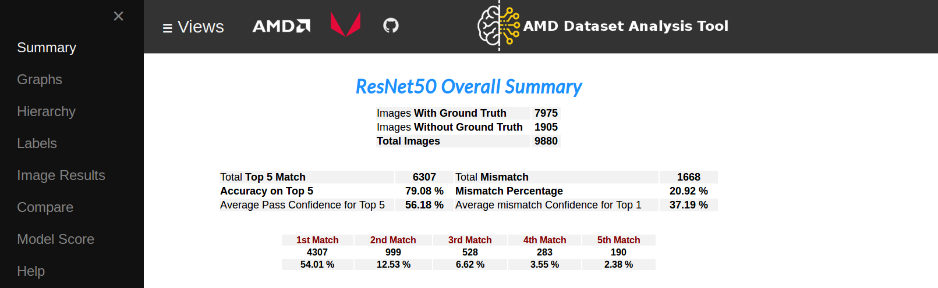
BACK UP

