Slide 1
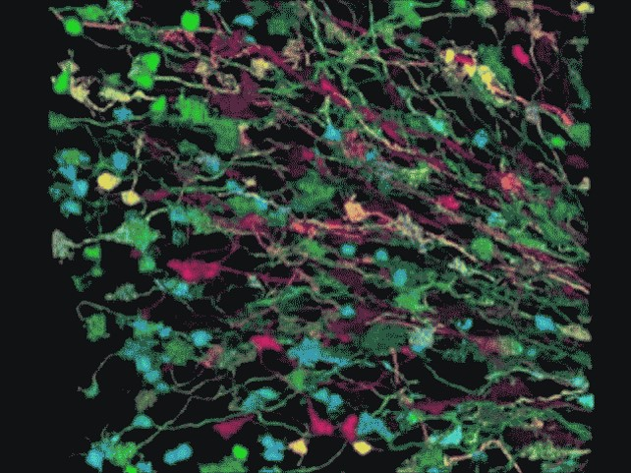
The brain: networks of neurons
3D, Harvard
Mouse cerebellum Lichtman et al. 2008

Slide 2
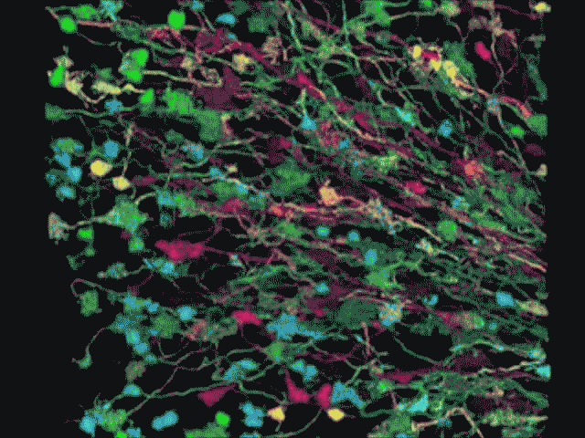
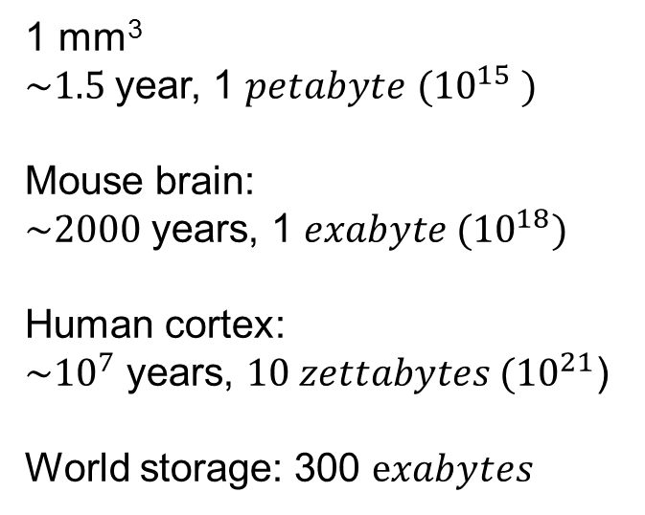
The brain: networks of neurons
1 mm³
$\sim 1.5$year, 1 $petabyte$ ${(10}^{15} )$
Mouse brain:
$\sim 2000$years, 1 ${exabyte (10}^{18})$
Human cortex:
$\sim {10}^{7}$ years, ${10 zettabytes (10}^{21}$)
World storage: 300 $exabytes$
3D, Harvard
~ on January 2015
Mouse cerebellum Lichtman et al. 2008

Slide 3
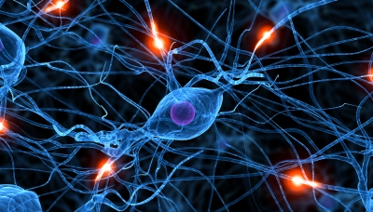
Scalable Inference in
Large Neural Systems
Allie Fletcher
Nov 5, 2015
UC Santa Cruz Electrical Engineering
UC Berkeley Redwood Center, HWNI
UCLA Statistics, Math, & EE– Jan 2016

Slide 4
Outline
Neural mapping via multineuron excitation
  Background: Neuroscience
  Optogenetic stimulation
  Estimation via graphical models
Network connectivity via Ca²⁺ imaging
  Large scale but indirect and smoothed
  Network model captures dynamics
  Scalable accurate algorithm
Receptive Field of Retinal Ganglion Cells
  Spatio-temporal filtering
  Improved identification with limited data

Slide 5

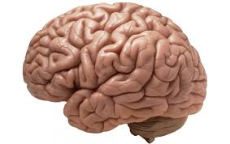

Neuroscience: Estimation Challenges
Stimulus
Large-scale
  - ~86 billion neurons
  - V1 alone 140 million
  Sparse: ~1000 connections
  Complex:
  Nonlinear dynamics
  Feedback
Indirect measurements
Incomplete data
Limited in vivo collection
Visual system
F(u(t))

Slide 6
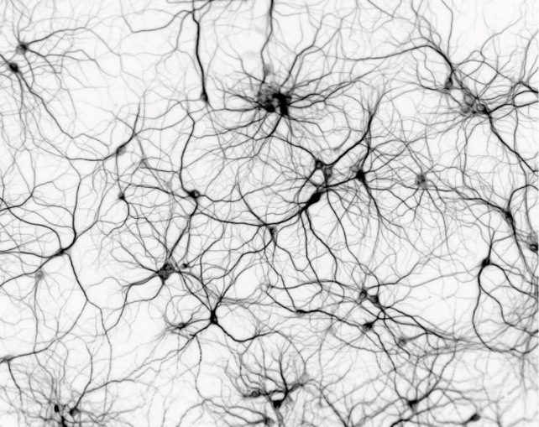
I. Connectivity Detection to a Single Neuron
Problem:
Detect connections to one neuron
Goal:
Reduce trials and computation
How:
Optogenetics
Improved “decoding” via subset stimulation

Slide 7
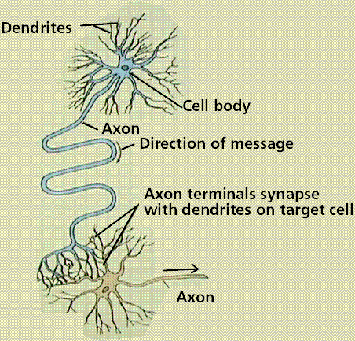
Neuron: Basic Anatomy
Neuron: Basic cell for information processing
Components
  Dendrites:
  Filaments receive signals
  Soma: cell body
  Axon:
  Outputs electrical signals to
  neurons or motor functions
  Synapses:
  Junctions of axons and dendrites

Slide 8

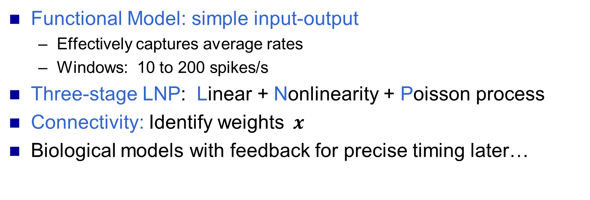




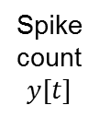

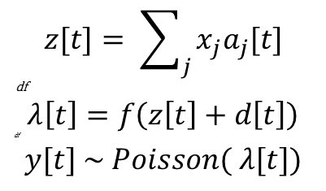

Neuron: Linear-Nonlinear Poisson Model
Inputs:
Spike Rate
Gaussian
noise $d[t]$
Poisson
spike process
Spike
count
$$y[t]$$
$$z[t]= \sum_{j}{x_{j}a_{j}[t]}$$
df
$$λ\left[t\right]=f\left(z\left[t\right]+d\left[t\right]\right)$$
df
$$y[t] \sim Poisson( λ[t])$$
Weights$x$
Nonlinearity
$$a_{1}\left[t\right]$$
$$a_{2}\left[t\right]$$
$$⋮$$
$$a_{n}\left[t\right]$$
$$z\left[t\right]=aT[t]x$$
Functional Model: simple input-output
  Effectively captures average rates
  Windows: 10 to 200 spikes/s
Three-stage LNP: Linear + Nonlinearity + Poisson process
Connectivity: Identify weights$x$
Biological models with feedback for precise timing later…

Slide 9
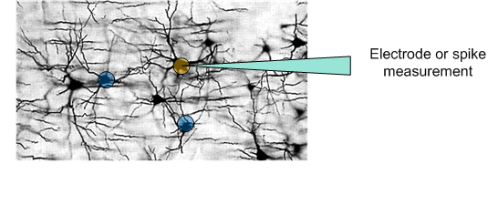
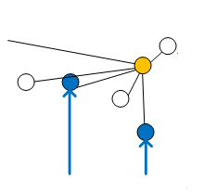
Classic Connectivity Detection
Measure at post-synaptic neuron of interest
Stimulate potential pre-synaptic neurons: one at a time
Problems: many measurements per test neuron
  Most neurons are not connected
  Noisy system with many exogenous inputs
  Test neurons die
Can we do better?

Slide 10
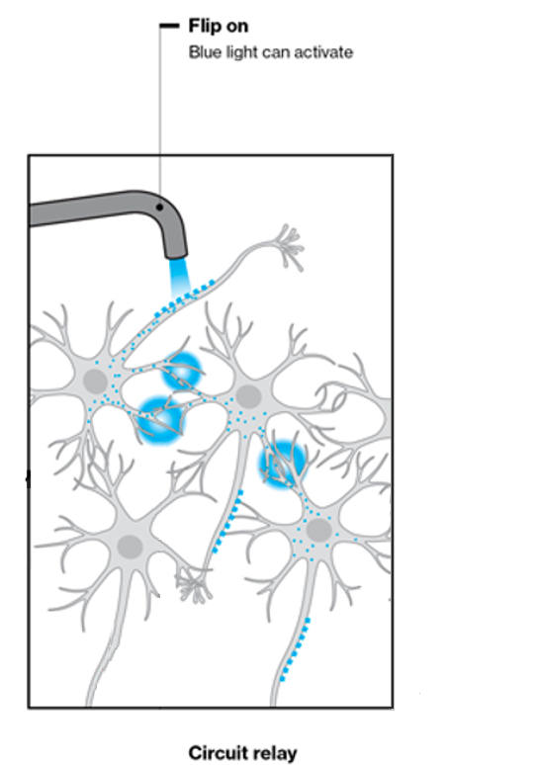
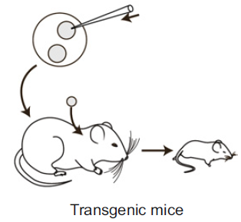
New Technologies: Optical Stimulation
  Connectivity Detection:
  Genetically modified neuron
    Photosensitive protein
  Optically activate test neurons
  Greater spatial precision
    Pinpoint individual neurons
    Multiple neurons at once
Wang, Hasan & Seung 2009

Slide 11

Connectivity via Multineuron Excitation
Spike recording
Average over time windows
Potential presynaptic neurons
Synapses or connections

Slide 12
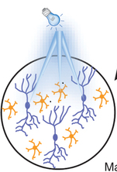
Detection via Multineuron Excitation
Strong:
Connections
Low response
No connection
Spike recording
Stimulate subsets of neurons at a time
  Increase probability of response
  Fewer wasted trials

Slide 13
Detection via Multi-Neuron Stimulation
Missed connection
Sub-threshold
Low response
No connection?
Connections:
strong or multiple
Spike recording
Stimulate subsets of neurons at a time
  Increase probability of a response
  Less measurements wholly wasted
Benefits
  Weak sub-threshold connection
  More reliable with less data
Hu & Chklovskii NIPS 2010,
Fletcher et al NIPS 2011

Slide 14
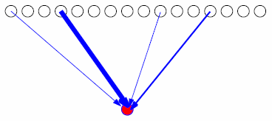
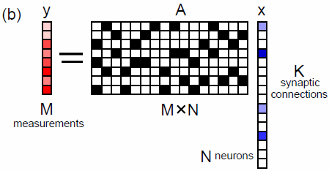
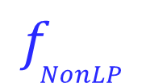
Multi-neuron Excitation: Model
Potential neurons: 1:N
j^{th} neuron
Excited
Not excited
Connection
weights
Excited: {2, 7, 9, 13}
Measurement neuron
“1” entries: {2, 7, 9, 13}
d
=
$$f_{NonLP}$$
j^{th} element
+
1
0
m

Slide 15

Multi-neuron Excitation: Model
Potential neurons: 1:N
j^{th} neuron
Excited
Not excited
Connection
weights
Second trial
Different random subset
Excited: {3, 6, 14, 16}
Measurement neuron
“1” entries: {3, 6,14,16}
d
=
$$f_{NonLP}$$
j^{th} element
+
1
0

Slide 16

Multi-neuron Excitation: Model
Potential neurons: 1:N
j^{th} neuron
Excited
Not excited
Connection
weights
m^{th} excitation
Measurement neuron
m trials or “measurements”
m^{th} row of A matrix
d
=
$$f_{NonLP}$$
j^{th} element
+
1
0
m
m

Slide 17

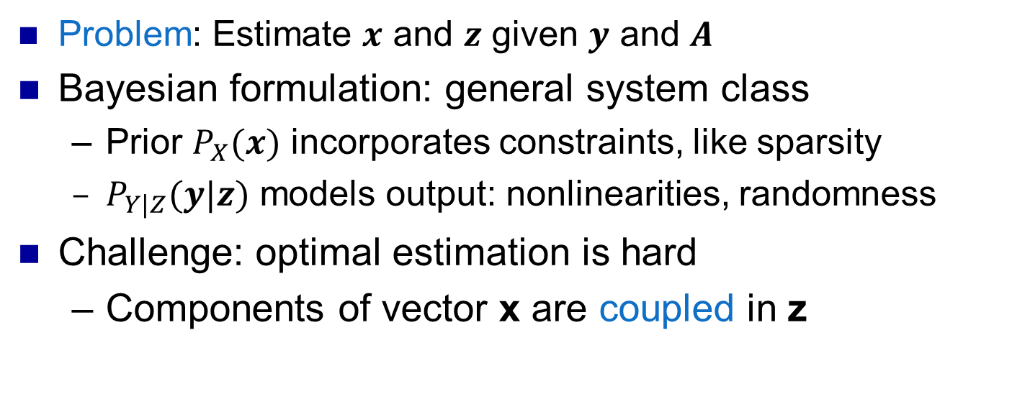


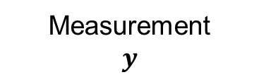
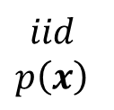
Bayesian Nonlinear Generalized Linear Models
Separable nonlinearity & noise
$$p\left(y | z\right)=∏p(y_{i}|z_{i})$$
$$iid$$
$$p\left(x\right)$$
$$x$$
A
$$z$$
Measurement
$$y$$
Known linear
transform
Problem: Estimate $x$ and $z$ given $y$ and $A$
Bayesian formulation: general system class
  Prior $P_{X}(x)$ incorporates constraints, like sparsity
  $P_{Y|Z}(y|z)$ models output: nonlinearities, randomness
Challenge: optimal estimation is hard
  Components of vector x are coupled in z

Slide 18



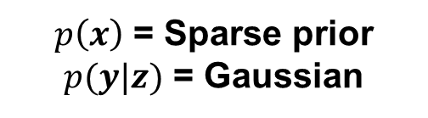
Example: Sparse recovery
$p\left(x\right)$ = Sparse prior
$p(y|z)$ = Gaussian
=
+
Problem: Given A and y, recover sparse x
Many applications
  Communication channels, linear inverse problems
  Wavelet image reconstruction
  Regularized linear regression, classification
  Compressed sensing…
Now many algorithms, theoretical analyses, …

Slide 19










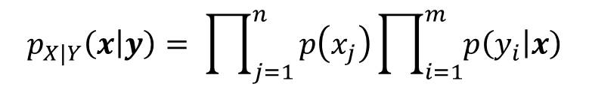
Divide & Conquer with Graphical Models
Subdivide & conquer
Few “smaller” components
  Few variables
  Limited connections
Message passing:
  Iteratively update marginals
  Global estimation local
But random A is dense!
$$p_{X|Y}\left(x | y\right)= \prod_{j=1}^{n}{p\left(x_{j}\right)}\prod_{i=1}^{m}{p\left(y_{i} | x\right)}$$
$$p(x_{1})$$
$$⋯$$
$$p(x_{n})$$
$$x_{1}$$
$$x_{n}$$
$$⋯$$
$$\hat{p} (x_{j}|y)$$
$$⋯$$
$$p(y_{1}|x_{1},..x_{r})$$
$$p(y_{m}|x)$$

Slide 20


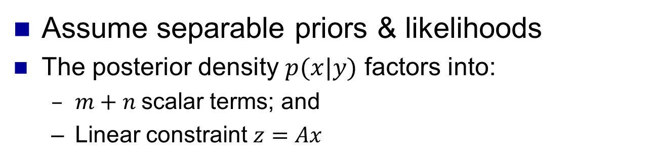







"Graphical Model" for GLM
$$x_{1}$$
$$z_{1}$$
$$p\left(y_{1}|z_{1}\right)$$
$$p\left(x_{1}\right)$$
$$x_{2}$$
$$z_{2}$$
$$p\left(y_{2}|z_{2}\right)$$
$$p\left(x_{2}\right)$$
A
$$z_{m}$$
$$p\left(x_{n}\right)$$
$$x_{n}$$
$$p\left(y_{m}|z_{m}\right)$$
x with indep components
Separable “output”
channel e.g. y = z + w
z=Ax
Assume separable priors & likelihoods
The posterior density $p(x|y)$ factors into:
  $m+n$scalar terms; and
  Linear constraint $z=Ax$

Slide 21

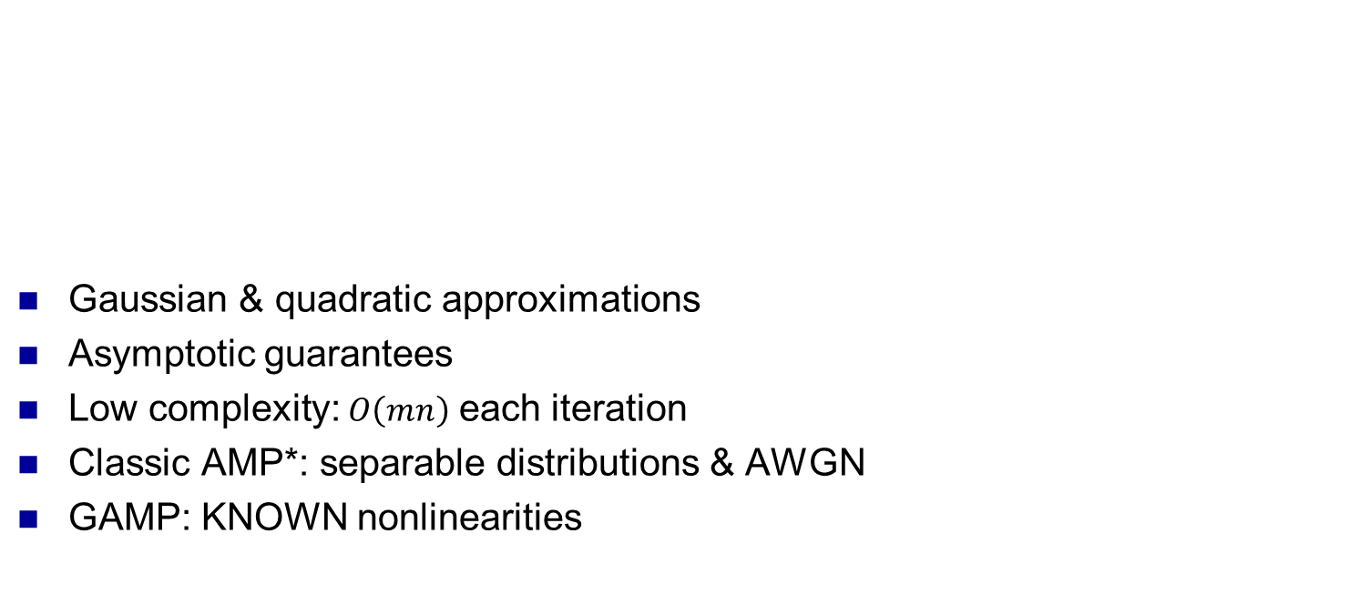





Generalized Approximate Message Passing (GAMP)
$$x$$
$$z$$
$$y$$
$$P_{X}(x)$$
$A$
$$P_{Y|Z}(y|z)$$
Gaussian & quadratic approximations
Asymptotic guarantees
Low complexity: $O\left(mn\right)$ each iteration
Classic AMP*: separable distributions & AWGN
GAMP: KNOWN nonlinearities
Multiplication by $A$
Scalar (separable)
estimation of x
Scalar (separable)
estimation of z
Multiplication by $A^{∗}$
  AMP Donoho, Maleki, Montanari 09, Bayati & Montanari 10,
  GAMP Rangan et al 10, HyGAMP Fletcher et al 11, …

Slide 22

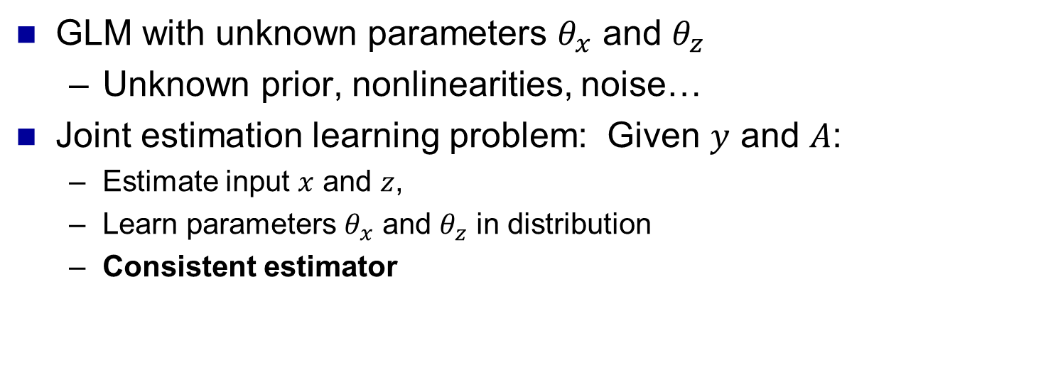








Theorem: Joint Estimation & Learning with Adaptive GAMP
$$θ_{x}$$
$$θ_{z}$$
Observations
Input
$x∈ℝ^{n}$
$z∈ℝ^{m}$
$y∈ℝ^{m}$
$$P_{X}(x|θ_{x})$$
$A$
$$P_{Y|Z}(y|z,θ_{z})$$
i.i.d. prior
Measurement channel
$$m x n$$
GLM with unknown parameters $θ_{x}$ and $θ_{z}$
  Unknown prior, nonlinearities, noise…
Joint estimation learning problem: Given $y$ and $A$:
  Estimate input $x$ and $z$,
  Learn parameters $θ_{x}$ and $θ_{z}$ in distribution
  Consistent estimator
Kamilov, Fletcher, Rangan, Unser NIPS 2012, Trans IT 2014

Slide 23
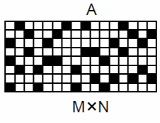
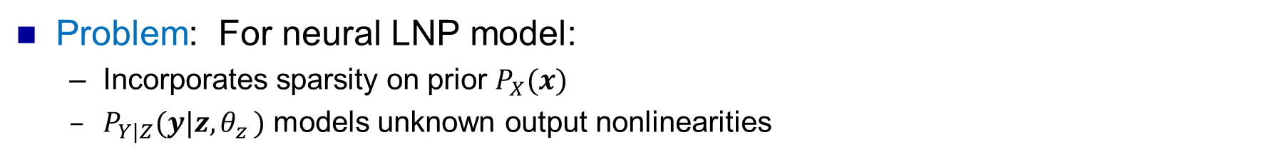
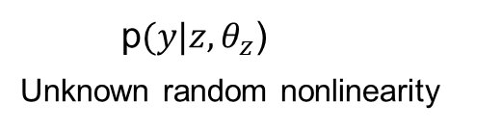
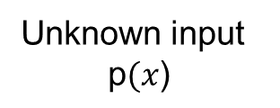
Neural Mapping via Adaptive-GAMP: NeuRAMP
Noise
z
Spikes
Unknown input
$$\text{p}(x\text{) }$$
A
y
p$(y|z,θ_{z}$)
Unknown random nonlinearity
Problem: For neural LNP model:
  Incorporates sparsity on prior $P_{X}(x)$
  $P_{Y|Z}(y|z{,θ}_{z})$ models unknown output nonlinearities
Jointly: Estimate weight vector x
Learn the nonlinearity
Computationally fast
Improved estimates with fewer measurements
Fletcher et al. NIPS (2011)

Slide 24
Simulation: MSE of Synaptic Weight Estimates
100%
RC
CoSAMP
Adapt GAMP
RC: Reverse Correlation
  Linear estimation
  No sparsity
*CoSaMP: Greedy CS
  Ignores nonlinearities
**Adaptive GAMP:
  Lower MSE
  Fewer measurements
10%
Relative squared error
40%
1%
Number of measurements (m)
m = number of trials, random excitation ~40
n = 500,
k =30 or 6% Bernoulli-Gayssuab weights
100 spike windows: 10.4s
Spike rate: 10 spikes/s with.4 second reset
300 trials: ~1 hour
*Hu & Chlovskii NIPS 2010
**Fletcher et al, NIPS 2011

Slide 25
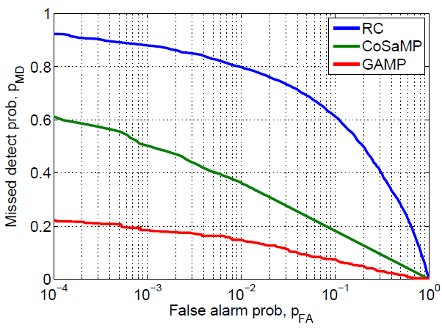
Simulation: NeuRAMP Connectivity Detection
Factors:
  Models nonlinearities
  Optimal learning
  Incorporates sparsity
  Similar complexity
GAMP outperforms RC & CoSaMP
  75% and 50% lower missed detects
Missed detection rate
50% reduction
False alarm rate
“Simultaneous all optical manipulation and recording…”, AM Packer, Dec 2014 Nature
**“Block sparse” filters: Salamander visual receptive field

Slide 26
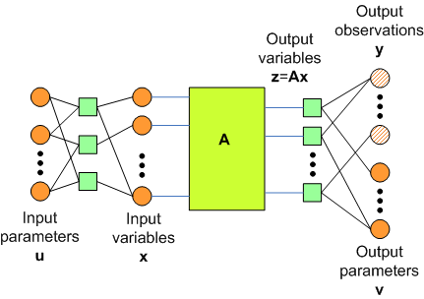
Moving forward: Scalable adaptive block
Generalized Approximate Message Passing (GAMP)
Improved neural connectivity detection
  Data limited
  Unknown nonlinearities, sparsity levels
Scalable adaptive GAMP block
  Linear mixing blocks
  Low complexity: scalable
  Extensible
  Rich input output models
  Adaptive

Slide 27
Outline
Connectivity via multineuronal stimulation
  Iterative fast adaptive GAMP framework
Network connectivity via Ca²⁺ imaging
  Large scale in vivo layers
  Remarkable spatial resolution
  Indirect, temporally smoothed
  Network model - captures dynamics
  Scalable accurate EM algorithm
Receptive field of retinal ganglion cells
  Space-time salamander response to stimuli
  Improved identification with limited data

Slide 28


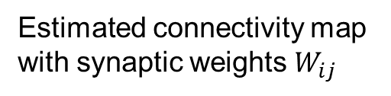

Inference of Network Connectivity
Neuron $i$
Neuron $j$
$$W_{ij}$$
Estimated connectivity map with synaptic weights $W_{ij}$
Network of neurons:
unknown synaptic connectivity

Slide 29
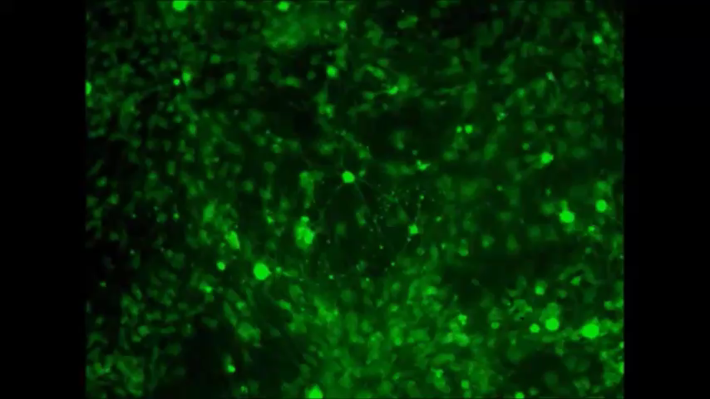
New Technologies: Calcium Imaging
Fluorescent Ca²⁺ indicators
  Genetically encoded
  Chemical dyes
Spiking: Ca²⁺ influx
Large populations in parallel
Mei Zhang 2009

Slide 30
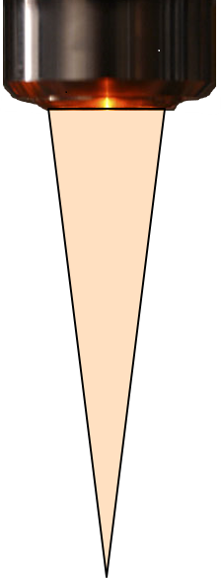

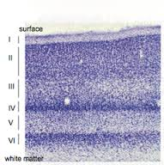
Two photon Ca²⁺ imaging: depth acquisition
Fluorescence & spiking:
  Ca²⁺ influx
Two-photon imaging
  Raster scan
  Depth acquisition
Spatial resolution
  Image into the cortex
Short pulses
Fluoresce:
Neuron is firing
and two photons

Slide 31
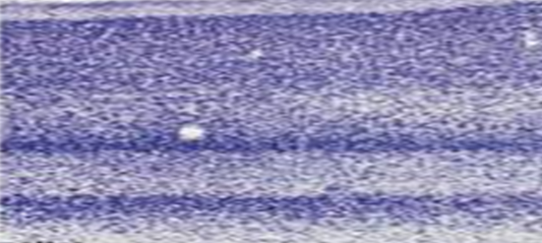
Two photon Ca²⁺ imaging: depth acquisition
Fluorescence & spiking:
  Ca²⁺ influx
Two-photon imaging
  Raster scan
  Depth acquisition
Spatial resolution
  Image into the cortex
Refocus depth
Cortical layers
Cortex ~ 2-4 mm

Slide 32
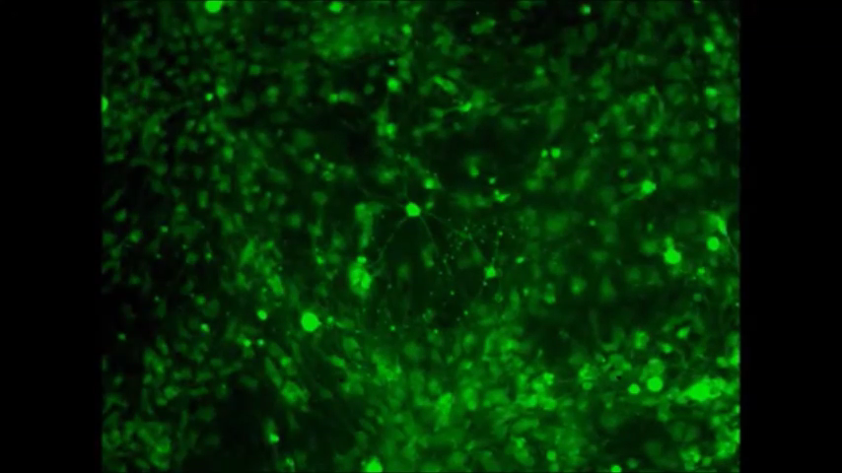

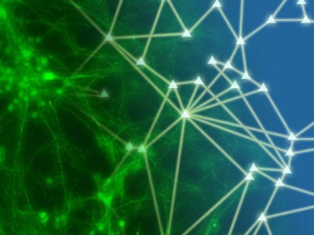
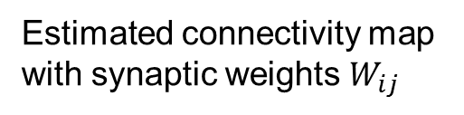
Calcium Imaging: Connectivity Detection Problem
Network of neurons:
unknown synaptic connectivity
Ca²⁺ fluorescence movie
Neuron $i$
$$W_{ij}$$
Neuron $j$
Estimated connectivity map with synaptic weights $W_{ij}$
Ca²⁺ fluorescence image MPI 2012

Slide 33
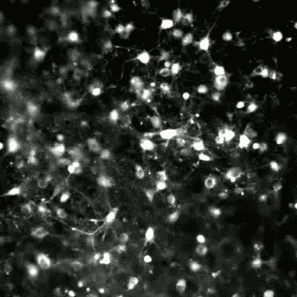
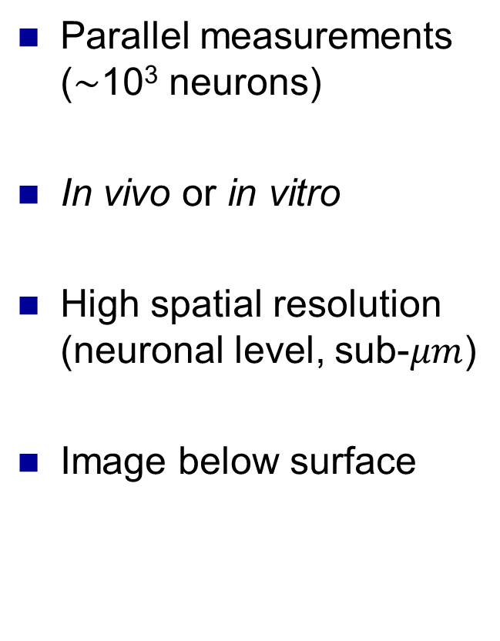
Ca²⁺ Imaging: Strengths
Parallel measurements
($\sim$10³ neurons)
In vivo or in vitro
High spatial resolution
(neuronal level, sub-$μm$)
Image below surface
M. Kuykendal and G. Guvanasen, Georgia Tech

Slide 34
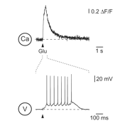
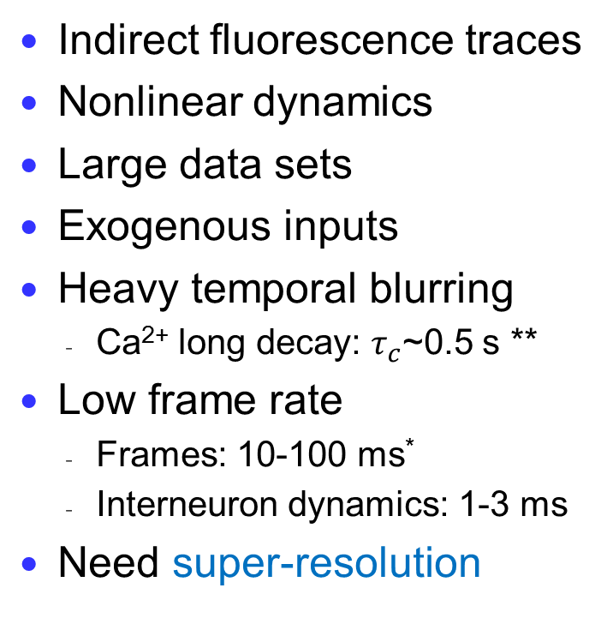
Challenges with Ca²⁺ Imaging
Calcium Fluorescence
Indirect fluorescence traces
Nonlinear dynamics
Large data sets
Exogenous inputs
Heavy temporal blurring
  Ca²⁺ long decay: $τ_{c}$~0.5 s **
Low frame rate
  Frames: 10-100 ms*
  Interneuron dynamics: 1-3 ms
  Need super-resolution
[Stociek et al. (2003)]
Glutamate induced spiking
**GCaMP5, newer indicators faster
NIPS 2013 & NIPS 2015 workshops:
"Statistical Methods For Understanding Neural Systems"

Slide 35
Network Inference: Causality Crucial
Neuron $i$
Neuron $j$
$$W_{ij}$$
Estimated connectivity map with synaptic weights $W_{ij}$
Network of neurons:
unknown synaptic connectivity
Elements of the network : time-varying electrochemical devices

Slide 36
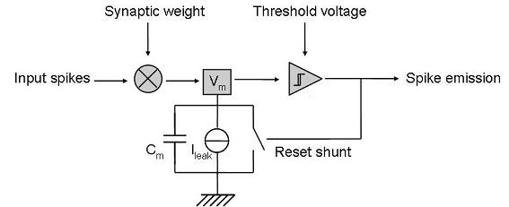
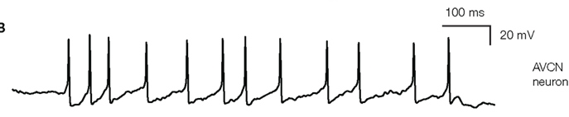
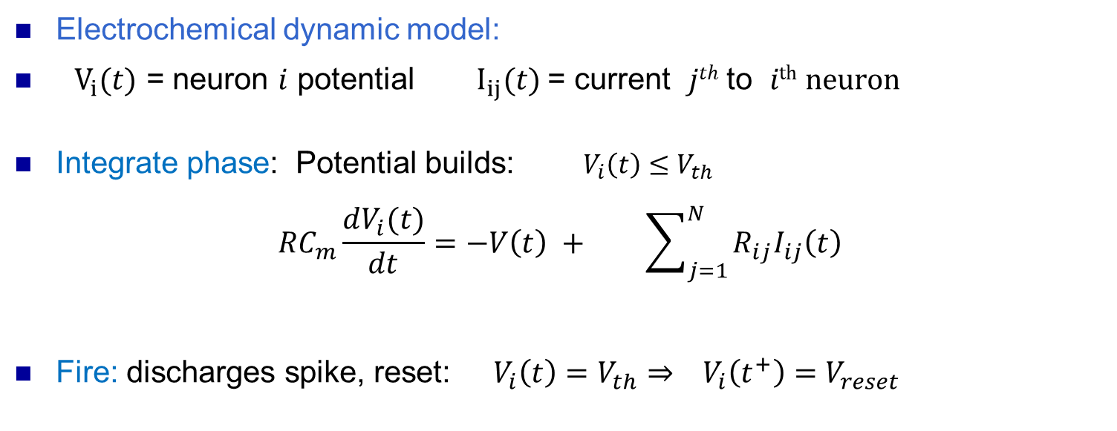
Neuronal Model: Integrate and Fire
Synaptic weight
Membrane voltage
Spike emission
Input spike currents
Threshold
Reset
Electrochemical dynamic model:
$V_{i}(t)$ = neuron $i$ potential${ I}_{ij}(t)$ = current $jth$ to $ith neuron$
Integrate phase: Potential builds: $V_{i}\left(t\right)≤V_{th}$
$${RC}_{m}\frac{dV_{i}(t)}{dt}=−V\left(t\right) + \sum_{j=1}^{N}{R_{ij}I_{ij}\left(t\right)}$$
Fire: discharges spike, reset: $V_{i}\left(t\right)=V_{th}⇒ V_{i}\left(t^{+}\right)=V_{reset}$
Charge increase
leakage
Incoming current
[Lapicque (1907)]

Slide 37
Calcium Imaging: Connectivity Detection Problem
Network of neurons:
unknown synaptic connectivity
Ca²⁺ fluorescence movie
Neuron $i$
$$W_{ij}$$
Neuron $j$
Estimated connectivity map with synaptic weights $W_{ij}$
Ca²⁺ fluorescence image MPI 2012

Slide 38
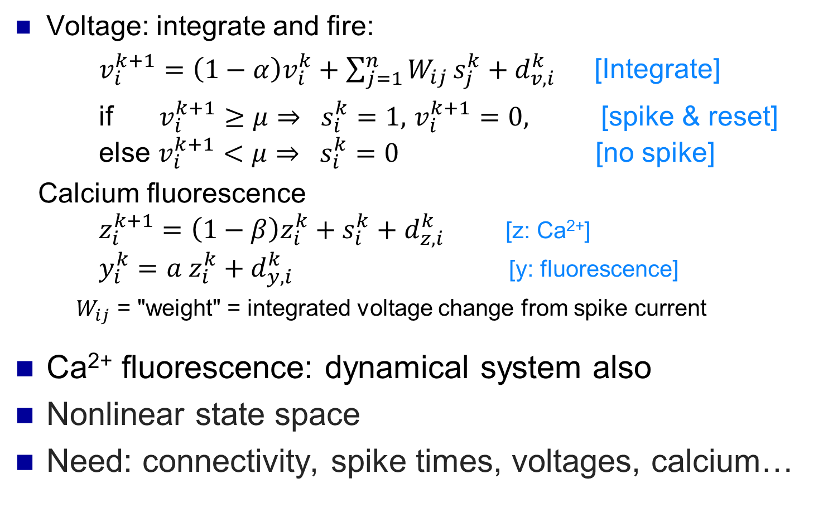
Each Neuron: Discrete-Time Neural Model
Voltage: integrate and fire:
  $v_{i}^{k+1}=\left(1−α\right)v_{i}^{k}+\sum_{j=1}^{n}{W_{ij }s_{j}^{k}+d_{v,i}^{k}}$ [Integrate]
  if $v_{i}^{k+1}≥μ⇒ s_{i}^{k}=1,$ $v_{i}^{k+1}=0,$ [spike & reset]
  else $v_{i}^{k+1}<μ⇒ s_{i}^{k}=0$ [no spike]
Calcium fluorescence
$z_{i}^{k+1}=\left(1−β\right)z_{i}^{k}+s_{i}^{k}+d_{z,i}^{k}$ [z: Ca²⁺]
$y_{i}^{k}=a z_{i}^{k}+d_{y,i}^{k}$ [y: fluorescence]
  $W_{ij}$ = "weight" = integrated voltage change from spike current
  Ca²⁺ fluorescence: dynamical system also
  Nonlinear state space
  Need: connectivity, spike times, voltages, calcium…
Mischenko, Vogelstein, Paninski (2010), Yasuda(2004), Vogelstein et al (2010), Fletcher et al, COSYNE 2014, NIPS 2014

Slide 39
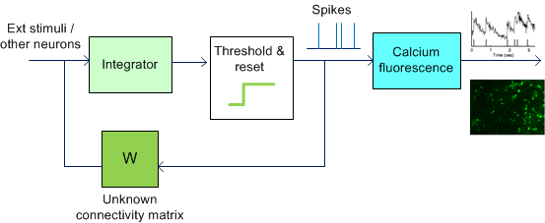
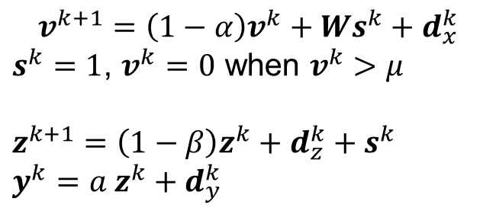
Summary: System
Input:
stimuli & neurons
$$v^{k+1}=\left(1−α\right)v^{k}+Ws^{k}+d_{x}^{k}$$
$s^{k}=1$, $v^{k}=0$ when $v^{k}>μ$
$z^{k+1}=\left(1−β\right)z^{k}+d_{z}^{k}+s^{k}$
$y^{k}={a z}^{k}+d_{y}^{k}$
Membrane voltage integration
Spike and reset
Bound Ca²⁺ concentration
Fluorescence

Slide 40


Maximum Likelihood Estimation of Connectivity
ML estimate:
$\hat{W}=\arg{\max_{W}{\log{p\left(y | W\right)}}}$
  Can add regularization term to impose sparsity
But….there are hidden states $x=\left\{s^{k},v^{k},z^{k}\right\}$
$$\hat{W}=\arg{\max_{W}{\log{E_{x}\left[p\left(y,x | W\right)\right]}}}$$
Computationally complex: high-dimensional integral
$$−λ{\left\|W\right\|}_{1}$$
Observations
Desired parameters
e.g. connectivity matrix
Fletcher et al COSYNE ’14

Slide 41







Expectation Maximization Algorithm
$$v^{k+1}=\left(1−α\right)v^{k}+Ws^{k}+d_{x}^{k}$$
$s^{k}=1$, $v^{k}=0$ when $v^{k}>μ$
$z^{k+1}=\left(1−β\right)z^{k}+d_{z}^{k}+s^{k}$
$y^{k}=az^{k}+d_{y}^{k}$
Want regularized ML:
$\hat{W}=\arg{\max_{W}{\log{p\left(y | W\right)−λ{\left\|W\right\|}_{1}}}}$
Problem: Hidden states $(v^{k},z^{k},s^{k})$
Use EM iterations
$$v^{k+1}=\left(1−α\right)v^{k}+Ws^{k}+d_{x}^{k}$$
$s^{k}=1$, $v^{k}=0$ when $v^{k}>μ$
$z^{k+1}=\left(1−β\right)z^{k}+d_{z}^{k}+s^{k}$
$y^{k}={az}^{k}+d_{y}^{k}$
$$v^{k+1}=\left(1−α\right)v^{k}+Ws^{k}+d_{x}^{k}$$
$s^{k}=1$, $v^{k}=0$ when $v^{k}>μ$
$z^{k+1}=\left(1−β\right)z^{k}+d_{z}^{k}+s^{k}$
$y^{k}={az}^{k}+d_{y}^{k}$
Distribution of hidden states $(v^{k},z^{k},s^{k})$
E step
Estimate distribution of hidden states given parameters
M step
Update parameter estimate
given density on hidden states:
Exact computation hard
High-dim integral or Gibbs sampling
[Mischenko et al., 2010]
Easy for Ca²⁺ Imaging problem
$W$ is linear in likelihood
LASSO problem
Parameter
estimate $W$

Slide 42







Decoupling for the E-Step
Want: State estimates for nonlinear system
  High dimensional : N Neurons, 3N states
Key insight: System decouples: scalar iterations
$$q^{k}=Ws^{k}$$
Ca²⁺ concentration
Summed
currents
${ q}_{i}^{k}$
Integrate and fire
spikes ${ s}_{i}^{k}$
${ z}_{i}^{k}$
Fluorescence
$y_{i}^{k}$
W
Connectivity matrix
$$q^{k}=Ws^{k}$$

Slide 43




Decoupling for the E-Step
N scalar 1-dim systems
N scalar 1-dim systems
$v_{i}^{k+1}=\left\{\begin{matrix}(1−α)v_{i}^{k}+q_{i}^{k} & v_{i}^{k}≤μ \\ 0 & v_{i}^{k}>μ\end{matrix}\right.$
$s_{i}^{k}=1$ when $v_{i}^{k}≥μ$
$$z_{i}^{k+1}=\left(1−β\right)z_{i}^{k}+s_{i}^{k}$$
  $$y_{i}^{k}=az_{i}^{k}+d_{i}^{k}$$
Ca²⁺ concentration
Integrate and fire
spikes ${ s}_{i}^{k}$
${ z}_{i}^{k}$
Summed
currents
$q_{i}^{k}$
Fluorescence levels $y_{i}^{k}$
W
$$q^{k}=Ws^{k}$$
Memoryless linear constraints
Approximate Message Passing
Connectivity matrix

Slide 44
Decoupling for the E-Step
N scalar Forward Backward
N scalar Forward Backward
$v_{i}^{k+1}=\left\{\begin{matrix}(1−α)v_{i}^{k}+q_{i}^{k} & v_{i}^{k}≤μ \\ 0 & v_{i}^{k}>μ\end{matrix}\right.$
$s_{i}^{k}=1$ when $v_{i}^{k}≥μ$
$$z_{i}^{k+1}=\left(1−β\right)z_{i}^{k}+s_{i}^{k}$$
  $$y_{i}^{k}=az_{i}^{k}+d_{i}^{k}$$
Ca²⁺ concentration
Integrate and fire
spikes ${ s}_{i}^{k}$
${ z}_{i}^{k}$
Summed
currents
$q_{i}^{k}$
Fluorescence levels $y_{i}^{k}$
W
$$q^{k}=Ws^{k}$$
Memoryless linear constraints
Approximate Message Passing
Connectivity matrix

Slide 45



EM Overview
Fluorescence movie: estimate
  Connectivity matrix $W,$ spike times, voltages
Scalable block
  High-dimensional, nonlinear dynamical system
E step
voltages
spikes
Ca level
$$j$$
Neuron $i$
$$W_{ij}$$
E step: Linear Mixing AMP block
Connectivity matrix
M step

Slide 46


Simulation Results: Accuracy of the Weights
Accurate estimation
  Neuron model [Sayer (1990)]
  100 guinea pig cortical neurons
  Synchronized bursting: 10 spikes/s
  10% sparse random connectivity
  20 ms integrate-fire $τ_{c}$
  2 ms inter-neuron conduction time
  1 ms time step
Ca²⁺ imaging model
  100 frames/s, 100 s trials
  10000 Fl values per neuron
  500 ms Ca²⁺ $τ_{c}$
  Fluorescence SNR = 20 dB
Estimated weight
True weight
Fletcher et al NIPS ‘14

Slide 47




Accuracy of the Weights
Fast convergence
  Neuron model [Sayer (1990)]
  Guinea pig cortical column
  100 neurons
  10% sparse random connectivity
  Synchronized bursting: 10 spikes/s
  20 ms integrate-fire $τ_{c}$
  2 ms inter-neuron conduction
  1 ms time step
Data Collection
  100 frames/s, 100 s trials
  10000 Fl samples per neuron
  Ca²⁺ $τ_{c}$ = 500 ms, Fl SNR = 20 dB
previous method
Mean relative error
Iteration number
Relative MSE = $\frac{E{\left(W_{ij}−{\hat{W}}_{ij}\right)}^{2}}{E{\left(W_{ij}\right)}^{2}}$ = 0.12
Previous work MSE=0.28, same parameters Mischenko et al. (2010)
Accurate, low complexity $O(N)$ per iteration, instead of $O(∗^{N})$
Fletcher et al NIPS ‘14

Slide 48
Network Connectivity Summary
Network analysis from Ca²⁺ imaging
  Attack temporal resolution issues for neural dynamics
  Scalable EM algorithm
Rich, flexible modeling framework
  Incorporates nonlinearities, indirect measurements, dynamics
Computationally scalable solution
  Linear in number of measurements
Demonstrated performance
  Outperforms existing techniques
  Allows more biologically plausible model with feedback
http://gampmatlab.sourceforge.net/
Phil Schniter!!!

Slide 49
Outline
Connectivity via multineuronal stimulation
  Iterative fast adaptive GAMP framework
Network connectivity via Ca²⁺ imaging
  Network model - captures dynamics
  Graphical models
  Scalable accurate based algorithm
Receptive field of retinal ganglion cells
  Space-time salamander response to stimuli
  Improved identification with limited data

Slide 50


Receptive Field Identification
Spikes
Retinal ganglion cell (RGC)
Sensitive to light in its field of view,
or receptive field
Tuned to some local features
in time and space (curve, edge, etc)
Response estimation of RGCs:
  Expose retina to image
  Measure response via electrode
  Fit model
Challenge: Model is often nonlinear
Electrode
RGC cell

Slide 51

Salamander Receptive Field Identification
Spikes
Electrode
RGC cell
Visual stimuli

Slide 52










Retinal Ganglion Cell LNP Model
Time $k$
$$h_{1}[k]$$
Nonlinearity
+ noise
$$u_{1}[k]$$
$${α_{1}(h}_{1}\left[k\right]∗u_{1}[k])$$
$$z\left[k\right]$$
$y\left[k\right]$
+
$λ\left[k\right]$
$${α_{n}(h}_{n}\left[k\right]∗u_{n}[k])$$
Poisson spike process
Spike count
$$u_{n}[k]$$
Weighted sum over pixels
Stimuli
( $n$ pixel movie)
$$h_{n}[k]$$
Temporal filtering
Linear-Nonlinear Poisson model. Given stimuli $u_{i}[k]$
  Filtering over time and space: $z\left[k\right]=\sum_{i=1}^{n}{{α_{i}(h}_{i}\left[k\right]∗u_{i}[k])}$
  Nonlinear phase: $y\left[k\right]=Poisson\left(f\left(z\left[k\right]+d\left[k\right]\right)\right)$
Identification problem: Given stimuli $u_{i}[k]$ and spike counts $y\left[k\right]$
  Estimate weighted filters $w_{i}\left[k\right]=α_{i}h_{i}\left[k\right],$
  Describes space-time response of neuron to pixel $i$
  Each $h_{i}[k]$ is an $L$ tap filter
  Estimate nonlinearity $f(⋅)$
Fletcher et al. NIPS 2012

Slide 53










Structured Matrix View of Dynamic LNP
$$A$$
$$w$$
Poisson( $f\left(\text{z}\right)$)
$L$ taps / pixel
$$⋮$$
Spike
counts
$T$
time bins
$$⋮$$
$$⋮$$
Nonlinearity
& Poisson
Stimulation matrix
$$z$$
$$y$$
LNP model: cascade of linear and nonlinear system
  A rows: $n$ pixel values at $L$ delays ($L$= filter taps)
Weights have a group sparse constraint:
  RGC sensitive to small image region (spatial sparsity)
  Coefficients of filter of one stimuli are on or off together

Slide 54

Classical Methods and their Limitations
Linear methods:
  Matched filter: $\hat{w}=\frac{1}{n}A^{T}y$ (also called STA)
  Linear MMSE: $\hat{w}={\left(A^{T}A+σ^{2}I\right)}^{−1}A^{T}y$ (also called RC)
  Also, linear least squares / zero forcing
  Simple but does not exploit sparsity
Compressed sensing methods
$\hat{w}=\arg{\min_{w}{{\left\|y−Aw\right\|}_{2}^{2}+λ{\left\|w\right\|}_{1}}}$
  Exploit sparsity of w
  Many methods: LASSO, OMP, CoSAMP,…
  Could also incorporate group sparsity via group Lasso
  But, does not account for output nonlinearities

Slide 55




Hybrid Algorithm for Structured Input: GAMP
$${p(w}_{iℓ}|ξ_{i})$$
$$w_{iℓ}$$
$$z=Aw$$
Standard loopy BP messages
Use GAMP messages
Introduce binary variables ξ_{j} to correlate sparsity over time
Apply GAMP in a “turbo” manner with loopy BP
Low complexity: each ξ_{j} is binary
More general than group OMP and group lasso;
  Similar complexity,
  Better performance [Rangan, Fletcher, Goyal & Schniter ‘12]

Slide 56
Receptive Field Computation Considerations
Problem size: 3630 variables
  11 x 11 pixels, 30 taps per pixel
  190,000 measurements (~30 min at 10 ms sampling)
  Structured A matrix is 190,000 by 3630
AGAMP iteration cost: multiplying by A & A*
  Exploit block Toeplitz structure and entries are 0-1
For larger problems, algorithm is parallelizable
  Graphical methods: inherent decomposable
  Parallelize multiplications across rows/columns of A
Cannot theoretically guarantee convergence
  Demonstrate performance experimentally

Slide 57

Experimental Results: Cross-Validation
STA
GAMP
Num training samples | Cross-validation score
 | STA | G-AMP
25000 | 0.906 | 0.917
50000 | 0.914 | 0.921
100000 | 0.918 | 0.923
Validated on data used in training (190000 total samples)
Cross-validation score = Geometric mean of likelihood of spike rate
GAMP: same error, 25000 samples versus 100,000
Data: Anthony Leonardo
Janelia Farm

Slide 58


Salamander Retinal Response (Spatial)
Spatial receptive field:
Plot estimated 11x11 response magnitudes.
  Color = 30-tap filter magnitude for each pixel
Standard STA estimate shows noisy (spurious) responses outside
GAMP method removes noise
Shows only a response in a small area
Spatial receptive field estimates for 11x11 pixel area
0
1
Filter response 11 x 11 pixels for salamander RGCs
Data from Anthony Leonardo, Janelia Farm
(normalized)

Slide 59
AMP++ methods: Applications in Imaging
Hybrid-AMP can incorporate complex structure
  Incorporate dependencies between wavelet coefficients
  Hierarchical models, etc
http://gampmatlab.sourceforge.net/
Algorithm | NMSE (dB) | Comp time (secs)
MHT+IRWL1 | -14.37 | 363
CoSAMP | -16.90 | 25
SPLG1 | -18.06 | 536
MCMC | -20.10 | 742
Turbo-GM | -20.74 | 51
Lowest MSE and almost fastest computation
[Som, Schniter, 2011]

Slide 60































Thank you
Much thanks! To: Fritz Somer, Surya Ganguli, Eero Simoncelli, Eftychios Pnevmatikakis,Matthias Bethge, Anthony Leonardo, Evan Lyall, students of Deisseroth & Adesnik labs, Liam Paninski, Mayur Mudigonda, Jascha Sohl-Dickstein…
Funding: NSF CAREER,ONR, AFOSR, Qualcomm

Slide 61
Moving forward
Better account for exogenous effects
  Correlations across neurons of interest**
  Larger areas via “shotgun” techniques [Pnevmatikakis et al. 2013]
Data sets in collaboration
  Paninski Lab, Columbia; Tolias Lab, Baylor, Allen Institute
  Validate methods: first cultured without exogenous
Model new Ca²⁺ indicators:
  GCaMP6f (2013): faster decay, rise time = 50-75 ms, ….
  Nonlinear fluorescence model
Theory
  Convergence issues of GAMP via new ADMM GAMP
  Networks of low-dimensional, nonlinear dynamical blocks
  Provable results for structured non-iid, structured A

Slide 62


Future work : dynamical networks
High dimensional inference for dynamical systems
Generalized linear dynamical networks:
  Underlying low-dimensional, nonlinear dynamical blocks
  Linear memoryless constraints, graphical models
Many phenomena
  Neural systems, communication networks, particles, media, …
  Extends GLM to include networked dynamics
Can we extend methods for:
  Scalable estimation algorithms?
  Learning connectivity?
  Provable guarantees?
$$W_{ij}$$
$$x_{i}^{k+1}=f_{i}(x_{i}^{k},u_{i}^{k})$$

Slide 63

Joint Estimation and Learning for GLMS
$$θ_{x}$$
$$θ_{z}$$
Observations
Input
$x∈ℝ^{n}$
$z∈ℝ^{m}$
$y∈ℝ^{m}$
$$P_{X}(x|θ_{x})$$
$A$
$$P_{Y|Z}(y|z,θ_{z})$$
i.i.d. prior
Measurement channel
$$m x n$$
GLM with unknown parameters $θ_{x}$ and $θ_{z}$
  Unknown prior, nonlinearities, noise…
Joint estimation learning problem: Given $y$ and $A$:
  Estimate input $x$ and $z$,
  Learn parameters $θ_{x}$ and $θ_{z}$ in distribution
  Consistent
Fletcher, Rangan NeuRAMP NIPS 2011
Kamilov, Fletcher, et al NIPS 2012, Trans IT 2014

Slide 64
Future work : broader
High dimensional inference for dynamical systems
Generalized linear dynamical detworks:
  Underlying low-dimensional, nonlinear dynamical blocks
  Linear memoryless constraints, graphical models
Many phenomena
  Neural systems, communication networks, particles, media, …
  Extends GLM to include networked dynamics
Can we extend methods for:
  Scalable estimation algorithms?
  Learning connectivity?
  Provable guarantees?
$$W_{ij}$$
$$x_{i}^{k+1}=f_{i}(x_{i}^{k},u_{i}^{k})$$

