Slide 1
Scene Understanding in the Era of Deep Learning
Jitendra Malik
UC Berkeley & Google

Slide 2
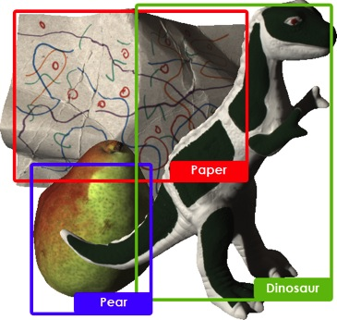

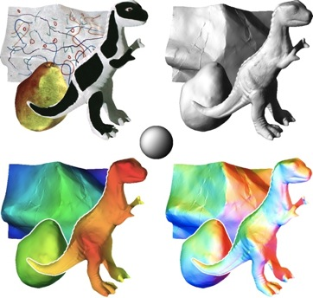
Recognition, Reconstruction & Reorganization
Recognition
Reorganization
Reconstruction

Slide 3
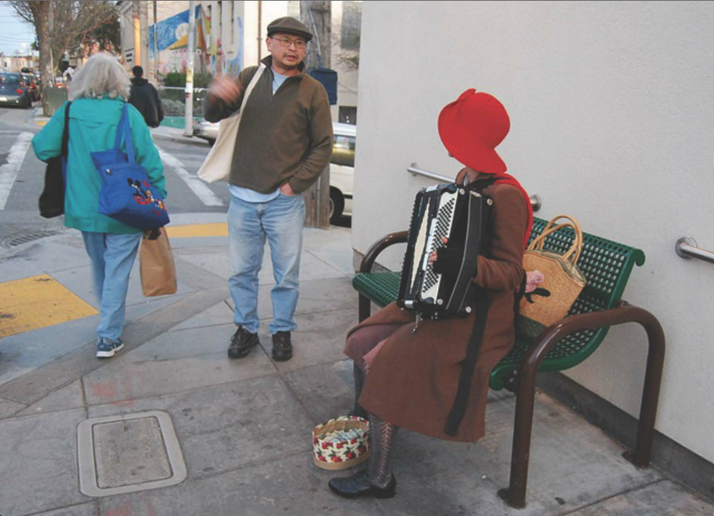

Slide 4
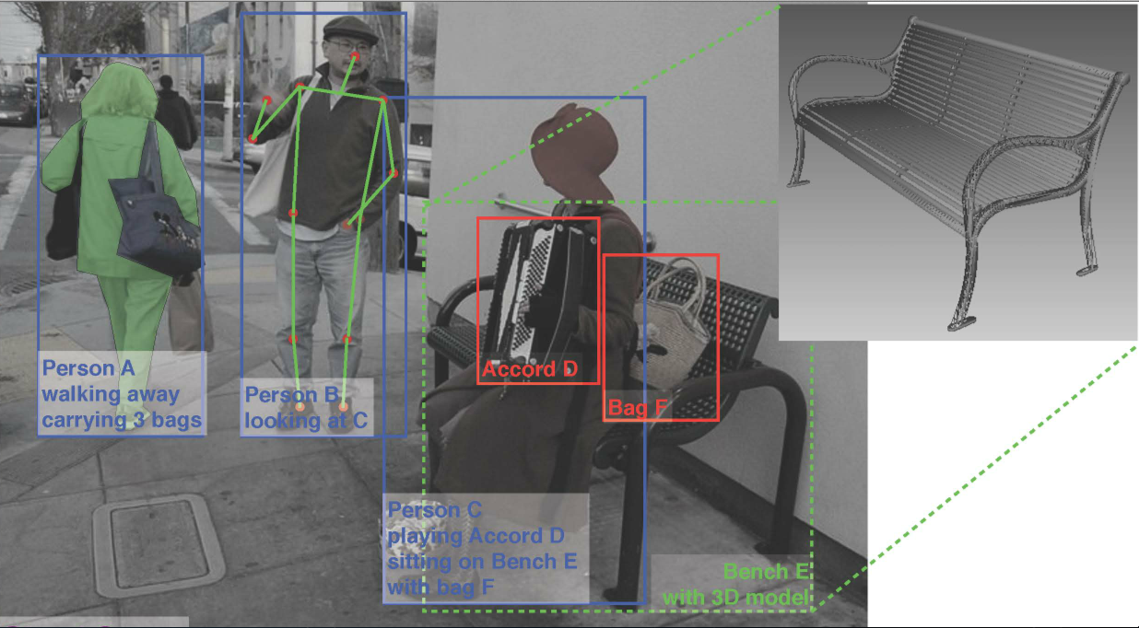
What we would like to infer…
Will person B put some money into Person C’s tip bag?

Slide 5
Features in Computer Vision
Edges and Corners (1963 – 1993)
Linear Filters (1990-2003)
Orientation Histograms (1999-2013)
Multilayer networks (2012-continuing)

Slide 6
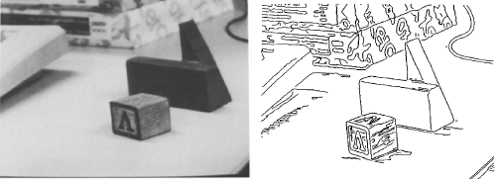
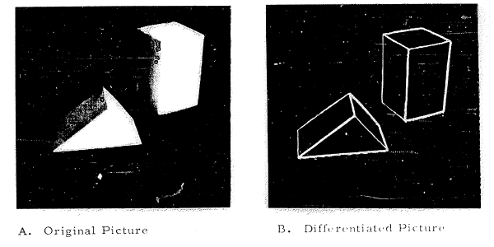
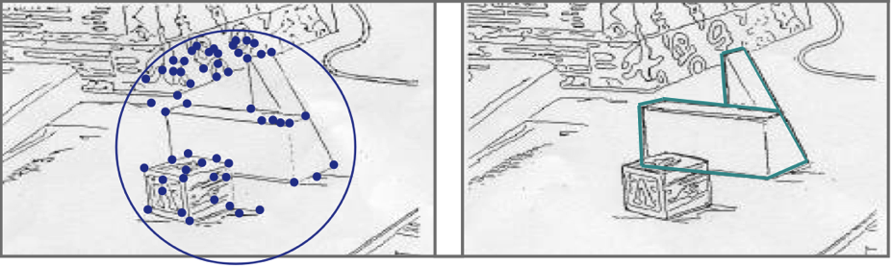
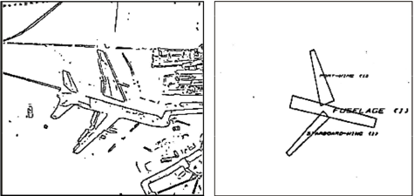
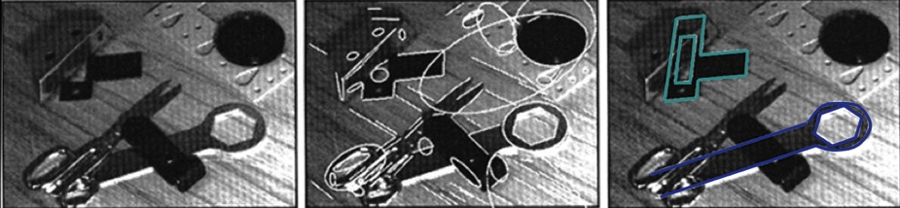
Edges & Corners
Roberts (1963)
Brooks & Binford (1981)
Huttenlocher & Ullman (1990)
Rothwell, Zisserman, Forsyth & Mundy (1995)

Slide 7
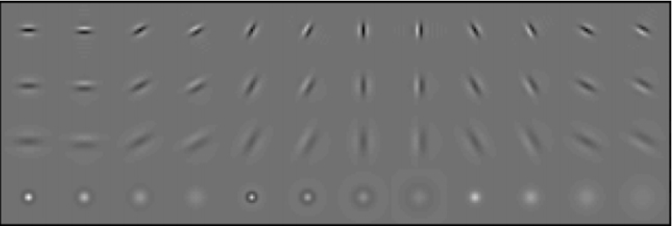
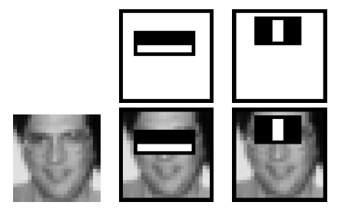
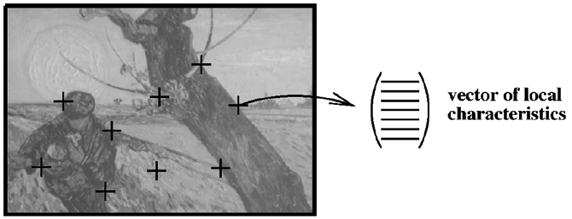
Linear Filters
Malik & Perona (1990), Leung & Malik (1999) for texture analysis
Schmid & Mohr (1997)
for image retrieval
Viola & Jones (2001) for face detection

Slide 8
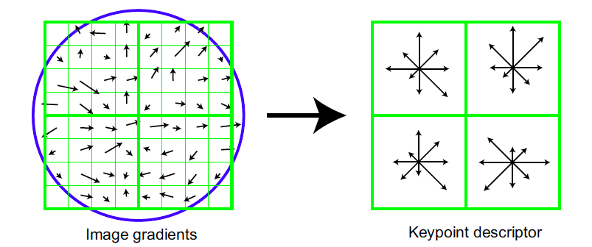

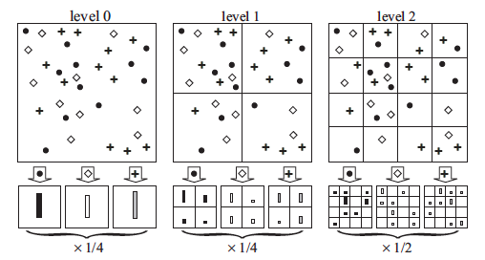
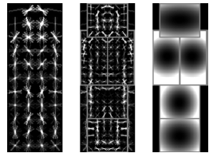
Histograms everywhere
Shape Contexts,
Belongie, Malik & Puzicha(2001)
SIFT, Lowe (1999)
Spatial Pyramid Matching,
Lazebnik, Schmid & Ponce (2006)
DPM based on HOG,
Felzenswalb et al (2010)

Slide 9
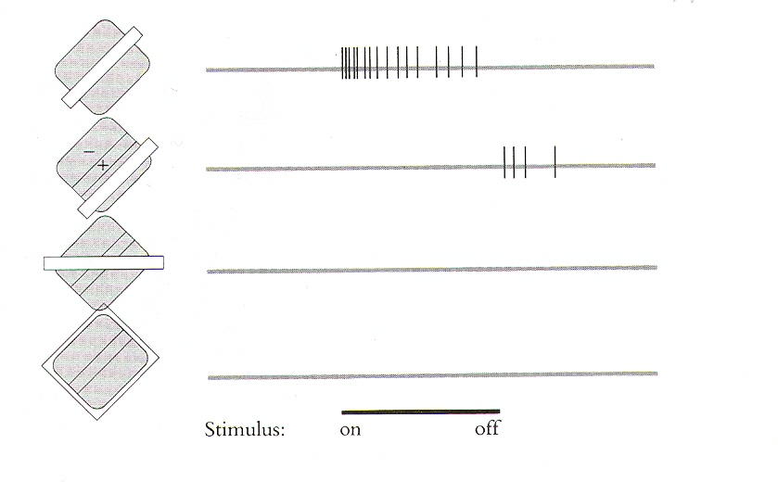
Hubel and Wiesel (1962) discovered orientation sensitive neurons in V1

Slide 10

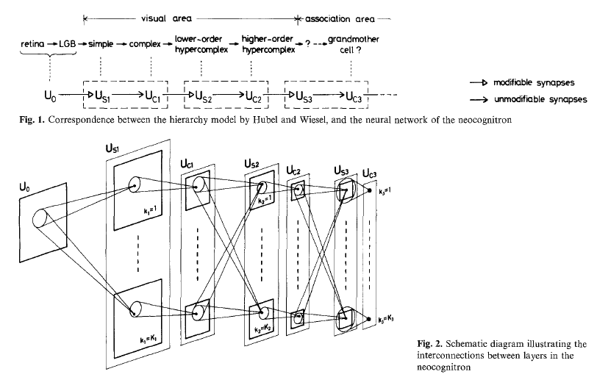

Slide 11
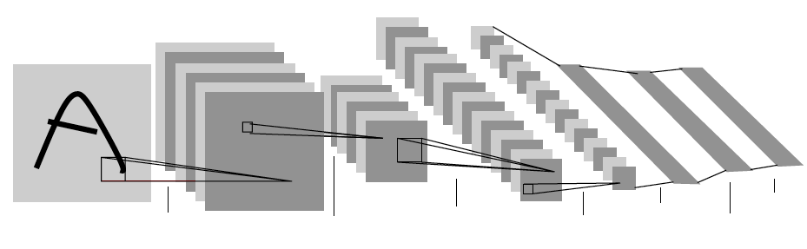
Convolutional Neural Networks (LeCun et al )
Used backpropagation to train the weights in this architecture
First demonstrated by LeCun et al for handwritten digit recognition(1989)
Krizhevsky, Sutskever & Hinton showed effectiveness for full image classification on ImageNet Challenge (2012)
Girshick, Donahue, Darrell & Malik (CVPR 2014) showed that these features were also effective for object detection
And many others…
The battle between SIFT/HOG style features vs. convolutional net based features for recognition is over. CNNs have won.

Slide 12
Facts about the Visual World
The world consists of rigid, or piecewise rigid, objects
Object surfaces have piecewise constant color and texture
Objects in a category share parts
Projection from the 3D world to 2D image is uniquely defined
Objects are opaque & nearer objects occlude farther objects.
Objects occur at varying distances and locations in the image
Objects occur in context, stereotypical relations to each other
Actions are performed by agents with goals and intentions
….
We can incorporate these into the design of visual
processing architectures. Parameters should be learnt.

Slide 13
The Three R’s of Vision
Recognition
Reconstruction
Reorganization
Each of the 6 directed arcs in this diagram is a useful direction of information flow

Slide 14
The Three R’s of Vision
Recognition
Superpixel assemblies as candidates
Reconstruction
Reorganization

Slide 15
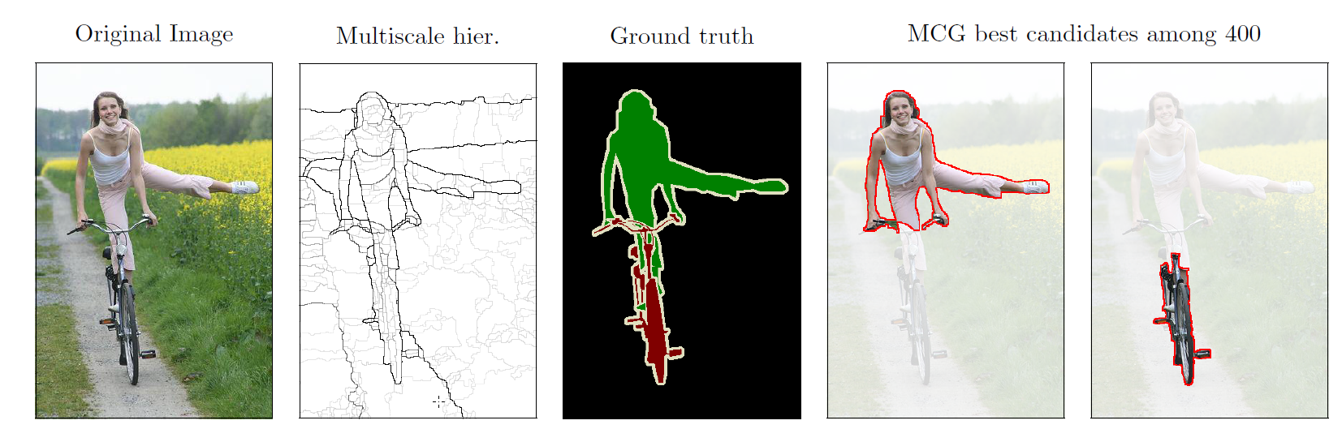
Bottom-up grouping as input to recognition
We produce superpixels of coherent color and texture first,
then combine neighboring ones to generate object candidates

Slide 16
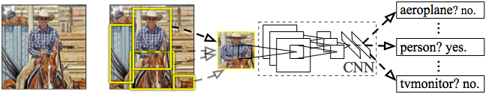
R-CNN: Regions with CNN features
Girshick, Donahue, Darrell & Malik (CVPR 2014)
Input
image
Extract region
proposals (~2k / image)
Compute CNN
features
Classify regions
(linear SVM)
CNN features are inspired by the
architecture of the visual system

Slide 17
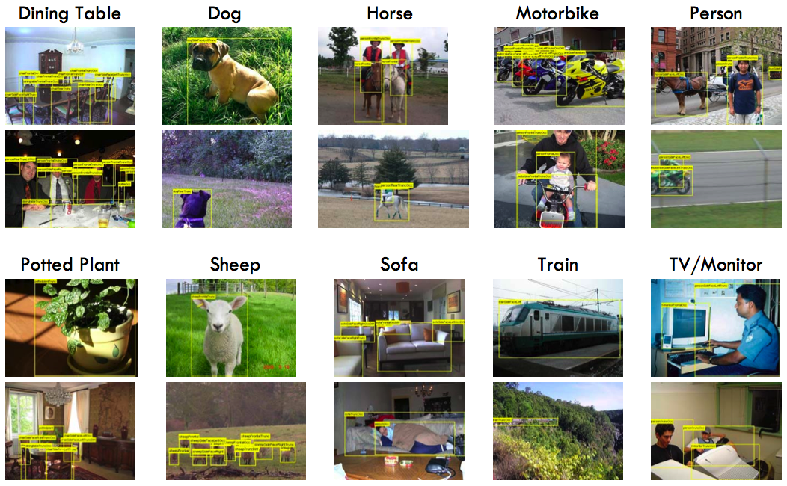
PASCAL Visual Object Challenge
(Everingham et al)

Slide 18
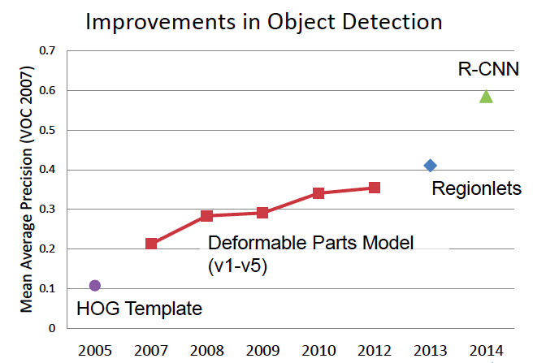
State of the Art in Recognition
(Slide from D. Hoiem)

Slide 19
How about the other direction…
Recognition
Reconstruction
Reorganization

Slide 20
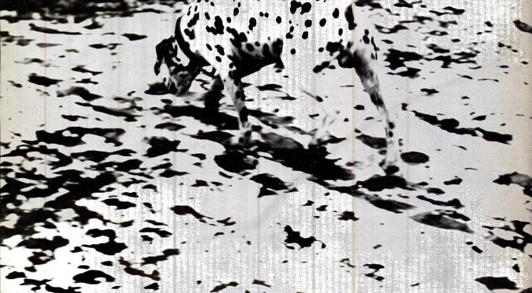
Recognition Helps Reorganization

Slide 21
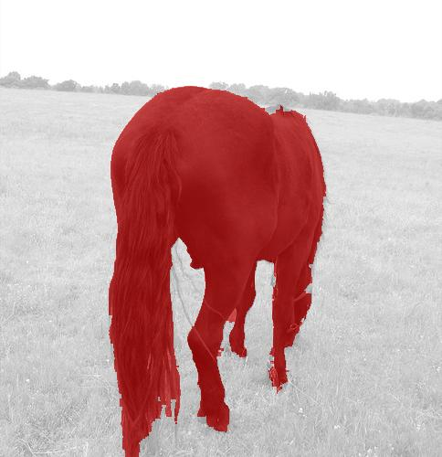
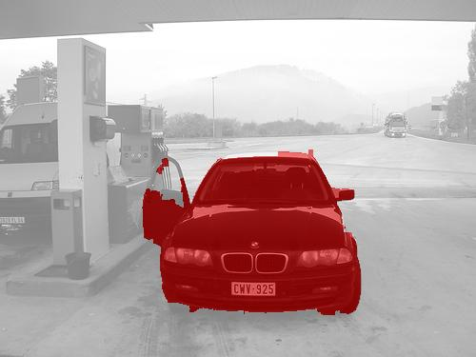
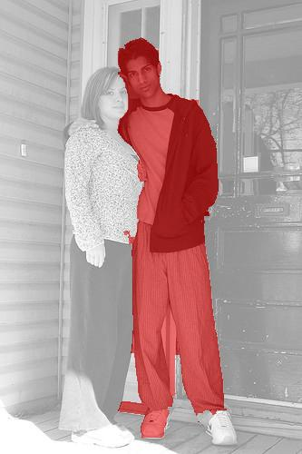
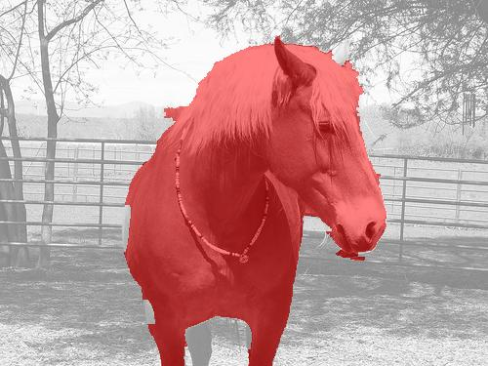
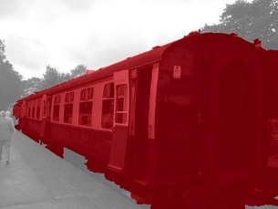
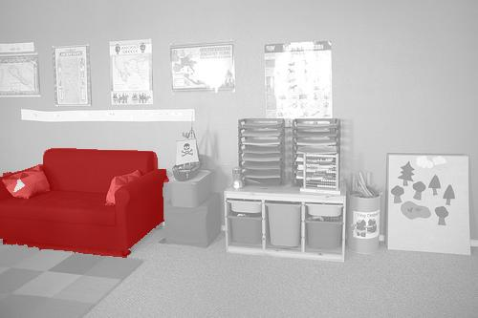
Simultaneous Detection & Segmentation
Hariharan, Arbelaez, Girshick & Malik (2015)
We mark the pixels corresponding to an
object instance, not just its bounding box.

Slide 22
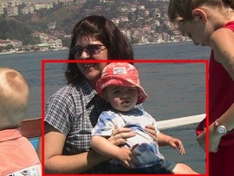
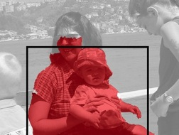

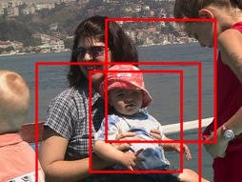
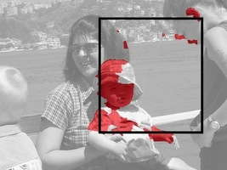
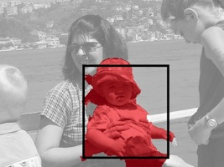
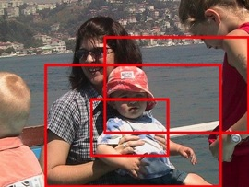

The SDS pipeline
Score
Original detection
Search nearby
Segment
Score
Regress boxes
Score

Slide 23
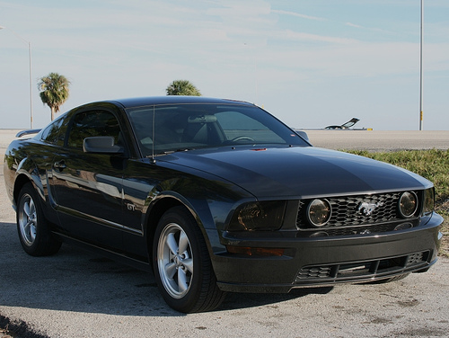
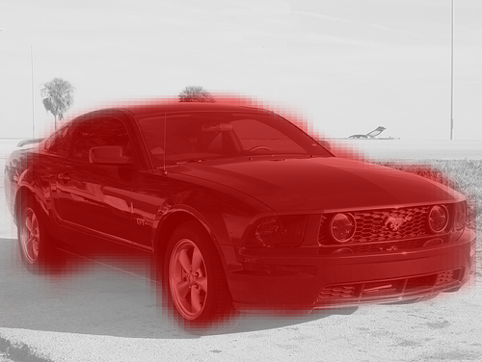
Top-down figure-ground prediction
Pixel classification
  For each p in window, does it belong to object?
Idea: Use features from CNN
Notes:
We approached the problem of top down figure ground prediction as one of pixel classification: for every pixel p in the window, we want to ask if the pixel is in the object or in the background. To make this figure-ground prediction, we wanted to use features from the CNNs that we had already trained.

Slide 24
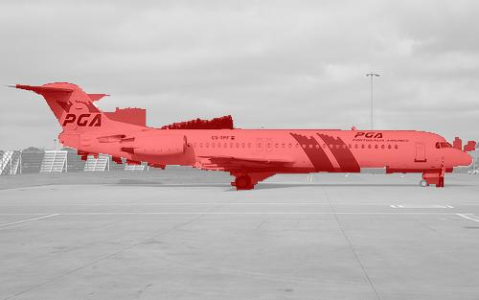
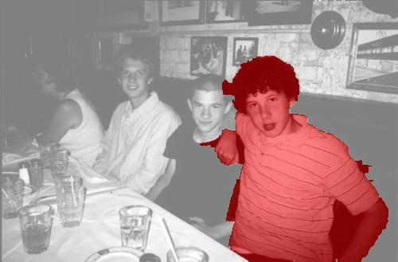
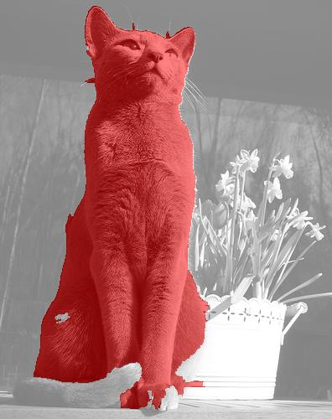
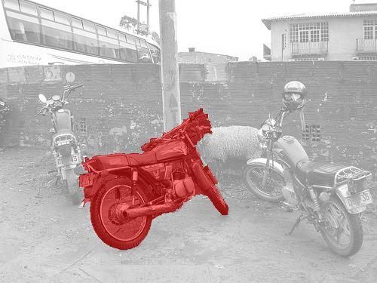
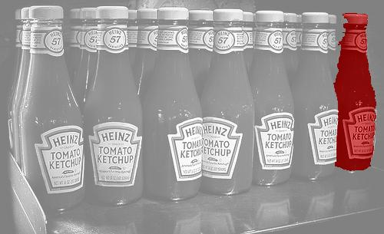
Some more results

Slide 25
Viewpoint Prediction
Tulsiani & Malik (2015)
The columns show 15th, 30th, 45th, 60th, 75th and 90th percentile instances in terms of the error.

Slide 26
The Three R’s of Vision
Recognition
Reconstruction
Reorganization
We have explored category-specific 3D reconstruction.

Slide 27
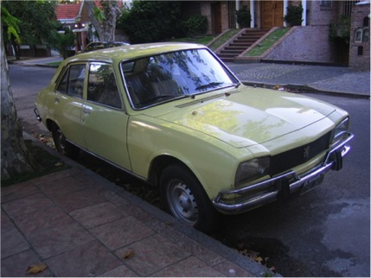
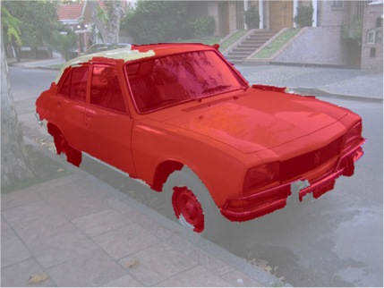


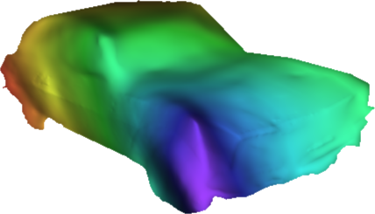
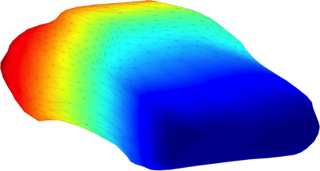
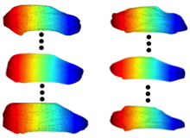
3D Reconstruction from a Single Image
Kar, Tulsiani, Carreira & Malik (2015)
R-CNN, SDS
Girshick et al., Hariharan et al.
CVPR 2014 CVPR 2015
Object Detection and Instance Segmentation
Viewpoints and Keypoints
Tulsiani & Malik, CVPR 2015
Image
Viewpoint Estimation
car
car
Deformable 3D model
High Frequency
Depth Map
Category Specific
3D Reconstruction
Notes:
We now look at the individual steps of our reconstruction pipeline. ->
- As a first step, we use the “Simultaneous Detection and Segmentation” system from Hariharan et. al. which, given an image, outputs object detections alongwith their associated segmentations. -> ->
For each of the detections, -> we obtain their pose using the viewpoint prediction system by Tulsiani and Malik that predicts the 3 euler angles for the detected object. -> ->
- At this stage, we have detected objects as well as obtained the associated segmentation and viewpoints. We can now combine these recognition system outputs with our learned shape models to obtain a category-specific shape for this object.

Slide 28
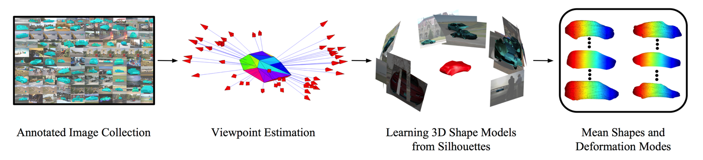
Deformable 3D Model Learning
  Viewpoint estimation – NRSfM on keypoint correspondences
  Idea - Deform a mesh to satisfy silhouettes from different viewpoints
  Energies - Consistency, Coverage, Smoothness, Keypoint
  Intra-class Variation - Linear deformation modes
Notes:
All energies are terms in the optimization. Consistency and coverage ensure that the silhouettes are obeyed, smoothness ensures a smooth shape (in both normals space) and keypoint constraints are also to be obeyed.

Slide 29
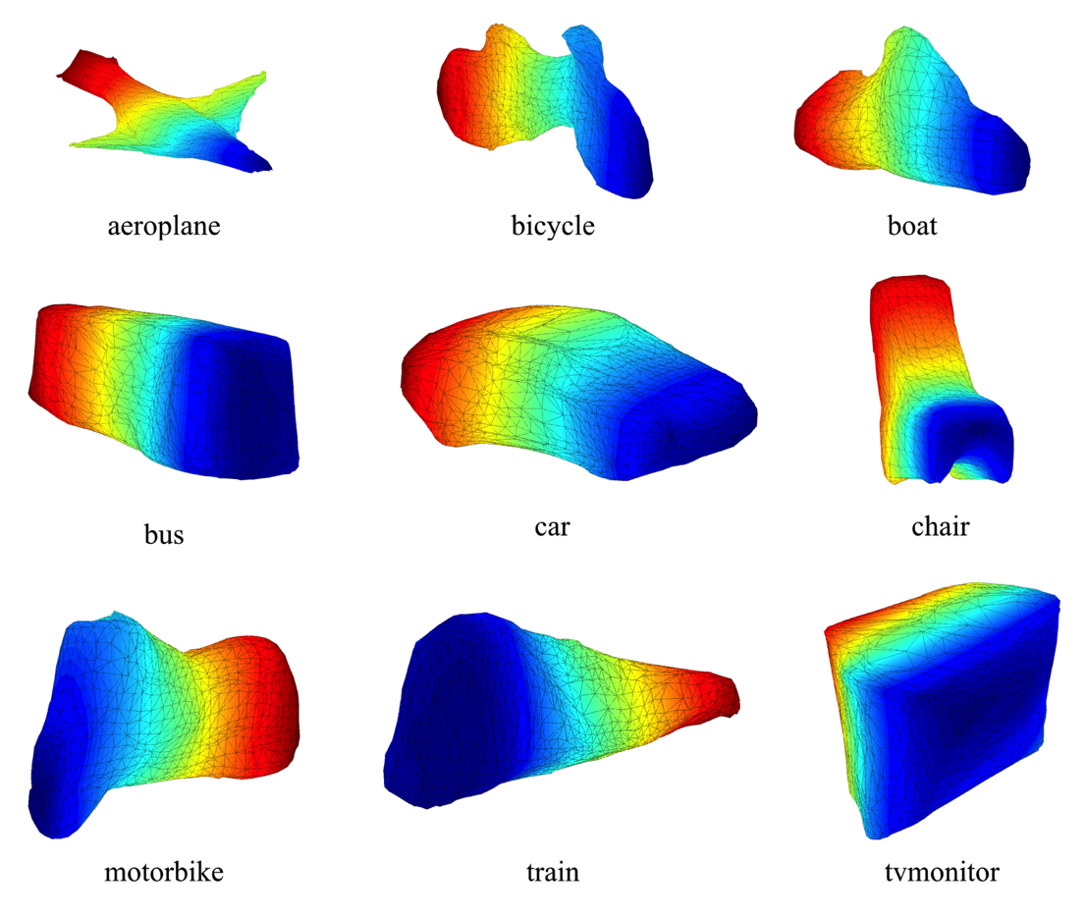
Basis Shape Models
Notes:
Mean shapes learnt for different classes

Slide 30
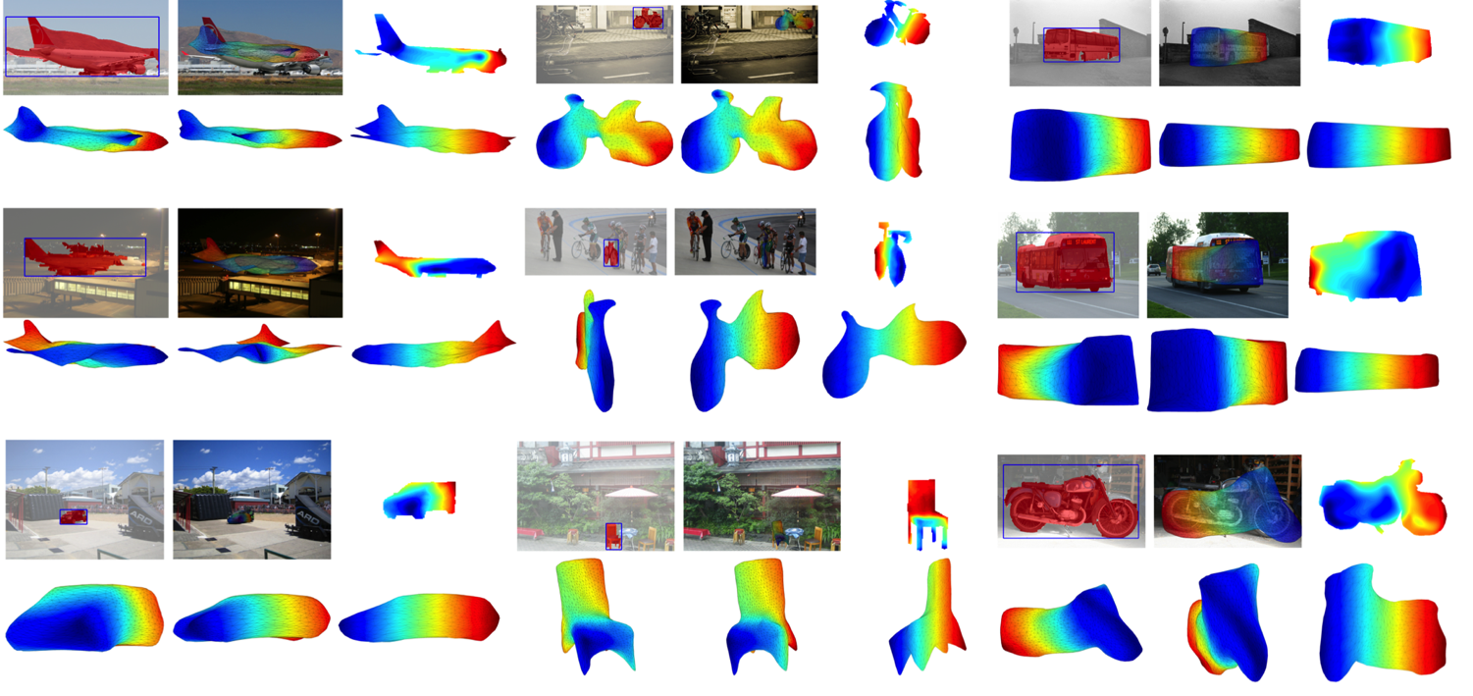

Results

Slide 31
The Three R’s of Vision
Recognition
Reconstruction
Reorganization
These ideas apply equally well in a video setting

Slide 32




Images
Video
Gkioxari & Malik, 2015
Image classification
“Is there a dog in the image?”
Object detection
“Is there a dog and where is it in the image?”
Action classification
“Is there a person diving in the video?”
Action detection
“Is there a person diving and where is it in the video?”

Slide 33

Approach
Given a video
We extract motion salient region proposals for each frame
We classify the proposals using CNN classifiers on spatio-temporal cues
We link the detections across the frames to produce action tubes

Slide 34

Action specific classifiers

Slide 35

Results on UCF Sports
Tracking error
Action prediction error

Slide 36


UCF Sports: Comparison with baselines

Slide 37
Results on J-HMDB
Action Detection
Action Classification
(%) | AP
spatial-CNN | 37.9
motion-CNN | 45.7
full | 53.3
(%) | Accuracy
Dense Trajec. | 56.6
CNN | 56.5
Ours | 62.5
Static and motion features are complementary
On average, motion cues performs better
Action tubes can be used for action classification:
The label of a video comes from the prediction of the maximum scoring action tube in the video

Slide 38

Results on J-HMDB

Slide 39


Slide 40


Slide 42



Slide 43


Slide 44


Slide 45
Scene Understanding from RGB-D Images
Object Detection, Semantic and Instance Segmentation
Pose Estimation
Saurabh Gupta, Ross Girshick, Pablo Arbeláez, Jitendra Malik
UC Berkeley

Slide 46







Overview
Input
Re-organization
Recognition
Detailed 3D Understanding
Contour Detection
Semantic Segm.
Color and Depth
Image Pair
Instance Segm.
Object Detection
Region Proposal
Generation
Pose Estimation

Slide 47






























Instance Segmentation

Slide 48






Pose Estimation
[ECCV 14]
Instance
Segmentation
Estimate
Coarse Pose
Input
Align to data
3D reasoning by initial 2D processing and then ‘lifting’ to 3D
Learning from synthetic data and generalizing to real data
Starting with weak annotation (instance segmentation) able to produce a much richer output
Search over scale, placement and sub-type to minimize
re-projection error
3 layer CNN on normal images trained on synthetic data
[ECCV 14] Learning rich features from RGB-D images for object detection and segmentation. In ECCV 14.

Slide 49


Slide 50


Slide 51
Summary
Object detection
Top-down object segmentation
Estimating pose
Category specific 3D reconstruction
Action detection in video
…

