Slide 1
Video Codecs for Production and Post-Production
Edward Reuss
Co-chair SMPTE Technical Committee TC-10E Essence

Slide 2
Agenda
High Level Concepts
Production & Post Workflows vs. Consumer Distribution
Low Resolution Chroma Channels
Image Transformation
  Macroblock-Based Transform Compression
  Whole Image-Based Transform Compression
What’s Next?

Slide 3
High Level Concepts
Separate an image into “Orthogonal” components
  Red, Green, Blue (RGB)
  Luminance, Blue Hue, Red Hue (YCbCr)
  Optional Alpha component for subtitles, etc.
Compress the individual components
Generate a standardized bitstream
  Standards define the bitstream and decoder operation
  Encoders must generate a bitstream that meets the decoder’s requirements
Transmit or store the bitstream
Decode the bitstream
Decompress the components
Regenerate the original image from the components

Slide 4
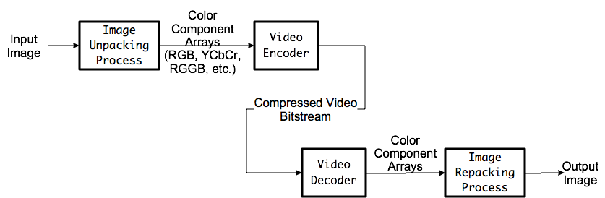
High-Level Workflow

Slide 5
Consumer Distribution
Very high compression ratios – very low bit rates
Simple (inexpensive) decode implementation with small buffers
  Encode may be complex to generate efficient bitstreams
  Requires Reference Decoder Buffer Model (RDBM)
    “Leaky bucket” buffer model - Transport Stream & Elementary Stream
    Encoded bitstream must always satisfy the RDBM & PCR to PTS timing
Long GoP sequences of predicted frames to reduce bit rate
  Typically 12 to 24 frame “Closed GoP” starting with a single I frame”
  Tradeoff time to start decode & length of decode errors, versus bit rate
Latency is not an issue – Usually unidirectional
Normally use 8 bit 4:2:0 YCbCr image formats

Slide 6
Production & Post Workflows
High decoded image quality
Minimum image degradation over multiple compress-decompress cycles
  “Concatenation losses”
Real-Time Workflows
  Real-Time requires Low latency – Bidirectional ENG & DSNG contribution links
  Sub-frame latency requires encoding on horizontal strips “tiles” of each frame
File-Based Workflows
  Fast encoding & decoding – “Time is money”
  Relaxed decode buffer requirement – available frame buffer memory
  Frame-by-frame editing – “I frame” only
    No predicted frames – “P frame” or “B frame”
Image Formats:
  RGB or YCbCr: (4:2:2 or 4:4:4)
  Recently Bayer – Color Filter Array (CFA) format “Camera RAW”
  8, 10 or 12 bits per component sample (16 bit for some Bayer RAW formats)

Slide 7
Low Resolution Chrominance
Humans perceive luminance(shades of grey) with greater spatial resolution than colors
  Green is the highest resolution
  Red and Blue are the least
    Especially Blue
Transform RGB signals to YCbCr (a.k.a YUV)
  Y = Luminance “Black & White”
    Y = 0 makes black, Y = 1 (limit) makes white
  Cb = Blue hue (Color Difference: Yellow to Blue)
  Cr = Red Hue (Color Difference: Cyan to Red)
    Cb = 0 and Cr = 0 makes Black & White
    Cb = -limit and Cr = -limit makes green
    Cb = +limit and Cr = +limit makes magenta

Slide 8
Analog Chrominance Compression
NTSC, PAL – Red & Blue chroma QAM modulated on a chroma subcarrier
SECAM – Red & Blue chroma FM modulated on a subcarrier, sequencing red or blue on alternate lines
Bandwidth of the chroma signals < luma signal
  NTSC (RS-170, a.k.a SMPTE ST 170M-2004):
    Luma = 4.2 MHz
    Red-Cyan “I” = 1.5 MHz
    Blue-Yellow “Q” = 0.6 MHz
Compatible with legacy B&W televisions during the transition from B&W to color

Slide 9
Digital Chrominance Compression: YCbCr (YUV)
Sample luminance (Y) at full spatial resolution – Every pixel
  Unsigned number: 0 is black, Max value is white
Sample chrominance (Cb & Cr) at reduced spatial resolution
  Signed numbers
  Chroma hues are similar to the analog equivalents

Slide 10
Digital Chrominance
Sub-sampling: YCbCr (YUV)
Chrominance subsampling represented by factors of 4
  4:4:4 – Equal sampling for Y, Cb and Cr (No sub-sampling)
  4:2:2 – Cb & Cr sample every other Y sample (Horizontal only)
  4:1:1 – Cb & Cr sample every 4th Y sample (Horizontal only)
  4:2:0 – Cb & Cr sample every other Y sample (Both Horizontal & Vertical dimensions)
  4:1:0 – Cb & Cr sample every 4th Y sample (Both Horizontal & vertical dimensions)
Commonly referred to as “Uncompressed”
  Technically incorrect (Except for 4:4:4)
SDI – ST 259 SDTV, ST 274 & ST 296 HDTV, ST 2036 UHDTV
ITU-R – BT.601 SDTV, BT.709 HDTV, BT.2020 UHDTV

Slide 11
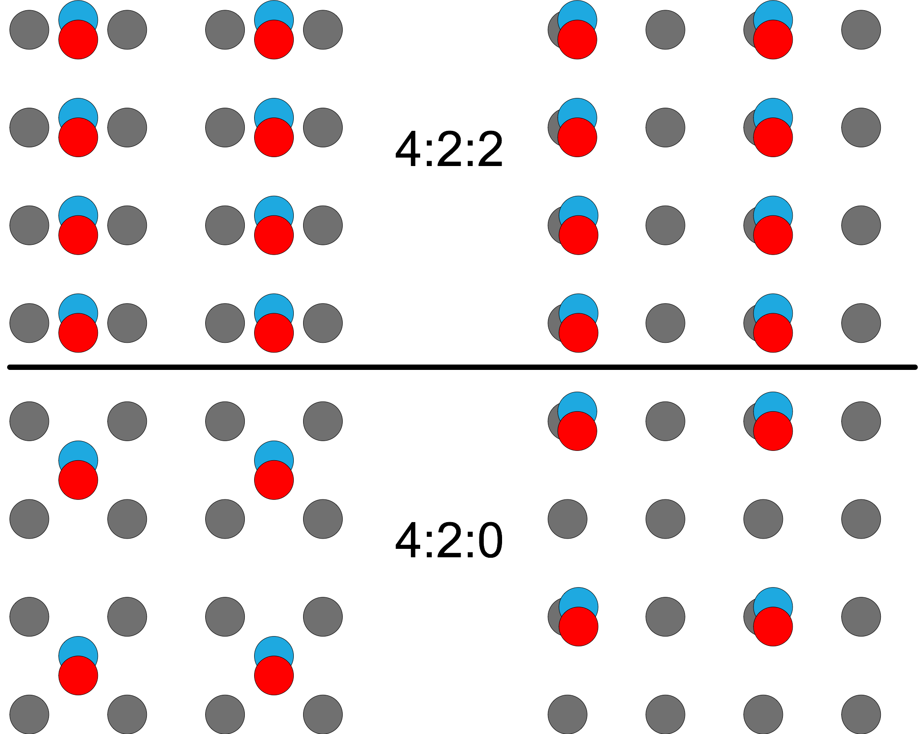
Image Luma-Chroma
Co-siting

Slide 12
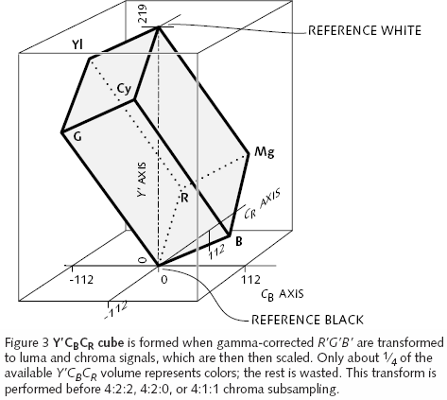
Color Volume Reduction in RGB to YCbCr Conversion

Slide 13
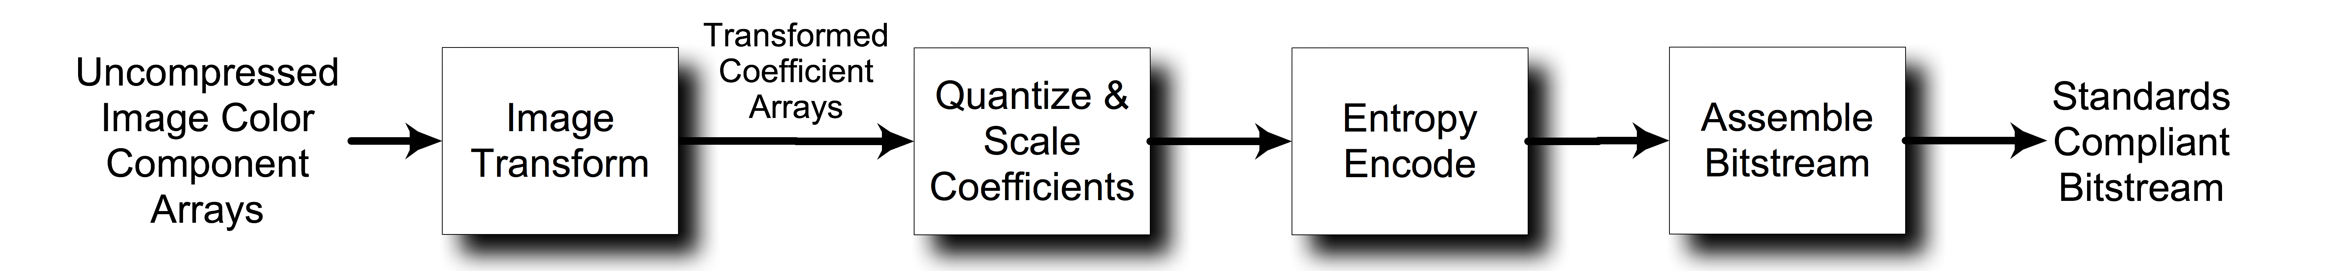
Transform-based Video Compression

Slide 14
2-D Image Transformation
Convert an image into a format that permits separating the fine detail from the large forms
Permits quantizing the fine details more than the large forms to reduce the compressed bitstream while minimally impacting the perceived image quality
Two Transform Types for Image Compression
  Macroblock Transforms
  Whole Image Transforms

Slide 15
Macroblock Transforms
Image decomposed into rows or mosaics of macroblocks
Early codecs used rows of macroblocks all 16x16 samples in size
  MPEG-1, MPEG-2 (H.262), VC-1 (Blu-Ray), VC-3 (DNxHD), VC-4, DV, DVCPro, DVCam, QuickTime, ProRes, etc.
Recent codecs allow variable size macroblocks, “Coding Tree Block” (CTB) within an image, following the contents of the image
  Any rectangle in powers of 4 samples from 4x4 up to 64x64 samples
  DCT size from 4x4 to 32x32
  H.264, H.265
Normally use Discrete Cosine Transform (DCT)
Macroblocks separate the image into regions that maximize the efficiency of the entropy encoding on that portion of the 2D transformed image

Slide 16
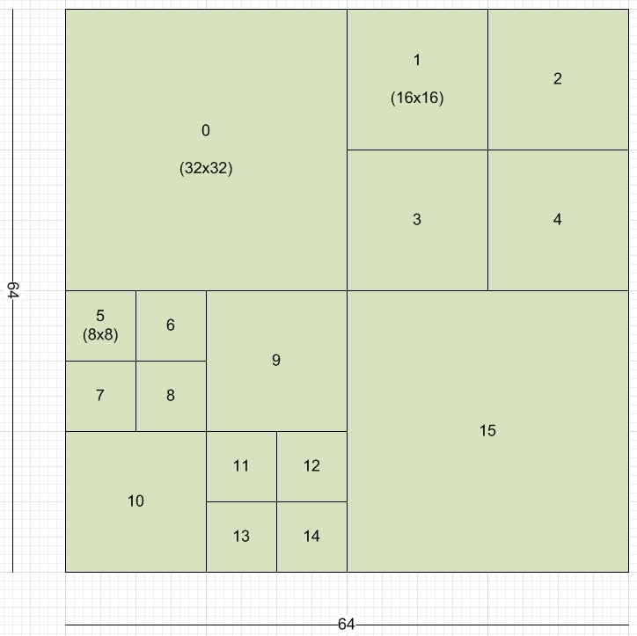
Coding Tree Block Partitioning of an Image

Slide 17
CTB Partitioned Image

Slide 18
Quantization & Scaling
Set the LSBs of the “fine detail” coefficients to zero
Hides the image artifacts due to quantization
Scale the quantized values to reduce the number of bits required to describe the quantized coefficients
Main method for controlling the amount of compression applied to the video images
Trade-off between compression ratio and decoded image quality

Slide 19
Entropy Encoding
Minimizes the bit redundancy of the transformed coefficients, similar to “zip” file compression
Variable Length & Huffman encoding
  Simple and fast
  H.262 and H.264
Arithmetic encoding
  Better compression efficiency (~5 to 10%)
  More complex - Slower
  More power consumption
  H.264 (optional) and H.265 (required)

Slide 20
Most macroblock codecs use sub-sampled (YCbCr)
  Reduces the required bit rate before applying video compression
  4:2:0 for consumer distribution
    Lowest compressed bit rate
    Usually 8 bits per component sample
  4:2:2 for production workflows
    Higher compressed bit rate
    4:2:2 is more robust against multiple encode-decode concatenation losses
    8 or 10 bits per component sample
  4:4:4 reserved for very high image quality production workflows
    highest compressed bit rate
    10 or 12 bits per component sample

Slide 21
Macroblock Transform Codecs
Motion Picture Experts Group
  H.262 (MPEG-2) – Uses Variable Length Coding VLC
  H.264 (MPEG-4) AVC – Uses CAVLC or Arithmetic Coding (CABAC)
  H.265 (MPEG-5) HEVC – Uses Arithmetic Coding only (CABAC)
Constrained version of MPEG-2
  VC-1 (SMPTE ST 421M) 4:2:0 Used for BluRay, WMV9
  VC-3 (SMPTE ST 2019) Avid DNxHD
  VC-4 (SMPTE ST 2058) Extensions to VC-1 for 4:2:2 & 4:4:4
  Apple ProRes (4:2:2 & 4:4:4)
  Various DV camera formats
AVC-Intra Formats – Constrained versions of H.264
  Adobe Premiere Pro
  Various camera formats (GoPro Hero 3, etc.)
VP9 – Google - YouTube
  8 bit superblocks up to 32x32, 4:2:0, 4:2:2 & 4:4:4
  License free open source

Slide 22
Whole Image Transforms
Wavelet Transforms used to separate the image into Low Frequency and High Frequency coefficient sub-bands
  Separate high spatial frequency elements from low frequency elements
A 2D transform generates four sub-bands: LL, HL, LH and HH
Transform the LL sub-band recursively into four more sub-bands 2 to 6 times
Quantize the samples in each sub-band to different bit resolutions
  Minimize the perceived decoded image degradation
Entropy encode the sub-band coefficient arrays & assemble the bitstream
JPEG 2000 (ISO/IEC 15444), VC-2 (BBC Dirac), VC-5 (CineForm), REDCODE

Slide 23
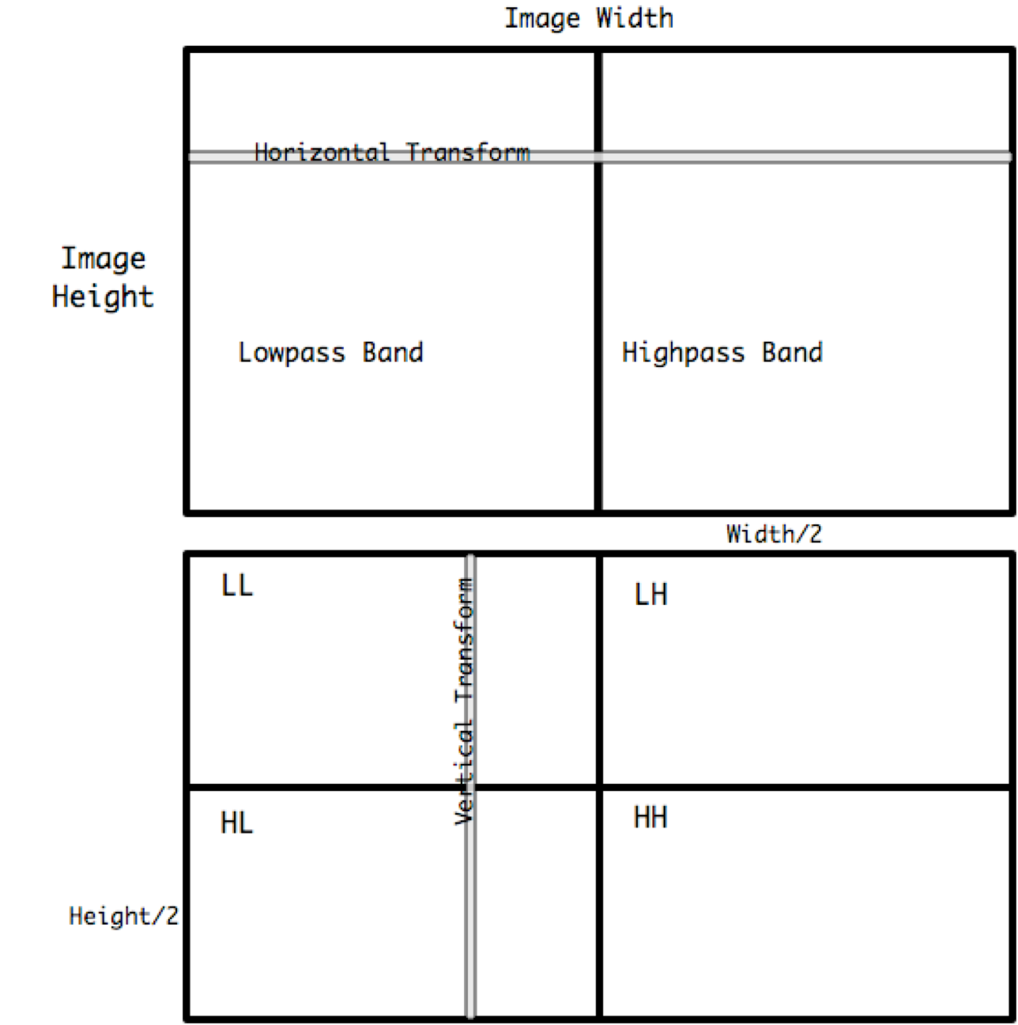
2-D Wavelet Image Transformation

Slide 24
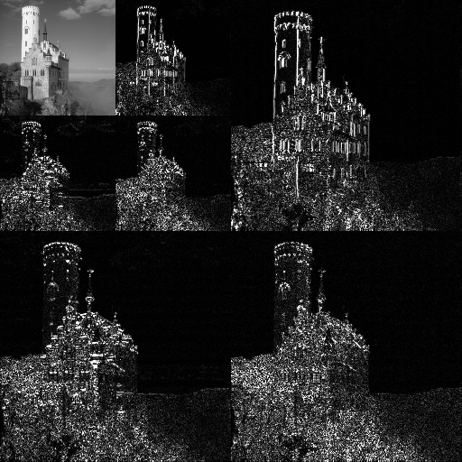
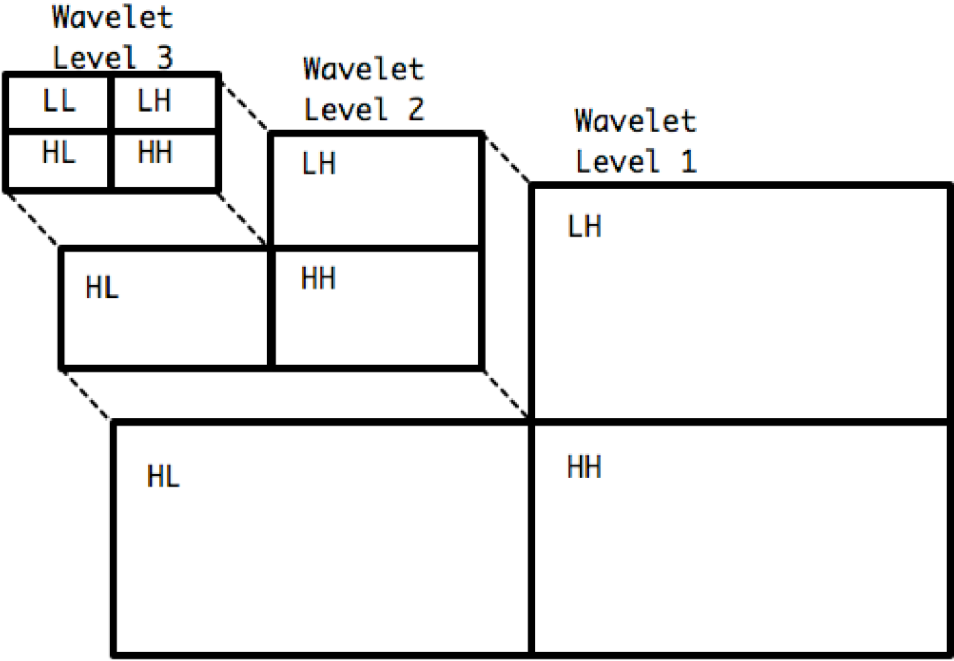
Multi-Level Wavelet Coefficient Transform

Slide 25
Wavelet-Based Codecs
JPEG 2000 (ISO-IEC 15444)
Excellent Image quality
Very good image compression – but very complicated
Used by Digital Cinema Industry for distributing feature films for theaters with digital cinema projectors
Choice of two wavelet transforms
  Lossy:
    Irreversible Cohen-Daubechies-Feauveau 9/7
    Excellent sub-band filter properties – High MTF
    High number of filter coefficients make it slow & power hungry
    Best performance uses floating point implementation
    Slow & power hungry
  Lossless:
    Reversible biorthogonal Cohen-Daubechies-Feauveau 5/3

Slide 26
Wavelet-Based Codecs
JPEG 2000 (ISO-IEC 15444)
Arithmetic Entropy Encoding (Binary MQ)
  Encodes on each plane of the significant bits
  Preceded by a 3-pass quantization optimization process
    Optimizes image quality for a specified level of quantization
    Complex, slow & power hungry
Code stream definition provides many options for tiles & image structure
  Complex to specify the code stream in the encoder
  Complex to parse in the decoder
  Complex, slow & power hungry

Slide 27
Wavelet-Based Codecs
SMPTE ST 2042 VC-2
Supports RGB, and 4:4:4, 4:2:2 & 4:2:0 YCbCr
Dirac wavelet transform
  Dirac Pro uses either 2 level Harr Transform
    Simple & fast
  Or LeGall 5/3 Transform
    Similar to CDF 5/3 from JPEG 2000
    Better compression, but more complex & slower
Choice of exp-Golomb VLC or arithmetic coding
  Permits either efficient compression or low latency
Developed and used in the BBC (Tim Borer)
Open Source – No license fees

Slide 28
Wavelet-Based Codecs
SMPTE ST 2073 VC-5
Designed for high speed encoding & decoding
Camera Acquisition & Post Production
  High speed
    “Time is money” for studios & post houses
  Modest increase in compressed file size is acceptable
    Cheap high capacity storage
Based on CineForm Codec – Purchased by GoPro in 2011
  GoPro Studio 2.0 editing application ingests H.264 from camera & transcodes to CineForm internally

Slide 29
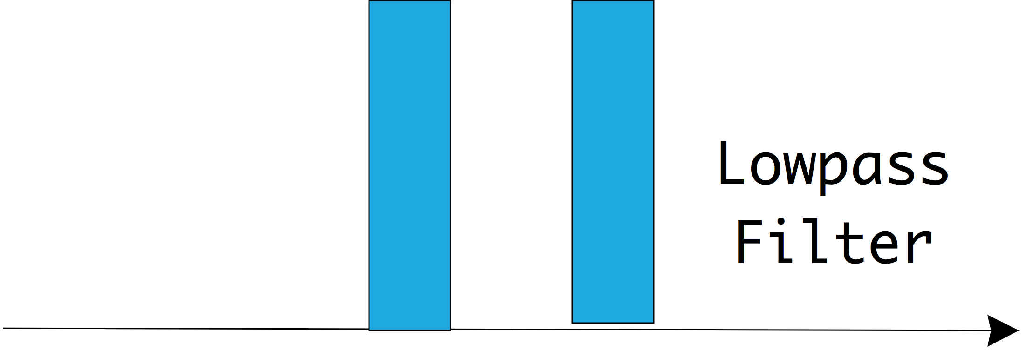
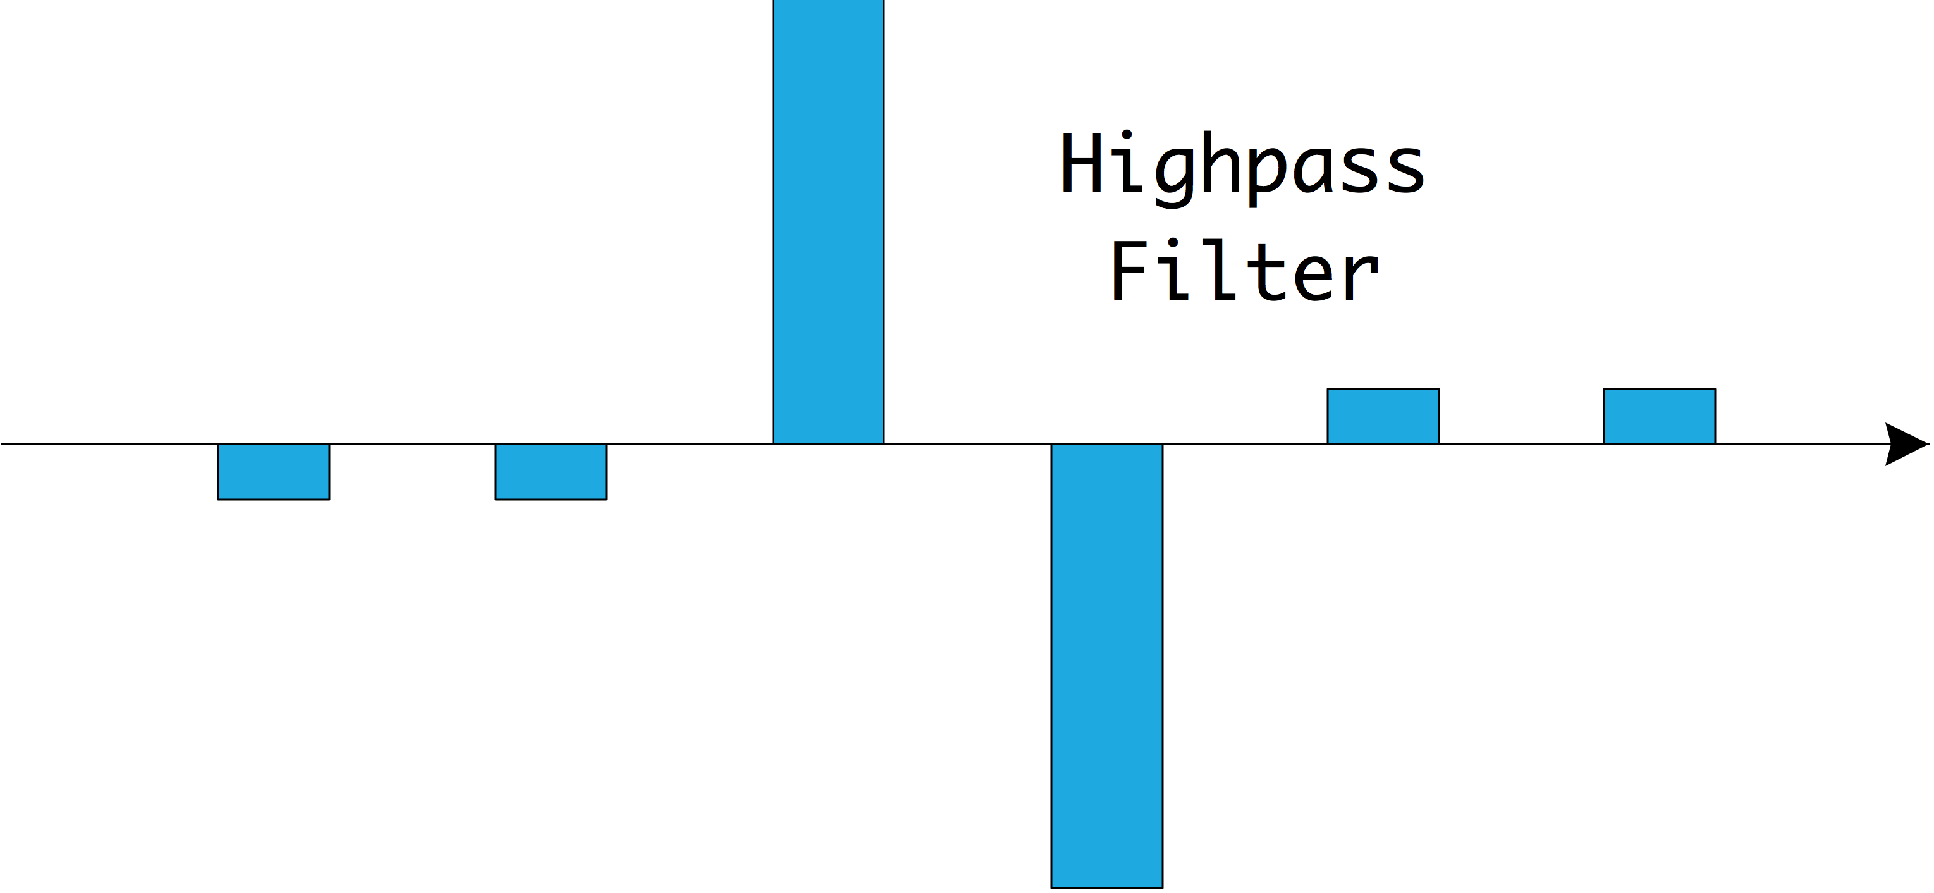
Wavelet-Based Codecs
SMPTE ST 2073 VC-5
Supports:
  RGB, 4:4:4, 4:2:2, 4:2:0, 4:1:1 or 4:1:0 YCbCr
  RGGB Bayer RAW, other Color Filter Array Formats
  8 to 24 bit sample resolution
  Embedded metadata formats – several standardized formats
    Critical for camera acquisition applications
  Composited Layers implemented in the image repacking process
    3-D & multi-camera, tiled images, HDR, mattes, subtitles & overlays
2/6 reversible wavelet transform
  Simple implementation – Shifts & Adds: Very fast, Low power
Run-length & Huffman Entropy Coding
  Simple, fast
  Lower compression efficiency
  Larger compressed file sizes: 5 to 15%

Slide 30
Wavelet-Based Codecs
REDCODE
Proprietary RAW Image Format for the RED ONE series of Digital Cinema Cameras
Compressed RAW Bayer Sensor Image Data (RGGB)
JPEG 2000 Video Compression/Decompression
  Lossy irreversible 9/7 CDF wavelet transform
Decompress and Demosaic Bayer RGGB to RGB Pixels to view an Image
Compression Ratios: 7.5 to 1, up to 12 to 1

Slide 31
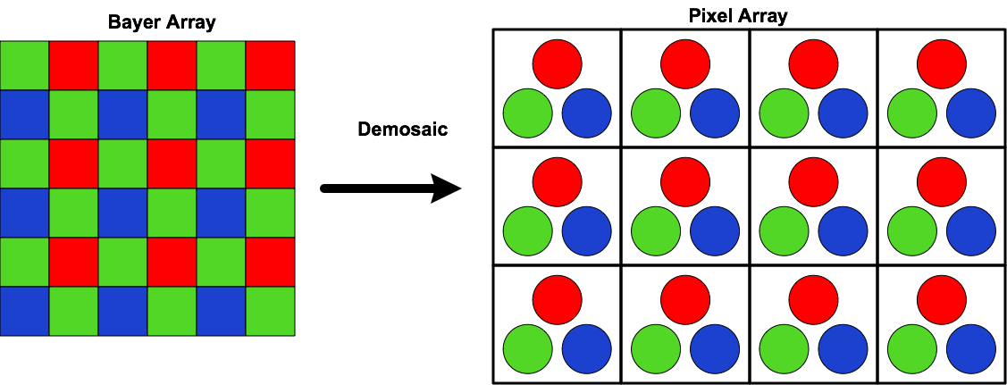
Bayer Array De-mosaic to a Pixel Array

Slide 32
What’s Next?
High EOTF & Wide Color Gamut
High Electro-Optical Transfer Function (EOTF)
  Up to 10,000 nits (candelas/m²)
  Conventional TV display is 100 nits
  Applications:
    Specular reflections: sunlight on metallic or glass surfaces
    Interior scenes without over-exposed exteriors
    NOT for intensely bright scenes: Avg. brightness still ~100 nits
Wide Color Gamut
  Television:
    ITU-T Rec. BT.2020 UHDTV
    SMPTE ST 2036-1 UHDTV Parameters for Program Production (Proposed revision)
  Digital Cinema:
    ACES
    High Luminance Differential XYZ

Slide 33
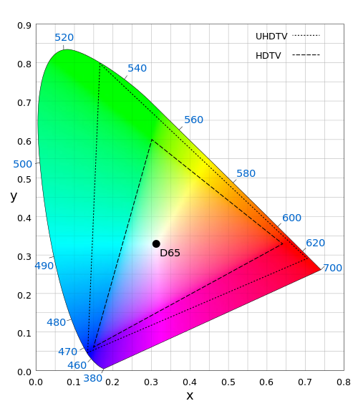
Compare HDTV & UHDTV Color Spaces
HDTV: ITU-T Rec. BT.709
UHDTV: ITU-T Rec. BT.2020

Slide 34
What’s Next?
High Dynamic Range &
High Frame Rate
High Dynamic Range (HDR)
  Necessary to support High EOTF and Wide Color Gamut
  Television: 12 bits
    ITU-T Rec. BT.2020 UHDTV
    SMPTE ST 2036-1 UHDTV (Proposed revision)
  Digital Cinema: 12 to 24 bits integer
    Some DC applications use short float format
High Frame Rate
  Television: 100 & 120 fps: ITU-T BT.2020, SMPTE ST 2036 UHDTV (Proposed)
    Potentially up to 300 fps
  Digital Cinema: 48, 72 & 96 fps
  More data, but motion encodes more efficiently
    Especially with smaller shutter angles

Slide 35
Future of Video
It’s going to look fantastic
It’s really cool
Lots of things are happening
Lots of work to do
Lots of opportunities

