Slide 1
Leading an Analog Semiconductor IP Company, Cowboy Style
Moises E. Robinson, Ph.D.
September 5, 2019

Slide 2
Exciting Times for Semiconductor IP
Why “Cowboy Style”?
Because Vidatronic started in Texas? Not fully!
The semiconductor IP industry offers many opportunities and challenges AND IT OFTEN FEELS AS IF WE ARE (SUCCESSFULLY) RIDING A WILD BULL.
Semiconductor IP Industry

Slide 3
Outline
Semiconductor IP Industry
Vidatronic: Global Analog Semiconductor IP Company
Semiconductor IP Challenges and Solutions

Slide 4
Semiwiki: March 2019

Slide 5
Three Decades of Semiconductor IP
Processors
Memory
Serdes / PHYs / PLLs
Wireless / RF / Data Converters
Power Management
1990
2000
2010
2020

Slide 6
Why Integrated Power Management?
Lower cost and reduced bill of materials
Independent control of voltage islands inside SoCs
For example, for different power states
Provide accurate voltages required by SERDES/PHYs
< 1V with ±2 to 3% accuracy requirements
Low noise and low ripples
Size/space restrictions don’t allow for external PMICs (e.g. IoT)

Slide 7
Vidatronic: Company Overview
Analog Semiconductor Intellectual Property (IP) company
Incorporated in October 2010
Integrated Power Management Unit (PMU) IP Cores
LDO linear voltage regulators
DC-DC switching converters
Bandgap voltage references
Analog SOC components
Oscillators, comparators, temperature sensors, Power-on-reset circuits
Radio-frequency solutions
CMOS transmitters
Lighting solutions
LED Drivers
Notes:
Vidatronic was incorporated in October 2010, and has been in business for over 7 years.
You can see the map of the Texas. Vidatronic Headquarters is located at the red marker in College Station, Texas. College Station is known for Texas A&M University, which has an excellent Electrical Engineering program.
We are located in the middle of the technology triangle of Dallas, Austin & Houston.
Houston has a lot of technology (eg. Compaq Computer). Vidatronic is 1 hour west of Houston.
Vidatronic is 2 hours east of Austin, another well-known technology city.
Vidatronic is 3 hours south of Dallas, known for Texas Instruments (TI)
Vidatronic is a technology company, focusing on power-management.
We offer the following power-management solutions: (see list on slide).
Our technologies have the following features: (see list on slide).
These features are beneficial for nearly every application.
Vidatronic is a pure-play IP vendor. We do not manufacture or sell any components or physical products. We do not compete with our customers; we cooperate with them. Our strength is in partnership. We succeed when our customers succeed.
Our business areas include: IP Licensing (this is the primary business), custom products, and design services.
Our primary business is IP licensing of our patented power-management circuit IP cores for ASIC & SoC Integration. We can also do turn-key PMIC ASSP designs.
Our technology is analog hard macro IP, which is unlike digital. Every customer has a little different requirement. They need a little different input voltage or output voltage or different current or some other parameter. Therefore, most of our customer engagements are for custom products. We start with the existing IP and customize it to meet the specific application requirements that the customer needs.
We also do some design services and consulting but our primary business model is IP licensing.

Slide 8
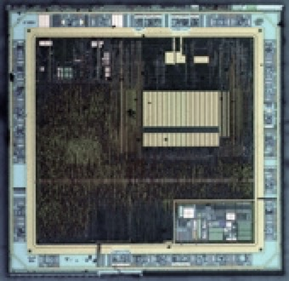
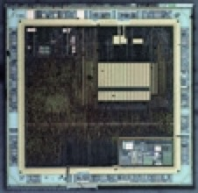
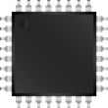
Vidatronic Business Overview
BUSINESS AREAS
IP Licensing
Patented Analog IP cores for:
ASIC and SoC PMU integration
Turn-key PMIC ASSPs or ASICs
Customization
Optimization of off-the-shelf IP to meet customer-specific performance requirements
Porting of IP to different foundries and process nodes
Design Services
On-site FinFET Process IP Integration
Analog/mixed-signal consulting
Low risk, on-time, and on-budget designs
IP USAGE CASES
Integrated PMU
Vidatronic IP Integrated on-die
Single-chip solution
Simplest application
Vidatronic
IP Block
Multi-Chip Module
Separate PMIC die in an MCM
PMIC in optimal process
More complex packaging
Vidatronic
Die
Stand-Alone PMIC
Stand-Alone PMIC ASSP or ASIC
Note: Areas are not drawn to scale.

Slide 9
Speaker’s Background in Semiconductor IP Industry
 | RocketChips | Vidatronic
Founded | 1997 | 2010
Main Business Model | IP license | IP license
Focus | High Speed Serdes | Analog, Power Management and RF IP
Process Technology | CMOS Planar | CMOS Planar CMOS FDSOI CMOS FinFet
Process Geometries | 180 nm → 110 nm | 180 nm → 5 nm
Locations | US | Global
Environment | Local Servers Local Software Licenses | Cloud-based
Exit | Acquired by Xilinx in 2000 (RocketIO)

Slide 10
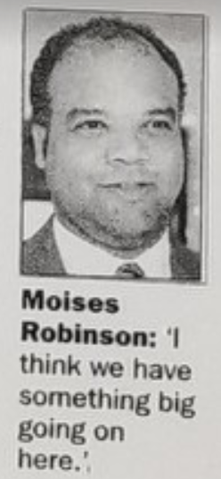
RocketChips: December 27, 1999

Slide 11
Vidatronic: Foundry, Process, Circuit Experience
 | UMC |  |  |  |  |  |  |  |  | GLOBAL FOUNDRIES |  |  | Samsung
 | 180 nm | 153 nm | 130 nm | 110 nm | 40 nm | 14 nm | 12 nm | 7 nm | 5 nm | 130 nm | 40 nm | 22 nm FDX | 130 nm BCD
LDO Voltage Regulator | ✓ |  | ✓ |  | ✓ | ✓ | ✓ | ✓ | ✓ | ✓ |  |  | ✓
Buck DC-DC Converter |  | ✓ | ✓ | ✓ | ✓ | ✓
Switched-Capacitor DC-DC Converter |  |  |  |  | ✓
Voltage Reference | ✓ | ✓ | ✓ | ✓ | ✓ | ✓ | ✓ | ✓ | ✓ |  | ✓ | ✓
Power Supply Monitor | ✓ |  | ✓ | ✓ | ✓ |  | ✓ | ✓
Analog Test Multiplexer |  |  | ✓ |  | ✓ | ✓ | ✓
Temperature Sensor | ✓ |  | ✓ | ✓
Power Switch |  |  |  |  | ✓ | ✓
Oscillator |  | ✓ | ✓ | ✓ | ✓ | ✓ |  |  |  |  |  | ✓
Analog to Digital Converter |  |  |  |  |  |  |  |  |  |  |  | ✓
Digital to Analog Converter | ✓ | ✓ | ✓ | ✓ | ✓ | ✓ | ✓ | ✓ |  |  |  | ✓
Comparator | ✓ | ✓ | ✓ | ✓ | ✓ | ✓ | ✓ | ✓ |  |  |  | ✓
CMOS RF Power Amplifier |  |  |  |  | ✓
Notes:
This slide shows the blocks Vidatronic supplies and the fabs and process they are available in.
On the left side of this table, you can see all the IP blocks we just talked about.
You can see that some blocks are not available in every process. However we have a lot of experience with multiple fabs and processes, so if you need a block that is not available in a specific process, we can easily, confidently and reliably port them to one of the other processes with very low risk.

Slide 12
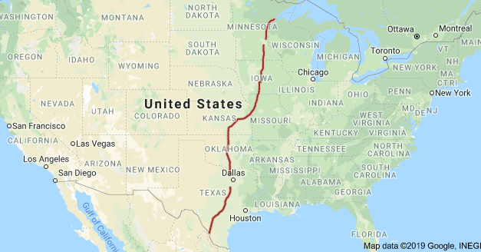
RocketChips: US-Based, Mostly IH35

Slide 13
Vidatronic – Global

Slide 14
Semiconductor IP challenges & solutions

Slide 15
Semiconductor IP Challenges
Compressed development schedules
Balance between custom and configurable IPs
Sync-up databases with teams around the world
Difficulty acquiring PDKs and silicon area for multiple fabs in multiple processes
Supporting multiple customers with multiple IP variations/revisions at multiple advanced nodes
Funding

Slide 16
Semiconductor IP Challenge #1
THE CHALLENGE
The fast-paced market requires a compressed development schedule.
THE SOLUTION
Utilizing global teams.
For example, we use layout teams around the world:
US and Mexico
Egypt (7 hours ahead of US CST)
Malaysia (13 hours ahead of US CST)

Slide 17
Semiconductor IP Challenge #2
THE CHALLENGE
Difficulty In Design And Test
Balancing between custom & configurable IPs.
Custom IPs
Smaller
Less power
Shorter (initial) design cycle
Easier to test
May not support multiple applications and customer needs
Configurable IPs
Supports re-use for multiple applications and customer needs
Custom IP
100% Configurable IP
THE SOLUTION
Proprietary techniques to support configurable IPs without much impact to power and area.

Slide 18
Semiconductor IP Challenge #3
THE CHALLENGE
Sync-up databases with teams around the world.
THE SOLUTION
All teams work with the same database in the Cloud and designers use a personal laptop/desktop.
Additional benefits include:
Scalability – can quickly add licenses/more users
Team is not distracted by IT management tasks like maintaining servers, multi-site redundancy, and disaster recovery

Slide 19
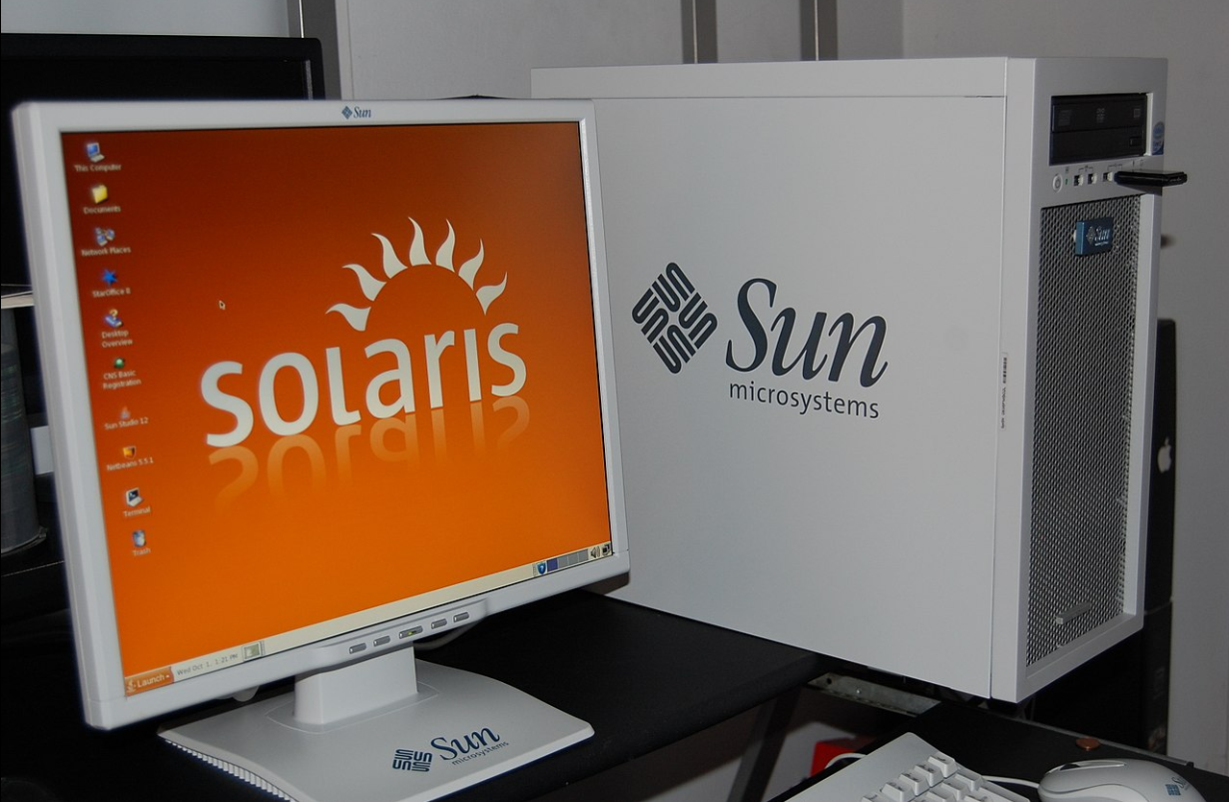
IP Development in the 1990s
Every designer had a Sun Sparc Workstation and Solaris operating system (now I am showing my age!)
This cost thousands of $$ per employee workstation

Slide 20
IP Development Today at Vidatronic
Engineers use a personal laptop or desktop to login to the Cloud Environment
This saves thousands of $$ per employee workstation

Slide 21
IP Development Today at Vidatronic
Distributed resources help us meet tight schedules.
CLOUD
Servers with Tools, Design Databases + Back-ups
US
Mexico
Egypt
Malaysia

Slide 22
Semiconductor IP Challenge #4
THE CHALLENGE
Acquiring PDKs and silicon area for multiple fabs in multiple processes can be very difficult.
THE SOLUTIONS
Good product marketing helps focus limited people and financial resources on stand-alone IP products with good market potential
The stand-alone IP is a way to develop a good working relationship with the fab and in turn have access to MPWs and PDKs
Develop cutting edge and high performance IPs with a large semiconductor or systems company as a sponsor

Slide 23
Semiconductor IP Challenge #5
THE CHALLENGE
Supporting multiple customers with multiple variations/revisions at multiple advanced nodes for some of our most popular IPs including:
The ACCUREF™ Voltage Reference
The Power Quencher® LDO
The FlexSupply™ Buck/Boost Converter
THE SOLUTIONS
Well documented and re-usable test-benches
In-house scripts to help with porting activities to different processes
Network of very senior consultants to augment our team on demand

Slide 24
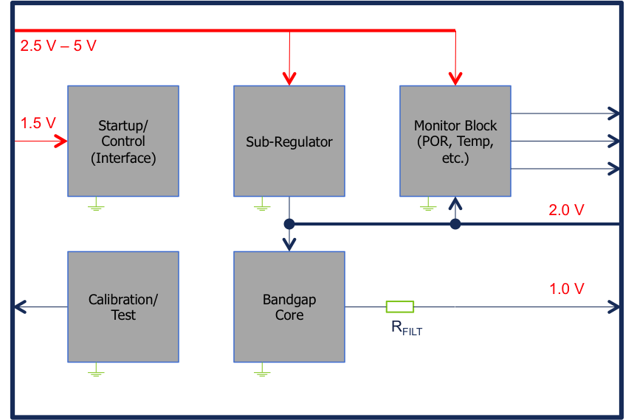
ACCUREF™ Voltage Reference IP
For generating a precise, adjustable reference voltage.
Parameters | Specifications
Input Power Supply | 2.5 to 5.0 V
Reference Accuracy (HP Mode) | ± 0.3%
Reference Accuracy (LP Mode) | ± 1.0%
Quiescent Current (HP Mode) | < 20 μA
Quiescent Current (LP Mode) | < 12 μA
Power Supply Rejection Ratio (at 100 KHz) | > 90 dB
Temperature Range | -30 to 125ºC
Silicon-proven in 130 nm BCD
Ultra-low levels of power consumption without sacrificing accuracy or noise performance
Fully integrated – no external components required
Two modes of operation: High Performance (HP) & Low Power (LP)
Integrated temperature sensor

Slide 25
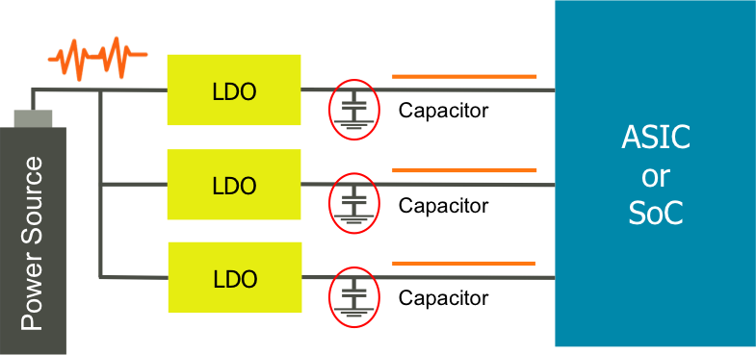
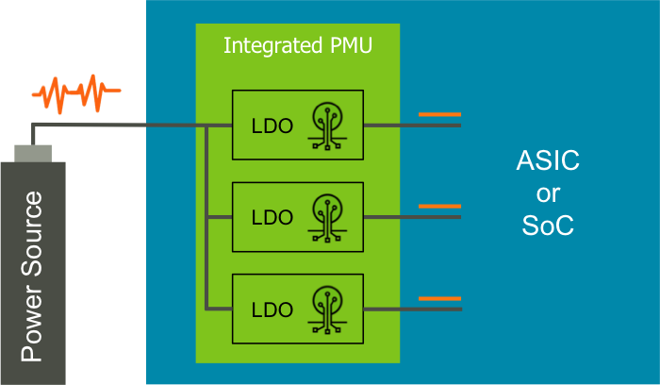
Power Quencher® LDO
Typical application requiring multiple external LDOs and capacitors.
Vidatronic integrated power management unit (PMU) - inside customer’s microchip
No external LDOs.
No external capacitors required.
Notes:
Power quencher does not require external capacitors, and also, because our technology is available in very small processes (ex. 40nm), you can integrate our LDO technology right onto the die of the ASIC or the SoC. And now this ASIC or SoC only requires one external supply voltage input, not 3 supply voltages. This is the much better solution for the customer. You save multiple LDOs, multiple capacitors, and multiple pins are saved on the ASIC or SOC package. With fewer required components, you save cost and improve reliability. This solution is easier to implement the circuit board layout.
Compare this to the solution at the top of the page. You can see this is a much better solution compared to multiple external LDOs and capacitors. For many customers, this is a change in their architecture, from multiple external supplies, to a single external supply to generate all the required supply rails internally. Customers should consider this architectural change as it gives their product advantages to their customers of fewer component count, lower cost, smaller board area, improved reliability and simpler implementation.

Slide 26
Flexsupply™ IP Cores
Current products designed around a 2.5 V supply function properly when the battery level is high.
When the battery level is low, however, the product stops working entirely.
Battery Level: 2.5 V
ASIC
or
SoC
OUTPUT
The Flexsupply™ family of switched-capacitor regulated voltage-doubler IP cores are designed to improve current products so that they can function properly at extremely low battery levels.
After integration into the SoC, the Flexsupply™ IP core provides the correct supply voltage to the SoC, even with low battery levels.
Flexsupply™
IP Core*
2.5 V
ASIC
or
SoC
OUTPUT
Battery Level: 1.6 V

Slide 27
Semiconductor IP Challenge #6
THE CHALLENGE
Funding.
THE SOLUTIONS
Diversify revenue and funding sources:
Investors
Services
IP Licensing
IP Royalties
Government Grants
We apply for grants to fund technologies with potential for high future rewards. Examples include:
FlexPA™ CMOS Power Amplifiers
InfinityLED Driver

Slide 28
FlexPA™ CMOS POWER AMPLIFIERS (PA) Started with Grant from United States National Science Foundation (NSF)

Slide 29
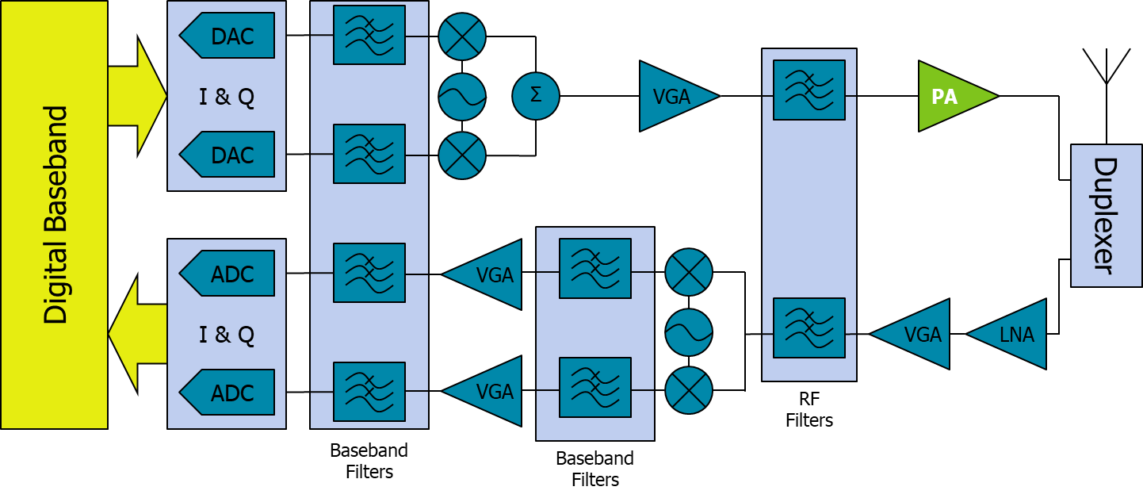
RF Transceiver – Transmit Power Amplifier
In the simplified RF transceiver signal-chain block diagram below, most of the semiconductor components are usually fabricated using standard CMOS process technology
The transmitter RF Power Amplifier (PA), however, is usually realized using non-CMOS, III-V technologies (e.g. GaAs, GaN) and high power-supply voltage levels
Challenge of implementing an RF PA in CMOS: Small power-supply voltage range limits the output voltage swing
Benefits of CMOS technologies: Cheaper, high density of CMOS technology allows integrated digital processing
Vidatronic has designed an innovative, patented* solution that implements the RF PA using standard CMOS technology
* Multiple patent applications filed
Notes:
The Power Amplifier (PA) section of the RF transmitter (upper right) is usually a non-CMOS technology
Very expensive
Can not be integrated with any other components in the signal chain
It is difficult to design a PA in CMOS technology.

Slide 30
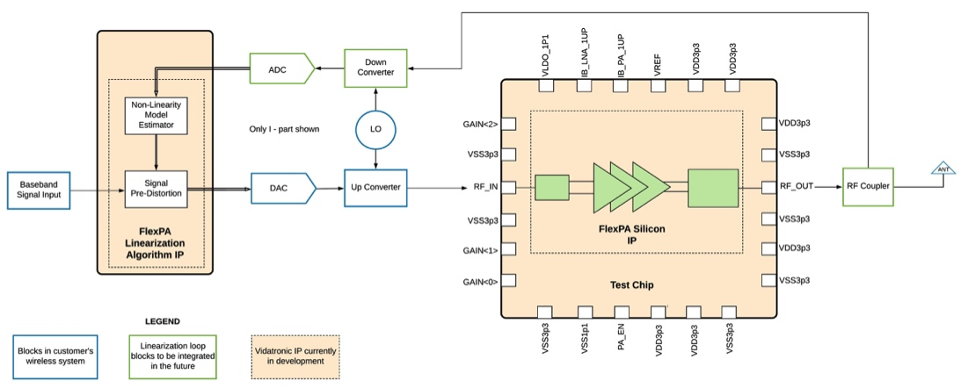
FlexPA™-I CMOS RF Power Amplifier (PA) System Solution

Slide 31
FlexPA™ – Standards and Applications
FlexPA™
Narrowband IoT
5G Systems
IoT Applications
1024 QAM
FDD and TDD 2G/3G/4G LTE Systems
3GPP Band 30 and 40 Small Cell Base Stations

Slide 32
Infinity LED Driver Started with GRANT from Egyptian Government

Slide 33
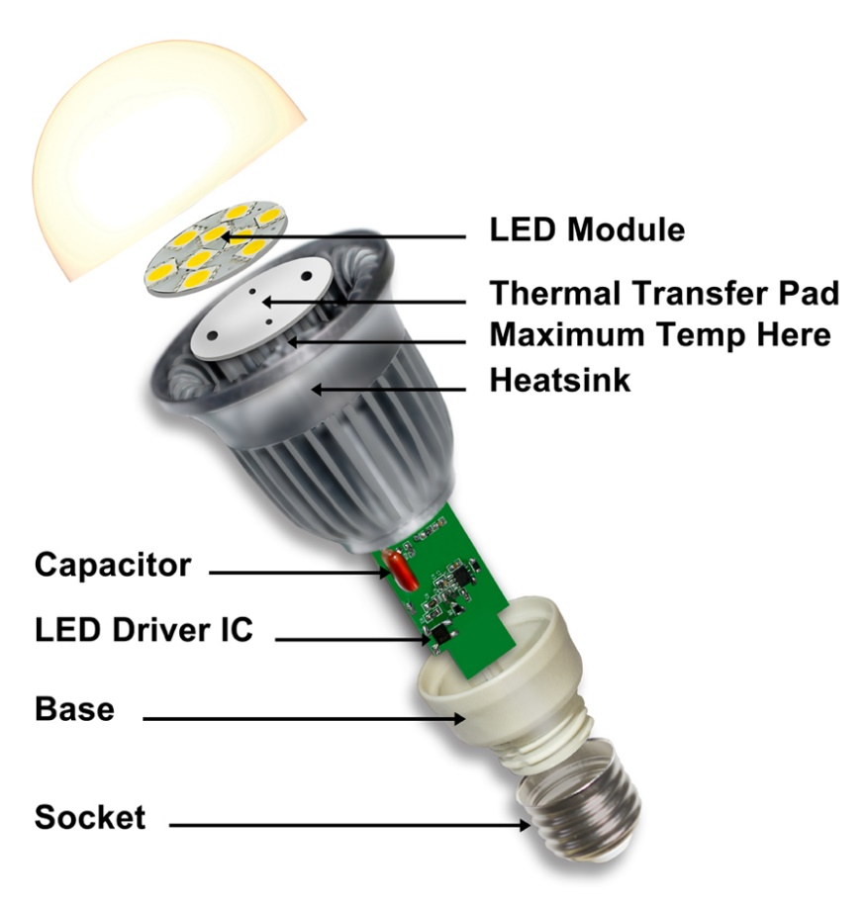
LED Driver Design Challenges
LED drivers typically require an electrolytic capacitor (E-Cap) for stable performance.
This E-Cap severely limits the total lifetime of the LED driver, thus limiting the lifetime of the full solution.
Driver failure due to the low lifetime of the E-Cap decreases the reliability and increases the costs of LEDs, preventing higher market adoption of LED lights.
Competitor solutions that attempt to replace the E-Cap with a film or ceramic capacitor suffer from:
Degraded Performance
Flicker (variations of luminance over time) Issues
Increased Total Cost
Increased Total Area
 | Lifetime (hours)
Lamp Fixture | No limit
LED Chip | 100,000
LED Driver | 5,000 to 10,000
Electrolytic Capacitor | < 10,000
Film Capacitor | > 100,000
Ceramic Capacitor | > 100,000

Slide 34
Infinity LED Driver Solution
Fully-integrated AC-DC LED Driver with no electrolytic capacitor (E-Cap), high reliability, and reduced flicker.
ROADMAP
FEATURES AND BENEFITS
Fully-integrated solution
E-Capless design to increase life-time of the solution
Decreased complexity and cost
Single-stage design
Simple, single-loop control technique
ENERGY STAR compliant, high efficiency
High power factor
Smart feature functions
Dimming function
Luminance control
PHASE 1
PHASE 2
PHASE 3
COMPLETED
Proven architecture to remove E-Cap.
This is our prototype.
IN PROGRESS
Improving prototype to remove flicker and improve performance.
Prototype Q1 2020.
NEXT STEP
Full integrated solution.
Prototype timeline pending.
Currently seeking partners.

