Slide 1
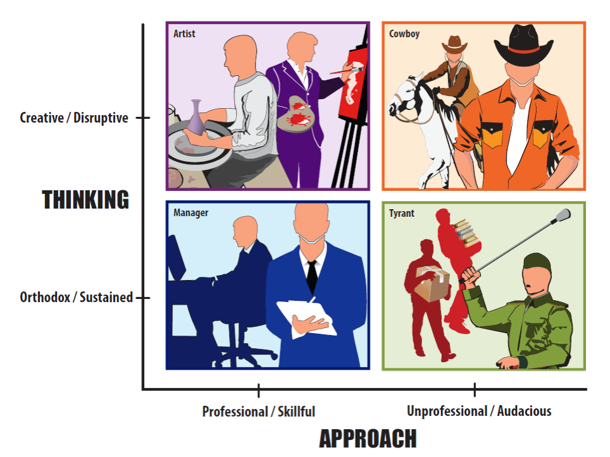
Steve Jobs and the Metamorphosis of Apple
Lessons from a Charismatic Leader
Anil Inamdar
Big Data Consultant

Slide 2
What’s in a name? – Shakespeare!
When was the first iPhone released?
In 1998 by InfoGear, it was a desktop phone
In 2000 Cisco bought InfoGear, owned iPhone trademark
Apple and Cisco negotiated before iPhone launch
In Jan 2007, Steve Jobs unveiled the iPhone, no mention of CISCO
CISCO sued
Companies settled within a month
What would a typical CEO do?
Follow rules, negotiate a contract, share revenue and profits
What did Steve Jobs do?
Defied conventional wisdom and challenged CISCO
He knew he would win because
Customer sympathy with Apple’s precedent of iMac, iPod
Triumph of iPhone, would make CISCO look like sore loser
Steve’s Charisma would play a key role

Slide 3
Table of Content
Idea Behind the Book
The City of Bricks / Marble
The Four Avatars
Apple Era I: Back to Apple Basics
Apple Era II: iPod
Apple Era III: iPhone
Lessons Learned
Ranking of top five decisions
Questions
Apple Refresher
Avatar Examples

Slide 4
Trivia Question: 1
When iPhone was unveiled in 2007, every ad displayed what time on the iPhone?
10:10 am
9:41 am
4:20 pm

Slide 5
Idea Behind the Book
Apple metamorphosis (1997-2011) – Second coming
What role did Steve Jobs play?
Was Steve Jobs a typical leader?
What differentiates him from other leaders?
Can we learn from his decisions and actions? “How” not “What”
Analyzed 47 decisions from 1997 through 2011
My Approach
Professional: Over 20 years in Data Analytics, 47 decisions
Academic: MBA
Passion: Apple fan

Slide 6
Apple Up To 1997: A Refresher
Apple – Inc 1/3/1977, public in 4 years, Fortune 500 in 3 more
Founder Steve Wozniak – “Father” of Apple II
Founder Steve Jobs – “Father” of Macintosh (1984)
By 1985 both the founders had left Apple
CEO John Scully – 1983 through 1993
Financial success - $600 M to $8 B, lacked innovations, org from products to function, growth slowed down, DOS-Windows was inching ahead
CEO Mike Spindler – 1993 through 1996
Beginning of crisis, forecasted 30 % growth in Market in 1995, Windows 95, Apple market share fell from 9 % to 7.5 %, $1 B of unsold Macs
CEO Gil Amelio – 1996 through 1997
Recognized OS issue, Acquired NeXT, good operations but lacked sales
By 1997 Apple on the verge of bankruptcy

Slide 7
Trivia Question: 2
Jobs spent seven months traveling in what country, experimenting with psychedelic drugs and eventually adopting the practices of Zen Buddhism.
China
Tibet
India

Slide 8
The City of Bricks

Slide 9
The Four Avatars
Categorized 47 Decisions
THINKING
Thought process leading up to the decision
Philosophy behind the decision
Creative or Orthodox
APPROACH
Method of execution of the decision
Skillful or Audacious

Slide 10
Unknown Quadrants
Unknown
Quadrants

Slide 11
Trivia Question: 3
What was the price of original Apple I
$ 500
$ 666.66
$ 399

Slide 12
Avatar Framework and Three Eras
The “Back to Apple Basics” Era
Period between 1997 and early 2000’s
Focus – mostly computers
17 decisions: Manager (5), Artist (5), Cowboy (4), Tyrant (3)
The “iPod” Era
Period between early 2000’s and 2007
Focus – mostly iPod music player, introduction to consumer products
14 decisions: Manager (4), Artist (4), Cowboy (3), Tyrant (3)
The “iPhone / iPad” Era
Period between 2007 and 2011
Focus – iPhone, iPad, consumer product manufacturing and marketing
17 decisions: Manager (5), Artist (4), Cowboy (5), Tyrant (3)

Slide 13
Apple Era I: Back to Apple Basics

Slide 14
Apple Era II: The iPod

Slide 15
Apple Era II: The iPhone

Slide 16
Trivia Question: 4
What was the name of Jobs’ illegitimate child with Chrisann Brennan
Lisa
Joanne
Siri

Slide 17
iTunes on Windows (Manager)
Microsoft wrote software for Apple but not VICE-VERSA!
iPod Market: In 2002, Macs – 25 million vs PCs - 500 million
Apple leadership – ability to mold music industry, offer iPod for Windows
Steve resisted iPod for PCs
Realized the potential
MusicMatch (not iTunes)
Lack of ”Apple Experience”, Need to FireWire (no USB)
Apple decided to port iTunes on Windows!
October 2003 – iTunes / iTunes Music Store for Windows – watershed moment
Within 1 year 10 million iPods, dominated mp3 market, market leader for the first time
This Steve was different than the one in 1985!

Slide 18
Introducing Mac OS X (Manager)
Original Mac released in 1984
Mac OS still based on original architecture
Motorola 68K to PowerPC
Stability issues, No full multi-tasking, memory protection, network capabilities
Next was bought to fix / replace Mac OS
Upgrading OS is a complex, multifaceted effort
Keep the press enthusiastic (Powerful NeXTSTEP + simplicity of Mac)
Keep developers excited
Backward compatibility (unlike original Mac)
Gil Amelio: Two-in-on OS Rhapsody (old apps will run but no new features)
8000 APIs, 1/4th will not work with new PS (Avie Tevanian)
New OS – Old 6000 APIs + new APIs – CARBON
CARBON (API Collection) will work on both Old Mac OS and New MacOS

Slide 19
Introducing Mac OS X (Manager) – Cont.
Developer conferences
Carbon – development time 1-2 months instead 1-2 years
Invited Microsoft, Macromedia and Adobe to developer conference (support)
Steve kept on encouraging developers, staged a mock funeral for Mac OS 9
GUI
Aqua, theme of water, colorful transparent buttons
Introduced “Dock” – moving between applications
Mac OS X – Future Proof
OS was the differentiator with competition like Dell, Gateway
Mini versions for iPod, iPhone
Ease of moving from PowerPC to Intel
Steve Jobs managerial skills (away from creativity)
Patience, encouragement, enthusiasm for complex, tedious effort

Slide 20
Trivia Question: 5
Jobs’ diet was?
Vegan
Pescetarian
Vegetarian

Slide 21
AT&T Negotiations (Artist)
Wireless carriers of 2000’s
Voice was commodity, long-term contracts
Data was still new
Controlled features and cost of handsets
Handsets subsidized for long-term contracts
AT & T (Ma Bell)
Rented phone and land lines
Monopoly broken, phone manufactures innovations – color, cordless, answering machines
Steve Jobs and Cingular / AT&T
Complete control over handset
“Data” as the new commodity – YouTube, Pictures, his charisma
40 % of iPhone buyers new AT&T customers
2013, ”Data” revenues surpassed “Voice”
Invigorated an inflexible industry, changed business model

Slide 22
Apple Stores (Artist)
First Apple Store: May 19 2001
Business Week: May be its time Steve Jobs stopped thinking quite so differently!
Modes of selling PCs
Internet or Resellers
Own box stores – disaster (Gateway)
Steve Jobs wanted his own Apple Store
Apple products were not generic like Dell / Gatewayy, they were buying an image
Apple share was < 5 % of PC market, Apple products were expensive
Steve Jobs reluctantly got approval from Board to open 4 trial stores
Hired Ron Johnson of Target Fame
Stores in high traffic areas (Mall) unlike Gateway (away from traffic to save cost)
No checkout counter, No commissions, No name (just logo), clean and welcoming
Genius Bar – free support , free classes on relevant topics
Huge success!, reached $1 B in 3 years, Apple Store generates $5600/sq. foot, Tiffany $3000/sq. foot in revenue
iPod, iPhone, iPad success – owes debt to Apple Stores
Steve went against conventional wisdom, against Board and came out the winner

Slide 23
Trivia Question: 6
What was the license plate number of Jobs’ Mercedez?
Lisa
Apple I
No License

Slide 24
iPhone: What’s in a name? (Cowboy)
First iPhone in 1998 by InfoGear, desktop phone
In 2000 Cisco bought InfoGear, owned iPhone trademark
iMac, iPod …. iPhone makes sense!
Apple and Cisco negotiations
In Dec 2006, Cisco rebranded Linksys VoIP as iPhone
In Jan 2007, Steve Jobs unveiled the iPhone, no mention of CISCO
CISCO sued
Companies settled within a month
Steve realized
Customer sympathy with Apple’s precedent of iMac, iPod
Triumph of iPhone, made CISCO look sore losers
Steve’s Charisma played a key role
Typical CEO
Negotiate a contract, share revenue and profits

Slide 25
Firing the Board in 1997 (Cowboy)
1997 CEO Gil Amelio resigned, Chairman Ed Woolard asked Steve to be the CEO, Steve declined and remained just an advisor but took control of Apple!
Started running as a CEO of a private company!
Asked board to lower exercise price of its options for key executives
Board asked for 2 month study – Steve threatened to leave Apple
Board reluctantly agreed for one time, but Steve instead of thanking – erupted
“Stop the train, this isn’t going to work. This company is in shambles, and I don’t have time to wet-nurse the board. So I need all of you to resign. Or else I am going to resign and not come back on Monday.”
Steve Jobs was not the CEO of Apple, had no stock options, was not even an employee
Most of the board was replaced including Steve’s mentor Mike Markkula!
New board were Steve’s friends (not independent as expected) – Larry Ellison, Jerome York (CEO if Microwarehouses, $150 M in Apple Products), Bill Campbell (Founder of Claris, Apple bought Claris)
With one swift move, new philosophy for Apple
Steve is the leader, he would not be questioned, challenged or opposed

Slide 26
Trivia Question: 7
What was Steve Jobs’ salary when he came back in 1997
Pro-bono
$ 1
$ 1 Million

Slide 27
Jeff Cooke Humiliation (Tyrant)
Apple Customer Service and Support in bad shape
Jeff Cooke, VP of Customer Service and Support
Steve wanted quick turnaround
Bullied Jeff and his team
“Everybody in Support and Services is brain dead”
Asked Jeff to end “SOS Apple” contract, Jeff resisted, FTC sued, Apple lost
Asked Jeff to terminate contract with Airborne Logistics Services (ALS) due to delay in delivery, Jeff resisted, ALS sued, Apple settled in 1999
Jeff resigned in 4 months (could have made $10 M in options)
Perplexing behavior
Not getting the results due to pressure, unethical behavior
Apple is struggling, cannot afford unnecessary lawsuits
Hiring and Firing takes time and money

Slide 28
“No Hire” Alliance (Tyrant)
March 2015, federal judge approved $415 M settlement from Apple, Adobe, Google, Intel against 64,000 technical employees
Illegal “No Hire” agreement alliance (2005-2009)
Ring Leader was Steve Jobs
Set the terms and diligently enforced them
Practice was deceptive and illegal
Steve wanted to closely guard his top employees
2005 Steve Jobs contacted Sergey Brin (Google) – not to recruit from Apple’s Safari team – “If you hired single one of these people, that means war”
2006 Steve Jobs objected to Google hiring 3 ex-Apple employees, Google agreed
Adobe, Intel followed
Palm CEO, Edward Colligan objected – Steve threatened him with patent infringements and lawsuits

Slide 29
Trivia Question: 8
Jobs forced employees to perform tasks they considered impossible – this was referred by many as
Charisma
Reality Distortion Field
The Apple Way

Slide 30
Lessons Learned

Slide 31
Trivia Question: 9
What was the name of the third partner of Apple for a brief 2 weeks when the company was formed in 1977?
Steve Wozniak
Mike Markkula
Ronald Wayne

Slide 32
Ranking of Top 5 Decisions
Firing of the Apple Board in 1997 (Cowboy)
Hired a supportive board, Traditional board would object to many controversial decisions – “Think Different”, Killing of Apple Clones
iTunes on Windows (Manager)
Boutique computer to consumer, younger customers, supply chain management, Significant revenue
“Think Different” Campaign (Artist)
Excited employees, customers, shareholders; Created an expectations; Steve personified later with iPod, iPhone
Making the iPhone (Artist)
Most successful product in Apple history, iMac – Steve is back, iPod – Financial independence/consumer products, iPhone – Icon
Apple Stores (Artists)
Defied board, retail consultants

Slide 33
Trivia Question: 10
What brand of sneakers did Jobs prefer?
Nike
New Balance
Adidas

Slide 34
Think Different - Trivia
“Think Different” Ad was recorded in Richard Dreyfuss’s voice
Lee Clow had asked Steve Jobs to record in his voice too – which he did
Moments before the ad was going live, Steve could not decide which version to use
He decided to use Richard Dreyfuss’s version
His Reason – “If we use my voice, when people find out they will say it’s about me. It’s not. It’s about Apple.”
https://www.youtube.com/watch?v=GEPhLqwKo6g

Slide 35
My Contact
You can contact me on “Steve Jobs and Apple Metamorphosis”
Similar overview (1 hour)
Detailed workshops (½ day to 1 full day)
Name: Anil Inamdar
Address: 3482 Rimini Lane, Dublin, CA 94568
Mobile: 858-361-6996

Slide 36
Questions

Slide 37
The Manager
Analytical and result-oriented person
Battle at Bosworth Field 1485
King Richard III held the English crown
Henry Tudor, Earl of Richmond
Shoe the horse
Shakespeare – “A Horse! A Horse! My kingdom for a horse.”
Jobs fired in 1985 for lack of basic managerial skills – operational efficiency, team collaboration, compromises, etc.
By 1997 he was a changed man

Slide 38
The Artist
Creative and imaginative thinker
Dome of Florence’s Cathedral – Santa Maria del Fiore
Conceived in 1296, by 1418 needed a dome
Dome – 150 ft in diameter, 180 ft above ground – impossible to carry weight
Florence competing with Milan
Brunelleschi labored for 16 years
Defied naysayers that the dome will collapse
Steve Job was no Brunelleschi but had the same attitude
Challenge the status quo
Attempt the impossible
Believed in instinct, intuition or a sixth sense

Slide 39
The Cowboy
A reckless, impulsive decision maker
Deadalus , finest craftsman in Greece
Icarus, his son Icarus
Imprisoned by King of Minos of Crete (an island)
Deadalus designed wings with feathers and wax
Icarus enjoyed soring into the sky
Icarus fell into the sea killing himself
Steve had a habit of taking risks
Both ingenious like Deadalus and
Imprudent like Icarus

Slide 40
The Tyrant
An autocratic, oppressive person acting without restraint
Drona – the supreme teacher
Arjun – Favorite student
Ekalavya – A commoner
Guru Dakshina (Fees)
Steve Jobs like Drona
Lacked empathy
In most cases Steve’s victims were innocent
His punishment did not justify the crime

Slide 41
Lessons Learned

Slide 42
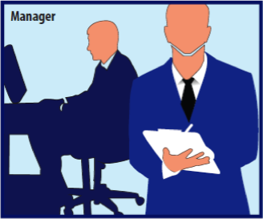
Lessons Learned
Manager Avatar
Lesson Name | Definition | The Hook | Apple Examples
The bird’s eye | Laser focus with minimal distractions | Prince Arjun’s focus on the eye of the terracotta bird | Product quadrant Initial iPod, limited features
Avoid fiefdoms | Avoid fiefdoms and work together | Middle ages: competing fiefdoms | iPod success One P&L Common design Common marketing
The strong bow | Successfully managing complex and mundane projects | Managing bow Is more important than arrow | Mac OS X Intel switch
The lion makers | Be pragmatic | Four friends make a lion from bones | Microsoft deal iTunes on Windows iPhone Apps
The longitude | Have a crystal clear strategy | Determining longitude Is difficult | Product quadrant Digital hub

Slide 43
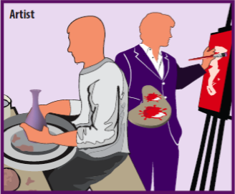
Lessons Learned
Artist Avatar
Lesson Name | Definition | The Hook | Apple Examples
The sixth sense | Identify and manage core competency | Maya Angelou: have a song, not the answer | The Whole Widget Killing of clones Apple Store
Hotel California | Customer loyalty, cult following, closed ecosystem | You can check out any time, but you can never leave | Apple Experience iMac, iPod, iTunes, iTunes Store iPhone, App Store
The book cover | Design trumps engineering | Do judge a book by its cover | Bondi Blue iMac iPod headphones iPhone touchscreen Product packaging
Combine art and technology | Ability to combine complementary abilities | Agassi-Gilbert partnership | Complex products – iPod, iPhone, iPad
The circus | It takes meticulous preparation to awe and delight an audience. | Circus is a coordinated chaos | Meticulous preparation iMac launch iPhone launch

Slide 44
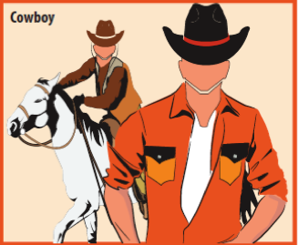
Lessons Learned
Cowboy Avatar
Lesson Name | Definition | The Hook | Apple Examples
The Godfather | Take advantage of your upper hand | Make an offer no one can refuse | Firing of Apple board Hiring of new board Sony royalty
Calculated risks | Taking calculated risks | Henry Ford: increased wages to cut cost | Intel chip ads Jetsons clip iPhone name/Cisco
Reality distortion field | Attempt the impossible | Frog churning butter to save life | iPod in 6 months Corning glass Apple “cube”

Slide 45
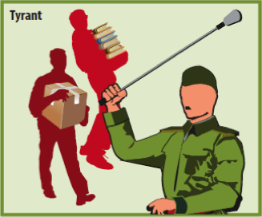
Lessons Learned
Tyrant Avatar
Lesson Name | Definition | The Hook | Apple Examples
The small stuff | Focus on important things, don’t sweat the small stuff | Rocks, pebbles and sand | Not Fucking blue enough (iMac) VLSI team
Emperor’s new clothes | Don’t create culture of fear | Weaver and Emperor’s new clothes | MobileMe fiasco Option scandal
The personal lamp | Don’t mix business with personal vendetta | The accountant with two lamps | Wiley publications Concealing health issues
The quicksand | Don’t fight the inevitable | Quicksand: the more you struggle, the more you are dragged down | Android fight DRM strategy

Slide 46
Think Different (Artist)
1984 Super Bowl Commercial for Apple Macintosh - creative, rebels, BRAND
By 1997 the BRAND had become irrelevant
Steve wanted to invigorate the BRAND along with products
In 1997 Steve Jobs started working with Lee Clow (“1984”) on a new campaign dubbed “Think Different”
No product, No service, Not even Apple name just logo
“Here’s to the crazy ones …., Piacsso, Einstein, Gandhi, Beatles
Excited the customers, employees and shareholders
Create excited and expectation for what is ahead
Steve Jobs followed that with iMac, iPod, iPhone and iPad
Steve Jobs the Artist
Bold statements but nothing substantial – no product, no service
Apple was on the verge of bankruptcy, yet Steve took on this nebulous concept

Slide 47
Making the iPhone (Artist)
iPod introduced in 2001, iPhone in 2007 – 6 years was time of experimentation
iPod was a success but mobile phones were popular too
More and more functions added into mobile phones – email, PDA, mp3 player, FM radio. Apple scared that mobile could make iPod irrelevant
Several experimentations were going on
Apple collaborate with Mororola (RAZR) to put iPod in it (ROKR)
Tony Fadell (iPod chief) stated working on internal music phone
Jobs wanted iMac on a tablet – no keyboard (Project Purple) – put on hold as technology was not there – battery, processor etc.
Research on multi-touch technology – dining table sized prototype
ROKR failed, Jobs decided to build a smartphone
Multi-touch, Fully functional browser, iPod, Video, Apps
Jobs decided to combine all of the research into one complicated product!
Without Steve we would have had smartphone but it would have taken form of several individual products – Music Phone, Mult-touch Tablet, Phone with Apps etc.
Jobs accelerated it – may be by 10 years!

Slide 48
Making the iPhone (Artist) – Cont.
Impact
Steve Ballmer (CEO, Microsoft) – Expensive phone with out keyboard, will not succeed – He was wrong!
2011 Cisco bought Flip camera for $600M, iPhone / iPad made it obsolete in few years
Google was working on Android, mobile OS, they underwent a major upgrade
Intel did not enter into Mobile Chips market for quite a while, until they realized that mobile phones were the new computers
Palm CEO, Ed Colligan – PC guys are not just going to figure out phone technology
Ericsson had good run in phones for close to 100 years, could not compete in mobiles

Slide 49
Apple Operations (Manager)
Making sexy consumer products – two parts
Creativity, design, engineering – Steve Jobs’ continued focus
Manufacturing, forecasting, delivery – Steve Jobs’ focus from 1997
Steve hired Tim Cook in 1998 and trusted his instincts
iMac era: Defense – outsourced manufacturing, reduce # of suppliers, reduce inventory
iPod era: Offence – Whole Widget, Virtual vertical integration
iPhone era: Winning Games
Became Gartner Supply Chain Master along with P&G, top performers, past 10 yrs
Closely managed end-to-end integration – R&D, Industrial Design, Engineering, Procure components, Manufacturing (Foxconn), Apple Stores
$60 B in Cash (now > $200 B) – used to strengthen Apple Supply Chain
2010 iPhone 4 touchscreen shortage for HTC, Apple pre-paid orders
Shortage of high-end drills, iPad 2, competition waited for 6 months

