Slide 1
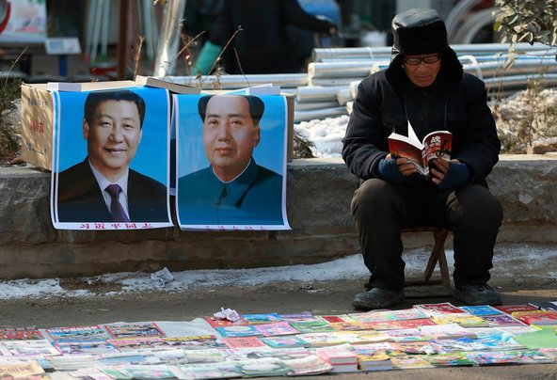
ROI, China: Risk and Opportunity in the Era of Xi Jinping
Book peddler in Yan’an, site of the Chinese Communist Party’s wartime headquarters and now a tourist destination. Text copyright © Matthew Brazil, all rights reserved
Notes:
China has undergone tremendous changes since the communist victory in 1949. Why are these changes so dramatic? What has remained the same? What can the world count on from China? While we cannot predict the future, it is possible to anticipate some developments already in progress - an increasingly dictatorial state that suppresses regional interests, sharper and more intense nationalism, and a shift away from the booming export-led economy of the recent past.

Slide 2
First, FYI
This is about staying secure while doing business in China, for foreign companies but also for domestic Chinese ones
I will pose comparisons between China and other nations…
…but only for the sake of clarity
No one can be perfectly objective. I try, nonetheless.

Slide 3

Who is your presenter?
Founder, Madeira Security Consulting, advising firms on the China market and security problems there
Former US Embassy Beijing officer, Asia security investigator for a US semicon firm and security director for an American chemical firm
Ph.D., Government and International Relations, student of Chinese Communist Party history
Co-author with Peter Mattis of the Handbook on Chinese Intelligence Operations (Naval Institute Press, 2018)
Author of articles on the problems of doing business in China. www.jamestown.org
Website: Madeirasecurity.com
Twitter: @matthew_brazil

Slide 4
Main Messages
Xi Jinping has genuine popular support to clean up corruption and raise China’s stature.
He may become a historical and transformational figure
Doing business in China can be profitable, but one must appreciate the changes under Xi
Foreign businesses now face higher risk to people and assets than before

Slide 5
Countermeasure Strategy
Things to Know Before Doing Business in China

Slide 6
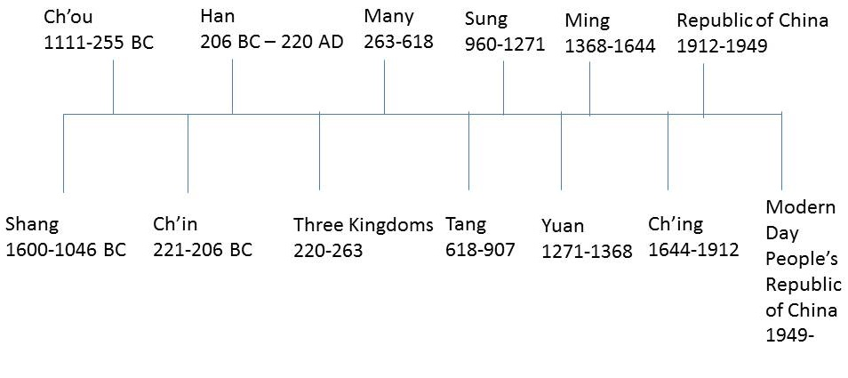
5000 years of the Emperor System—and a century with two republics
Notes:
China has only recently emerged from an emperor system with absolute rule from the top by an intermediary between heaven and earth. The math here is self-evident, and poses a more recent and sudden set of changes versus those experienced by other countries outside of Asia. In short, authoritarian rule and traditional thought with strong threads from centuries past remains strong. This isn’t absolute, because things are changing with each generation. It just means that change has been more abrupt in China than here.

Slide 7
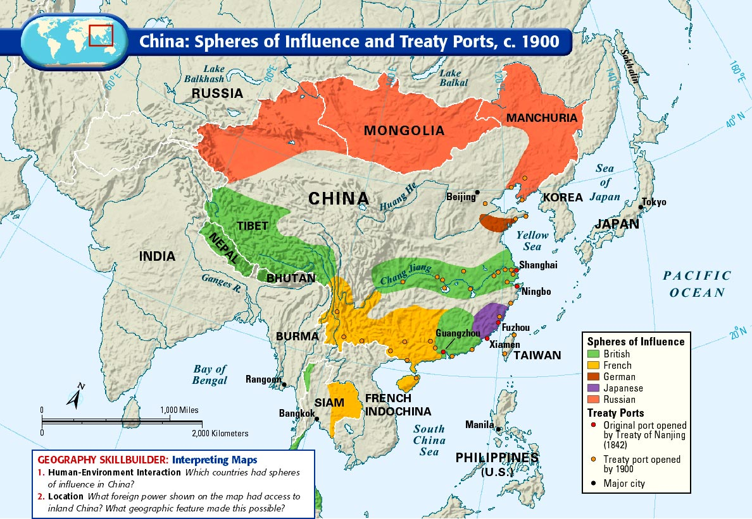
The Century of Humiliation, 百年国耻: 1842-1949
Notes:
Part of that sudden change was the assault on China during an already declining dynasty by Western interests and armed forces.
Why was China humiliated? It was “carved up” into foreign spheres of influence (not quite colonized) and eventually became a “loose sheet of sand” when the Qing Dynasty ended in 1911-12. Today, all Chinese students learn of this humiliation

Slide 8
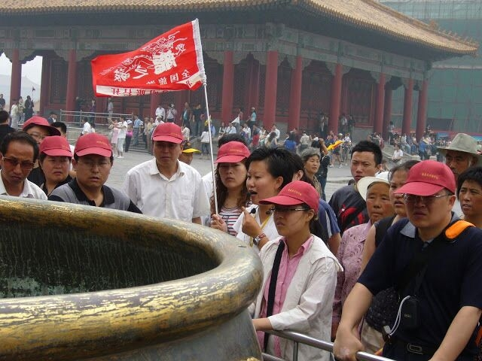
People can still become angry. Suddenly.
Chinese tourists in Beijing view relic in Imperial Palace defaced by French soldiers in Second Opium War (1856-60)
Notes:
The anger over the century of humiliation can emerge suddenly, given the right circumstances. I took this photo. The group changed in seconds from happy and excited to sober and grim as the guide described why the gold was missing from this ceremonial urn in Beijing’s Imperial Palace, the “Forbidden City”

Slide 9
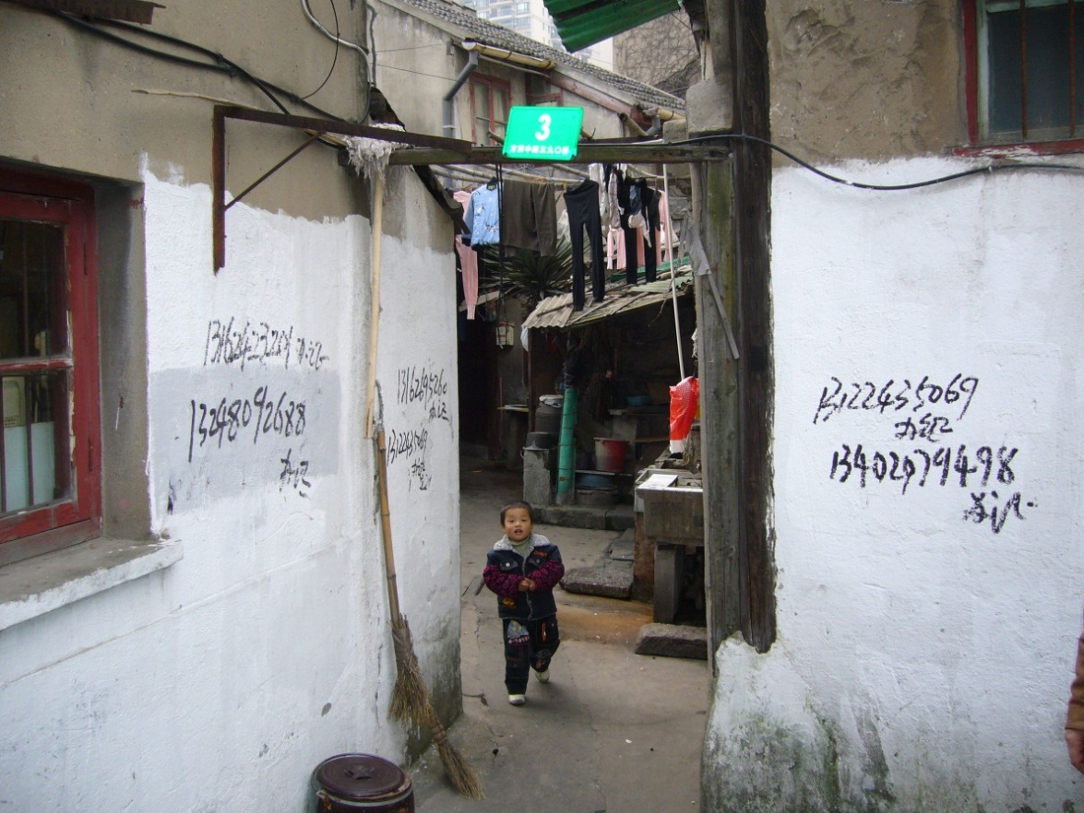
Why Did Corruption Blossom Before
Xi Jinping?
Law enforcement underpaid
CCP officials underpaid
CCP admitted the developing moneyed class: “The Three Represents” 三个代表
State assets privatized: sold off to friends of friends
Favoritism:
- Transfer of land and State assets
- Ignore rules for friends
- Make life difficult for others
- All without interference from Beijing
The party gradually lost control over its local officials
办证 (banzheng): “Official identification cards arranged, call 13402979498” etc. Shanghai, 2015
Notes:
The economy boomed but predictions by Party conservatives that “opening up” would lead to corruption were spot on. When the Party decided to begin privatizing state-held assets in order to weed out unprofitable enterprises, they sold them off to Party insiders or their relatives at very low prices. The new owners then turned around and laid off many workers, either re-tooling with loans from state banks that were often not paid back, or re-selling properties a bit later at a windfall profit. These activities would never have been specifically approved by the central government, but the point is that Beijing did not try to keep control of them, and local officials were often corrupt and pursued selfish interest at the expense of the public.

Slide 10
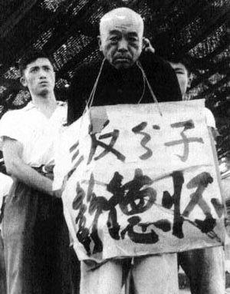
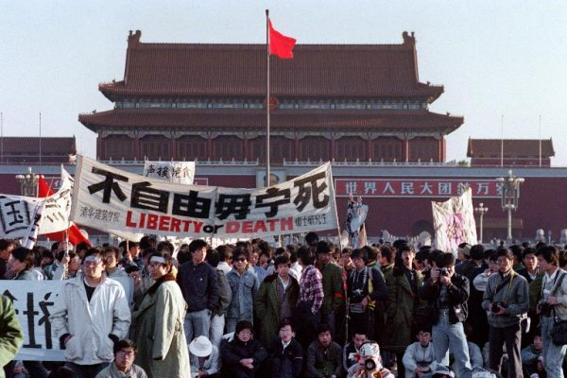
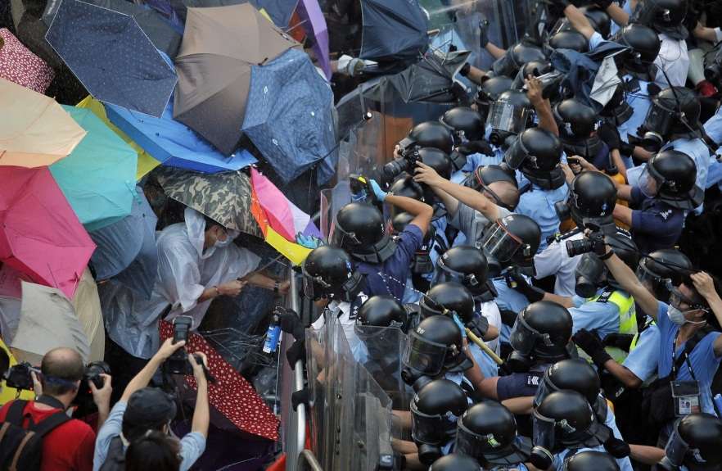
Fear of chaos should corruption erode Party and state authority
Uncertainty Avoidance
China’s Korean War commander, Peng Dehuai, denounced and jailed in 1967 by Red Guard mobs during the Cultural Revolution. He died in custody, 1974; the Tian’anmen demonstrations in 1989; the Hong Kong Occupy movement, 2014
Notes:
In the eyes of some Chinese leaders, and many ordinary people, the lack of a strong hand at the center can lead to instability and chaos. Therefore, there is a stronger imperative to avoid uncertainty and trust in routine, rules, and a strong leadership. This helps Chinese people accept the idea of not challenging the boss, referenced earlier.
Why do many Chinese people – and not just communist leaders – think that the peaceful demonstrations during 2014 in Hong Kong were dangerous? Because to a person viewing the situation in traditional terms might see the same things in Hong Kong that happened during the early stages of the Cultural Revolution. That’s a misreading of history, but nonetheless a common one.

Slide 11
The Result: Unique Mix of Old, New
CHANGE
CONTINUITY
More mobility, independence for people
An economy and polity that is less socialist
Innovation by domestic ventures is on the rise
An increasingly modern and centralized government
Modern geopolitical reality: threat is from the ocean
Continued need for parental, peer approval of mate, job
CCP remains at the center of political, economic life.
Foreign technology remains a staple of development
Persistent regionalism, fears of return to warlordism and chaos
Ancient geopolitical reality: China is safest when locally dominant

Slide 12
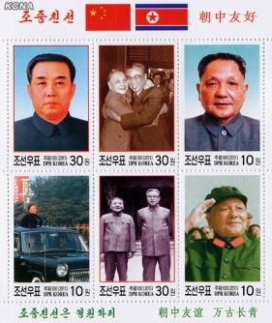
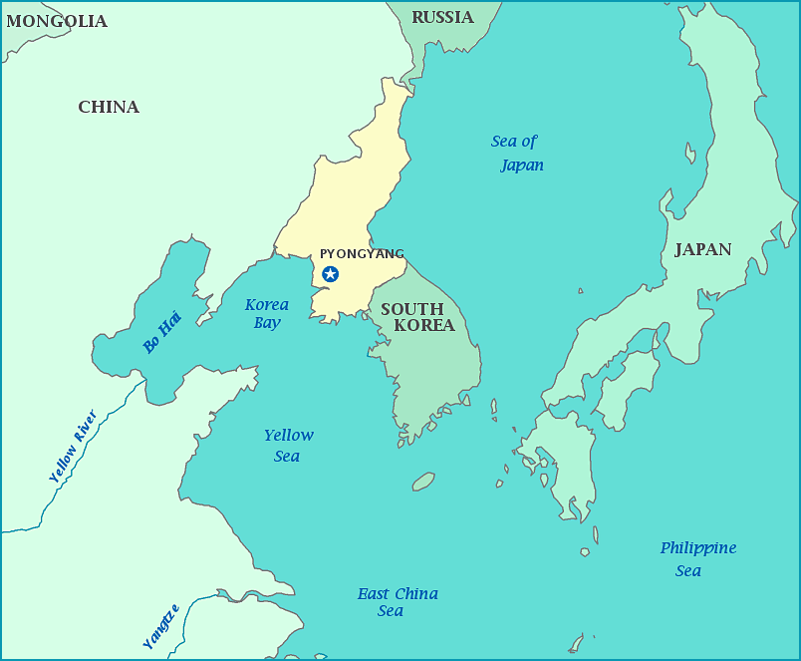
Geopolitical Example: Keep Korea Onside
Notes:
Korea, a “shrimp between whales.” Korean peninsula only united when one of the three regional powers is dominant. Balance of power scenario like today generates momentum to divide the peninsula, and for the northern half to cling to a close rel with China even though interests will diverge. This is why KN leaders and those in China continue to conclude that they need each other – but do not necessarily get along well. It is likely, by the way, that Chinese leaders today see the bluster between the US and KN to be an opportunity to be a sober, reliable influence for peace, and further their goal to push the US out of East Asia. This is not bad or evil, it’s just logical application of geopolitics.

Slide 13
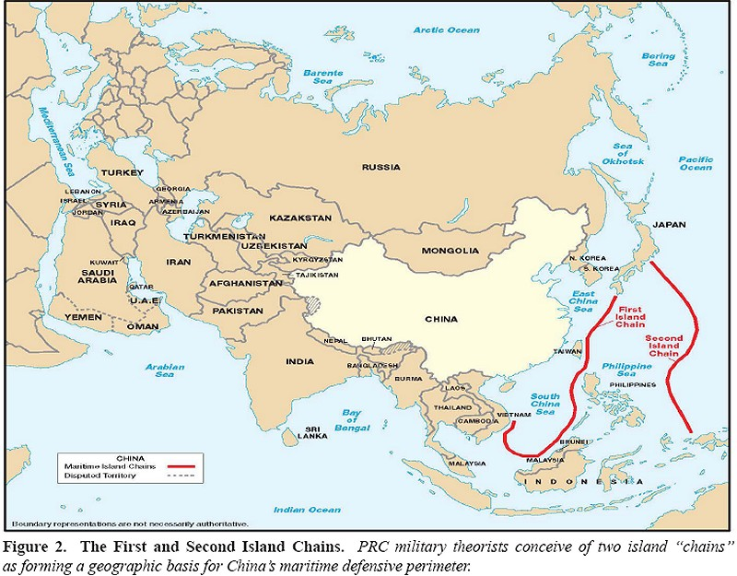
Geopolitical Example: Avoid a US and Japanese coastal blockade
Notes:
In the Imperial era, there was no threat from the east—from the ocean. But that changed with the coming of Western imperialism in the 19th Century. Chinese leaders have learned that as long as they cannot control the nations to the east, then they are vulnerable to blockade. With China’s increasing reliance on international trade, this situation has become increasingly unacceptable to Beijing. This concern lies at the core of the PRC leadership’s determination to neutralize Japan, retake Taiwan, control the South China Sea, and change the Philippines from being a US protectorate into a Chinese one. This is a big change. As Chinese leaders seek to reassert traditional suzerainty in East Asia, subsequent developments promise to become major historical events

Slide 14
Countermeasure Strategy
The Physical Risk Baseline for Foreign Business People in China
Physical risk and crime are much lower in China than in the US.
But protections to business under the law are uneven, and affected by politics
Notes:
Physical risk and crime are much lower in China than in the US.
But there are complications

Slide 15
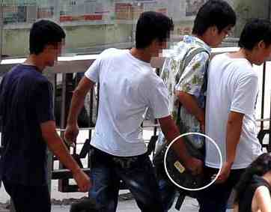
Crime in China
China’s homicide rate is low at 1.0 per 100k. Murder and robbery far less common than in the US
Crimes easily encountered in large Chinese cities:
Extortion in “black taxis”
Petty theft and pickpocketing
Counterfeit currency
Fraud and scams
Prostitution
Drug trafficking
Crimes that are common but relatively hidden:
Corruption
Money laundering
Human trafficking
The biggest threats to Americans in China seem to be traffic accidents and suicide.
Notes:
Police often ignore some technically criminal activity, perhaps because local Communist Party interests have been known to run it for profit (e.g.: gambling, prostitution). At the same time, violent crime and political dissidence are low and are vigorously pursued by the police. But traffic enforcement is inconsistent and traffic accidents are perhaps the greatest risk to the visitor. So the behavior by the police in China is different than in North America or Western Europe: it is less predictable and more driven by occasional crackdowns that take enforcement from dormant to hyperactive in a day. The trigger can be political considerations such as VIP visits to the city. The lesson: obey Chinese laws, no matter how much you see them being violated around you – the crackdowns can come instantly and when they do, they are vociferous.

Slide 16
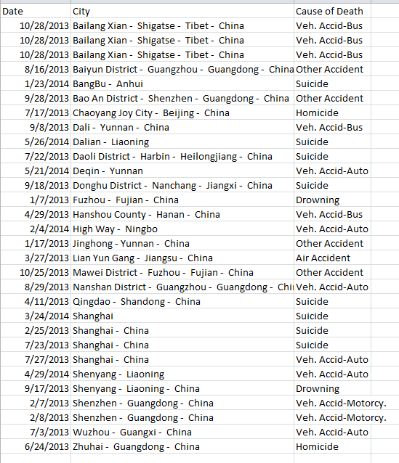
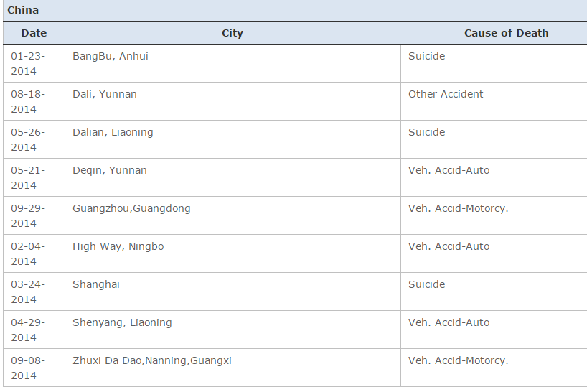
Available stats: American deaths, 2013 - 2016
2013: Vehicle 13; Suicide 8; Misc accidents 4; Air accident 1; Homicides 2.
2014: Vehicle 5; Suicide 3; Misc accidents 1.
2015: Vehicle 6; Suicide 4; Misc accidents 4.
2016: Vehicle 6; Suicide 7; Misc accidents 4; Air accident 1.
Source: travel.state.gov US Citizen Deaths Overseas

Slide 17
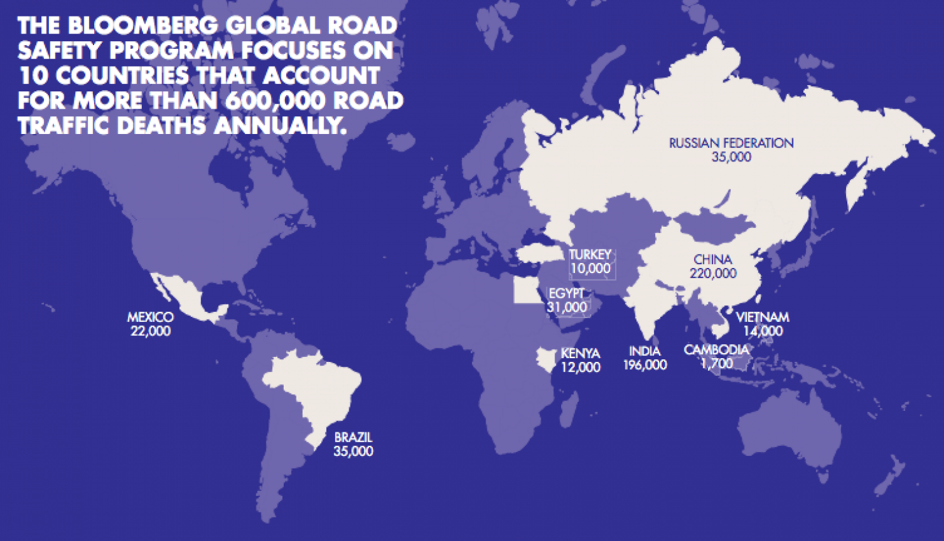
Fasten your seat belt: China, US have about the same number of cars, but China road deaths are 4.5x that of US
From China Daily:
The China Automotive Technology Research Center said last year that traffic deaths dropped 28 percent from 2004 to 2009, with 67,000 deaths in 2009.
But American and Chinese researchers questioned how such numbers could be accurate...
The study's researchers, from Johns Hopkins and China's Central South University, compared police data with death certificates from doctors logged between 2002 and 2007. They found that police statistics showed a 27 percent decrease in traffic fatalities, while those recorded on death certificates increased by 8 percent.
In 2007, for instance, police logged 81,649 deaths, compared to 221,135 listed on death certificates… (emphasis added)
http://www.chinadaily.com.cn/china/2011-01/07/content_11808453.htm
WHO: In 2015, 261,000 road fatalities in China
http://www.chinadaily.com.cn/china/2016-05/24/content_25442984.htm
http://www.washingtonpost.com/blogs/worldviews/wp/2013/01/18/a-surprising-map-of-countries-that-have-the-most-traffic-deaths/ Once again, the biggest threat to you in China is traffic accidents
Notes:
Such an article might be harder today to publish in official Chinese media

Slide 18
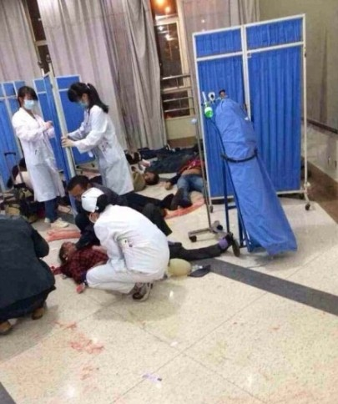
Wrong Place, Wrong Time
Indiscriminate attacks are rare, but always possible.
Foreigners normally not involved—but no reason to think they’d be spared
22 May 2014: attack in Urumqi, Xinjiang, killed at least 31 people and injured more than 90.
6 May 2014: six people were injured in an armed attack at a railway station in Guangzhou.
1 March 2014: armed attackers killed 29 people and injured scores of others at Kunming Railway Station.
June 2015 shotgun killings of five, Hebei
Bottom line, always:
- remain aware of your surroundings and
- know how to exit situations and places
Kunming Railway Station, 1 March 2014

Slide 19
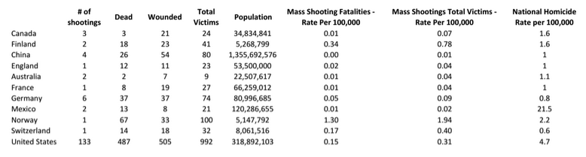
In Perspective: Mass Shootings Worldwide, 2000-2014
Jaclyn Schildkraut, H. Jaymi Elsass, Mass Shootings: Media, Myths, and Realities (ABC Clio, 2016)

Slide 20
Countermeasure Strategy
The IP Theft Risk Baseline in China

Slide 21
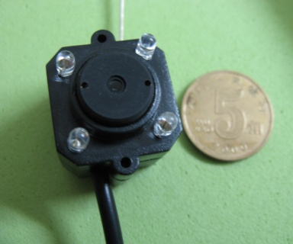
Since 2012, anyone with money can purchase surveillance equipment in China. Vulnerable:
  Hotel rooms, meeting rooms
  Office, cars, taxis
  Telephone, fax machines
  Personal computers
  Internet
Special Circumstances
It’s not just the government any more: ad for covert camera. www.hunanhydc.com/ (Hunan Marriage Investigation Company) August 2017

Slide 22

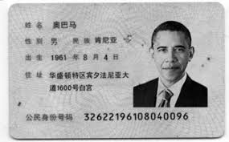
Proliferation of Fake Certificates: thorough due diligence is vital
Site (Aug 2017) advertising fake driver licenses, national ID cards, bank loan documents, graduation certs, etc. A fake ID with a foreigner’s likeness to demonstrate quality

Slide 23
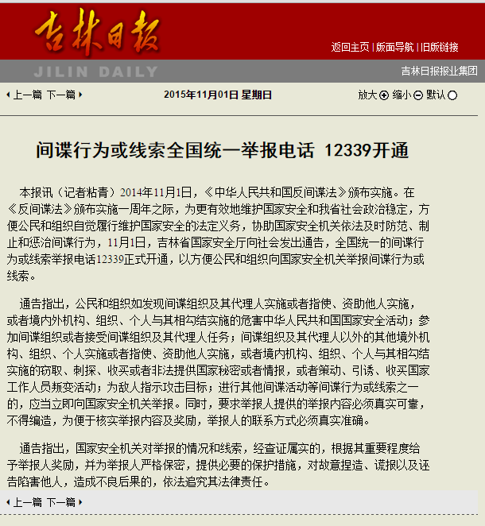
State Security Law of the People’s Republic of China
China’s Counter-Espionage Law (2014/15)
Article 4: Citizens of the People's Republic of China shall have the duty to safeguard the security, honor and interests of the State.
Article 20: Citizens and organizations shall facilitate and provide convenience or other assistance to anti-espionage efforts.
Chinalawtranslate.com; http://news.xinhuanet.com/legal/2017-04/10/c_1120777169.htm

Slide 24
网络安全法 The New Cyber Security Law and Regs
The Law Says:
Companies doing business in China must store their data in China (Article 37)
Inspections will be done at least yearly (Article 38)
This applies even if you are dealing with a firm in China, but don’t operate there
Prison time could result from an offense
One Possible Solution:
only do business in China that requires retention of data that you are willing to share with the PRC Government and its State Owned Enterprises (SOEs).
Full implications are TBD
第三十七条 关键信息基础设施的运营者在中华人民共和国境内运营中收集和产生的个人信息和重要数据应当在境内存储。因业务需要，确需向境外提供的，应当按照国家网信部门会同国务院有关部门制定的办法进行安全评估；法律、行政法规另有规定的，依照其规定。
第三十八条 关键信息基础设施的运营者应当自行或者委托网络安全服务机构对其网络的安全性和可能存在的风险每年至少进行一次检测评估，并将检测评估情况和改进措施报送相关负责关键信息基础设施安全保护工作的部门。
http://www.npc.gov.cn/npc/xinwen/2016-11/07/content_2001605.htm

Slide 25
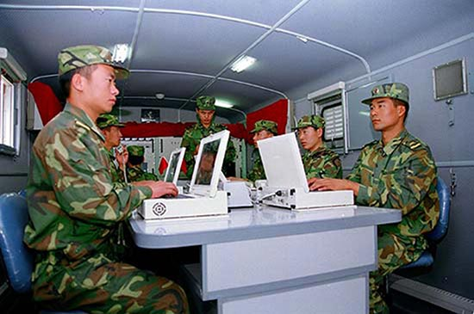
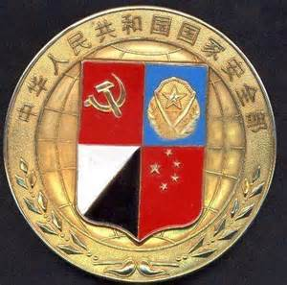
Chinese Security Organizations
中国人民解放军、People’s Liberation Army
  联合参谋部、Joint Staff Department: runs human agents
  战略支援部队、Strategic Support Force: monitors communications, runs electronic countermeasures
  国家安全部、Ministry of State Security: plants agents, gathers foreign intelligence
  公安部、Ministry of Public Security: China’s national police
  Western analysts: there is little coordination between them, therefore a foreign business of interest could be examined by more than one
SSF troops in the field; Ministry of State Security seal

Slide 26
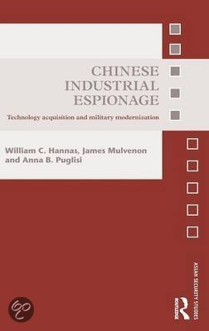
National Development Priorities (FYP) set then refined
Individual Ministries respond, task units
Units undertake collection activity against specific targets
Information collected, fed into system
Technology is commercialized
Government planning bodies draw up plans, coordinate among ministries; plans are reviewed and approved by the Communist Party and, finally, approved by the National People’s Congress and implemented.
Ministries, their managers and their subordinate units are rewarded based on their success in bringing “innovation” online in a commercial context.
Chinese Technology Acquisition Cycle
Information is digested through the Industry-University-Research Institute Collaboration system, which delivers results to commercial entities for commercialization.
Collectors include intelligence agencies, research institute, universities and state owned enterprises; the latter three can call on the resources of the intelligence agencies to assist with collection.
“We are talking here of an elaborate, comprehensive system for spotting foreign technologies, acquiring them by every means imaginable and converting them into weapons and competitive goods. There is nothing like it anywhere in the world. The system is enormous, benefitting a nation of one point three billion, and operates on a scale that dwarfs China’s own legitimate S&T enterprise.” Hannas, Puglisi and Mulvenon, Chinese Industrial Espionage (Routledge, 2014)
Notes:
National development priorities set and refined
Individual ministries respond, and task collection units (MSS, PLA)
Units undertake collection against targets
They collect data and feed it into the national system
Technology is commercialized

Slide 27
The Main Point: China conducts espionage mostly like other nations
China does:
Have professional civilian and military intelligence agencies
Keep operations secret and “compartmented”
Exercise unusually strong control over the few ordinary Chinese whose help they require
Have a unique system to gather and utilize advanced technology for benefit of its state owned enterprises (SOEs)
Allows SOEs to clandestinely seek their own sources of technology with no regard to FCPA-type laws
Does not:
Employ massive numbers of ordinary people living overseas
Force cooperation of every student headed abroad
Recruit only ethnic Chinese to spy

Slide 28
Countermeasure Strategy
The China Business Environment: Why is Risk Rising?

Slide 29
严打 Crackdowns Come and Go with Little Notice
Scrutiny of gambling industry in Macao, especially casino VIP rooms and junket tours; probably ongoing.
Anti-narcotics crackdown began in Fall 2014, probably finished.
Crackdown on prostitution and online dating websites probably continues in many locations. A prominent effort in Dongguan City, Guangdong ended in early 2015, but Public Security units continue to devote resources to the issue elsewhere, according to the China Daily.
Ban on ivory imports, in force through 15 October 2016.
Anti-espionage campaign: Including “dial 12339 to report a spy.” Targeted on foreign enterprise employees since 2014, apparently continuing
Sources:
http://www.ibtimes.com/china-drugs-crackdown-police-arrested-133k-people-seized-over-40-tons-narcotics-last-1884360
http://www.chinadaily.com.cn/china/2015-04/02/content_19983846.htm
http://www.csmonitor.com/World/Global-News/2015/1016/China-s-crackdown-on-trophy-hunting-Is-it-enough
http://jlrbszb.chinajilin.com.cn/html/2015-11/01/content_176708.htm

Slide 30
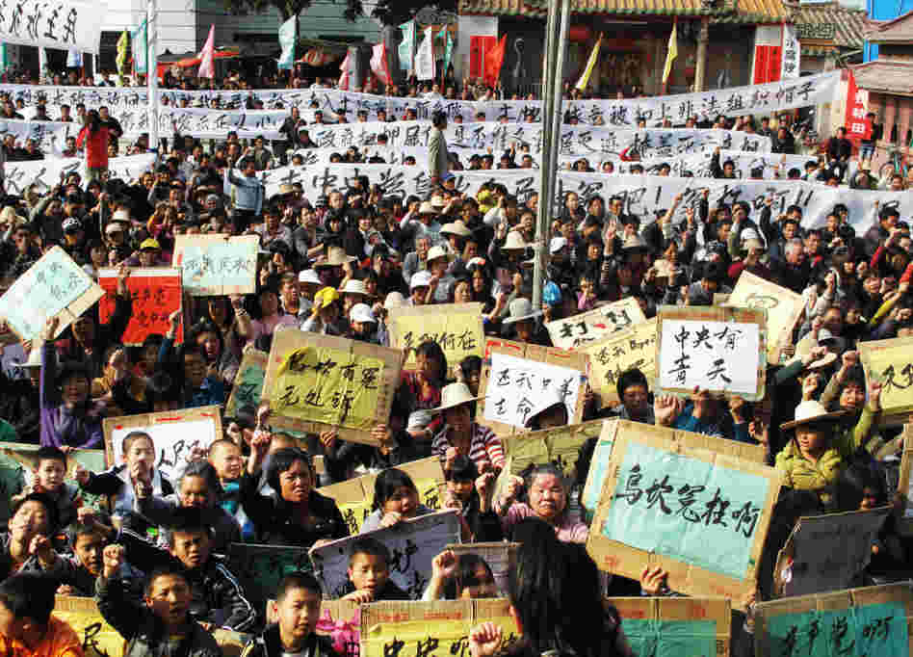
Land Seizures remain a tool of local governance
Urban plots for development
Rural areas for mechanized farming or housing development
Low compensation to the evicted
High fees collected by local CCP committees supplement budget and enrich top officials
Beijing tolerates as long as local CCP committees keep matters under control
“Overall, the national policy is quite good, but what is implemented at the local level is entirely another matter.” – Peasant woman being evicted in north China, from “Power and the People,” Aljazzera English, at 10:15
Nov 2011 land seizure protest in Wukan, Guangdong: local people evicted the county Party Committee and the military was preparing to assault the area when a compromise was reached.

Slide 31
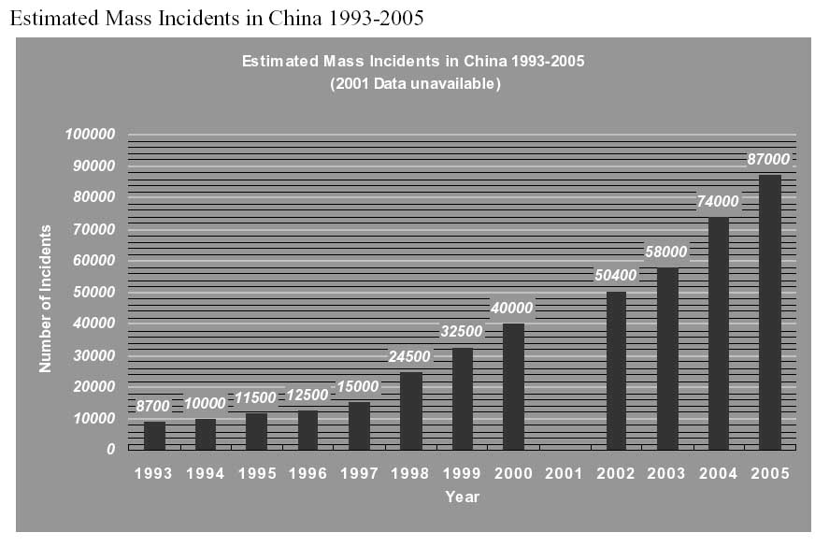
“Mass Incidents”
Common examples:
Farmers protesting large local projects or land seizures
Workers, especially in textile industry, protesting low pay, overwork, or conditions
Retirees demanding pension payments
Laid off workers demanding their jobs back
Urban citizens protesting a factory with bad safety or pollution record
Anti-foreign protests
Ethnic minorities protesting bad treatment by police
MPS announced 120,000 mass incidents in 2008, but has not provided statistics in subsequent years. See http://factsanddetails.com/china.php?itemid=305&subcatid=49#00

Slide 32
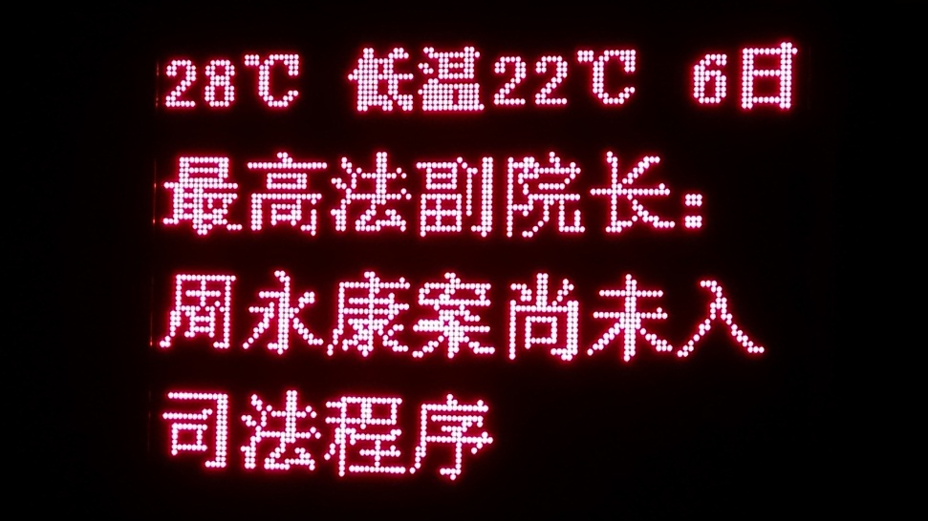
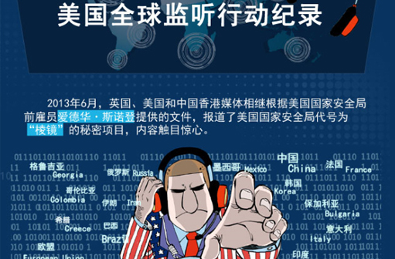
Under State Chairman Xi, a New Atmosphere
Most intense anti-corruption campaign since 1954
Accompanying campaign to improve efficiency
Increased auditing and efforts to regularize enforcement
Even less room for dissent
An anti-foreign sub-current: “dawn raids” on Microsoft, GM, others; more confrontational toward US, Japan, close neighbors
Public news board in Zhuhai gives update on the corruption trial of the most senior official under scrutiny, Zhou Yongkang (6 Nov 2014); Chinese cartoon depicts US cyber spying in aftermath of Snowden revelations.
Notes:
To put it simply, there was an escalating debate in China from the May 1999 to perhaps 2010 about how to treat the US: are we an ally, a competitor, an adversary, or a dangerous enemy to China? The intensified debate began with the US bombing of the Chinese embassy in Belgrade, Yugoslavia (May 1999). Three Chinese Ministry of State Security agents under cover as official journalists were killed. The bomb made a direct hit on the Chinese embassy’s equivalent of a CIA station, on the top floor, which makes many Chinese think—to this day—that the bombing was deliberate.
In short, this ruined the relations between Chinese security services and their US counterparts, and greatly affected US companies in China because the Chinese services have increasingly come to believe that the American intelligence agencies are using US business people in China as clandestine agents. The situation has never improved, and was made even worse by the revelations of Edward Snowden last year. To be sure, Chinese agencies have always closely watched US visitors, hacked computer systems, and many other if not all of the things Snowden discussed in public—like plant hostile devices into electronic exports. But the public discussion of what NSA and CIA have been doing against China has turned up the pressure on Chinese agencies to take countermeasures and find US spies: for us, this means increasing attention to everything we do in China, even though we want nothing to do with politics or related matters.
We as businesspeople are now more suspect than ever before, both to the host government and to ordinary people. You probably won’t be personally confronted about this, but you will be more suspected and closely watched than in past years. Questioning at the border, for example, is more of a possibility than five years ago. Such “interviews” of foreign business people reflect an increasingly aggressive security posture. Meanwhile, some Chinese employees at foreign businesses are selected to attend Saturday reporting meetings, where they are provided with monetary incentives to bring relevant information about their employer.
The situation is more sensitive now because of the high level political struggle underway for 5 of 7 seats on China’s highest level organization, the CCP’s Politburo Standing Committee, at the next (19th) CCP Party Congress in 2017. You can see on this slide a summary of the three rival factions in the CCP, which make them seem like three separate political parties. The ascendant faction right now is Xi Jinping’s “princelings,” the sons and daughters of the previous generation of senior communist officials. Understanding this is not really worth a lot of time here, but if you are interested there is a lot of reading available online.

Slide 33
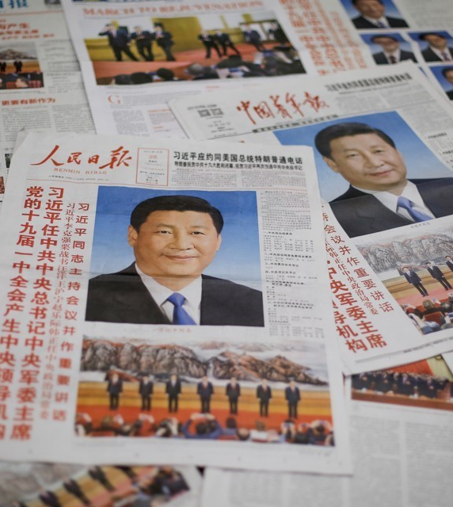
Countermeasure Strategy
Why Xi Jinping Thought (习近平思想) Will Increase in Importance
“Maoism” in English = “Mao Zedong Thought” in Chinese (毛泽东思想)
In theory, Xi Thought may now be on same level as Mao Zedong Thought
Opposing Xi Thought might become a “political mistake of line” （政治路线的错误)
That might mean prison time or worse.

Slide 34
Xi Jinping Thought
PROBABLY DOES MEAN:
Shows no signs of meaning:
Xi Jinping has attained a new level of prestige and power
Publicly expressed faith in the single leader is required
Xi’s “thought” may not be challenged
Radical left policies
A new Cultural Revolution

Slide 35
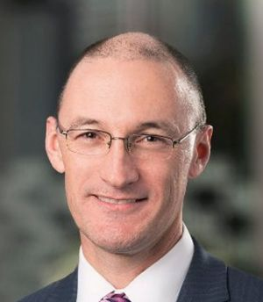

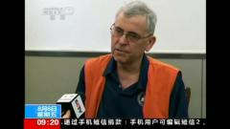
Famous Foreign Business-detainees in China
Xue Feng (US) of Information Handling Services, Inc, 2007
Stern Hu (AUS), Rio Tinto, 2009
Four Japanese construction execs detained over the Diaoyu/Senkaku Islands, 2010
Peter Humphrey (UK) and Yu Yingzeng (US), GSK and Chinawhys, 2013
Sandy Phan-Gillis (US), 2015-17
Jason O’Connor, Pan Dan, Jerry Xuan (AUS), and 15 other Crown Resorts staff, 2016 – 2017
O’Connor, Phan-Gillis, Humphrey
Shifting regulations and laws, changes in enforcement priorities, the corruption crackdown, bilateral politics, and unknown factors.

Slide 36
Countermeasure Strategy
Mitigating Risk

Slide 37
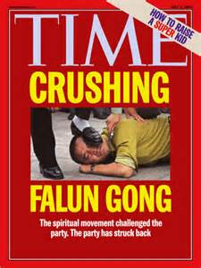
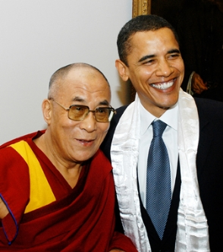
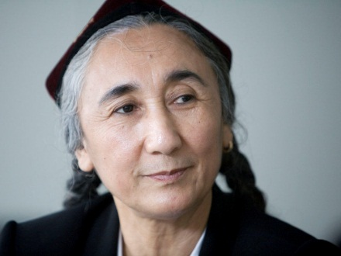
First: Keep out of trouble by not taking banned materials into China
Falun gong, aka: Falun dafa; New Tang Dynasty Television (NTDTV) and China Uncensored material
Dalai Lama’s books, photos, the Tibetan flag or unapproved literature about Tibet
Material about other minority areas, especially Xinjiang, not published in China
Time cover on the Falungong; Obama and the Dalai Lama; Rebiya Kadeer, one of the principal Uighur leaders in exile.

Slide 38
Travel and Life with Chinese Characteristics
Demonstrations without prior approval from the Chinese government are prohibited and protestors can be arrested.
Avoid photographing, videoing or participating in protests or other acts which could be seen as provocative by authorities in Tibet or elsewhere in the PRC.

Slide 39
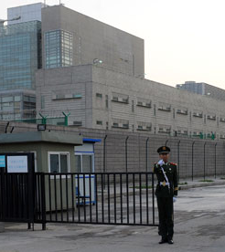
Take advantage of existing help for advice
U.S. Commercial Service
U.S. – China Business Council
American Chamber of Commerce, Beijing, Shanghai, Guangzhou, Hong Kong
Reputable security consultants

Slide 40
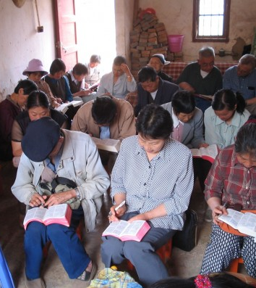
Avoid being tarred as part of “foreign hostile forces”
Stay politically neutral
Take care in selecting expats to send to China
Carefully instruct employees and dependents on conduct while in China
“Underground” churches: interesting, but foreigners should avoid

Slide 41
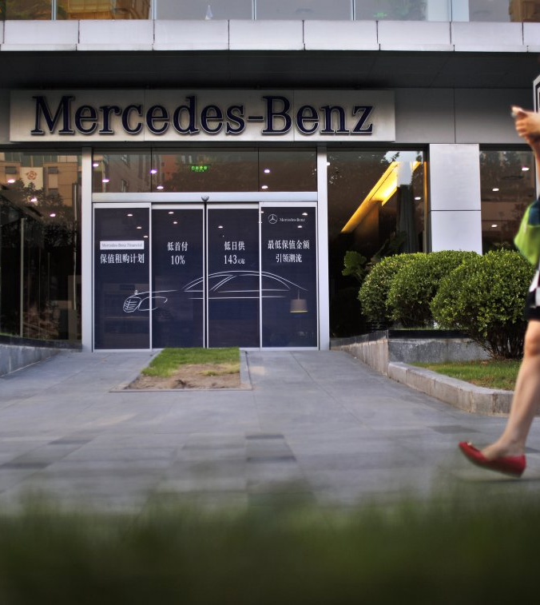
Make Realistic Business Plans
Foreign business still welcomed, but expectations have narrowed
Expect heightened regulation
Conduct training to avoid violation of monopoly and other laws
Conduct “dawn raid” training
Expect politics and bilateral relations to impact business more often. PLAN FOR IT.

Slide 42
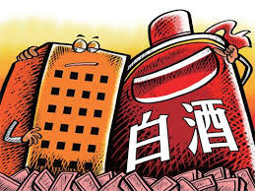
Reduce or Cease Reliance on 关系 (guanxi, connections)
The old way: hire family member of the right official, do other favors
Legal loopholes in the US FCPA were not enough to evade Chinese regulation
Corruption crackdown is one reason why Xi Jinping is so popular
Officials, food, liquor, cash, and favors: their mix was source of popular outrage

Slide 43

Make Realistic Security Plans
Harden IP and trade secrets here and overseas (shredders, proper info classification and controls, + +)
Have plans for detention of employees
Be prepared for a phased evacuation:
have a simple and effective plan
buy political and medical “evacuation insurance”
“Medevac” aircraft interior

Slide 44
Main Messages
Xi Jinping has genuine popular support to clean up corruption and raise China’s stature.
He may be a historical and transformational figure
Doing business in China can be profitable, but one must appreciate the changes under Xi
Foreign businesses now face higher risk to people and assets than before

Slide 45
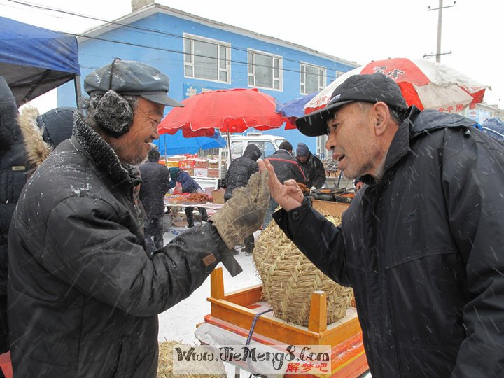
Questions?
Website: Madeirasecurity.com
Twitter: @matthew_brazil

Slide 46
Countermeasure Strategy
Backup Slides

Slide 47
Article 37, Cyber Security Law
第三十七条:
关键信息基础设施的运营者在中华人民共和国境内
Guānjiàn xìnxī jīchǔ shèshī de yùnyíng zhě zài zhōnghuá rénmín gònghéguó jìngnèi
运营中收集和产生的个人信息和重要数据应当在境内存储。
yùnyíng zhōng shōují hé chǎnshēng de gèrén xìnxī hé zhòngyào shùjù yìng dāng zài jìngnèi cúnchú.
Personal information and other important data gathered or produced by critical information infrastructure operators during operations within the mainland territory of the People's Republic of China, shall store it within mainland China.
因业务需要，确需向境外提供的，
Yīn yèwù xūyào, què xū xiàng jìngwài tígōng de,
Where due to business requirements it is truly necessary to provide it outside the mainland,
应当按照国家网信部门会同国务院有关部门制定的办法进行安全评估；
yīngdāng ànzhào guójiā wǎng xìn bùmén huìtóng guówùyuàn yǒuguān bùmén zhìdìng de bànfǎ jìnxíng ānquán pínggū;
they shall follow the measures jointly formulated by the State network information departments and the relevant departments of the State Council to conduct a security assessment;
法律、行政法规另有规定的，依照其规定。
fǎlǜ, xíngzhèng fǎguī lìng yǒu guīdìng de, yīzhào qí guīdìng.
but where laws and administrative regulations provide otherwise, follow those provisions.

Slide 48
Article 38, Cyber Security Law
第三十八条:
关键信息基础设施的运营者应当自行或者委托网络安全服务机构对其网络的安全性
Guānjiàn xìnxī jīchǔ shèshī de yùnyíng zhě yīngdāng zìxíng huòzhě wěituō wǎngluò ānquán fúwù jīgòu duì qí wǎngluò de ānquán xìng
Critical information infrastructure operators shall conduct an inspection and assessment of their networks security
和可能存在的风险每年至少进行一次检测评估，
he kěnéng cúnzài de fēngxiǎn měinián zhìshǎo jìnxíng yīcì jiǎncè pínggū,
and risks that might exists either personally, or through retaining a network security services establishment, at least once a year;
并将检测评估情况和改进措施报送相关负责关键信息基础设施安全保护工作的部门
bìng jiāng jiǎncè pínggū qíngkuàng hé gǎijìn cuòshī bào sòng xiāngguān fùzé guānjiàn xìnxī jīchǔ shèshī ānquán bǎohù gōngzuò de bùmén.
and submit a network security report on the circumstances of the inspection and assessment as well as improvement measures, to be sent to the relevant department responsible for critical information infrastructure security protection efforts.

Slide 49
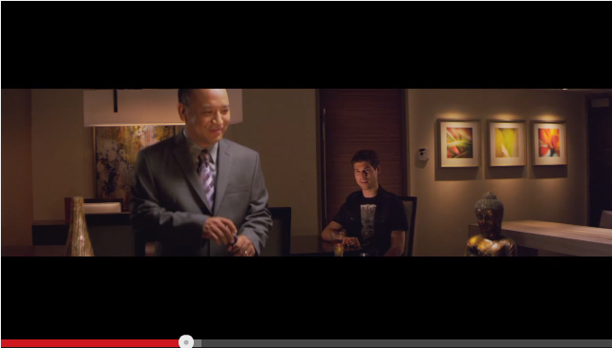
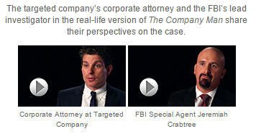
FBI Docudramas Online
“Game of Pawns,” based on the 2004-2007 MSS recruitment in Shanghai of American student Glen Shriver
“Company Man” based on the 2012 attempted theft from Pittsburgh Corning of cellular glass insulation technology
See more background at FBI.gov

